Slide 1
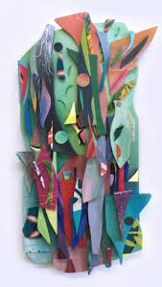
Assemblage
HIAS Art Team Home Learning Resource
Katia Bulbenko
KS2-3

Slide 2
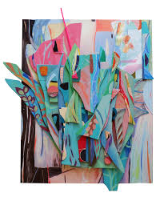
Assemblage is…
HIAS Art Team Home Learning Resource
a work of art made by grouping together found or unrelated objects.

Slide 3
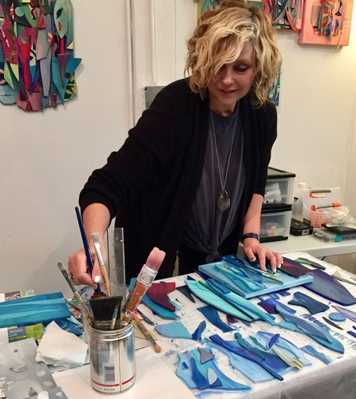
About Katie Bulbenko
HIAS Art Team Home Learning Resource
She lives in Weehawken, NJ, a small town on the Hudson River, USA.
She describes herself as ‘ A lifelong artist’.
Education: She studied at Tyler School of Art in Philadelphia and Rome, Italy.
Her inspiration is nature, landscapes and erosion.
In her work she likes to use organic shapes. She works
intuitively and experimentally and considers composition,
colour, texture and balance in her work.
Find out more: www.katiabulbenko.com
Her abstract works are related to nature and landscape.
Her layered assemblages include upcycled materials, wood, canvas, paper, felt, and beads.

Slide 4
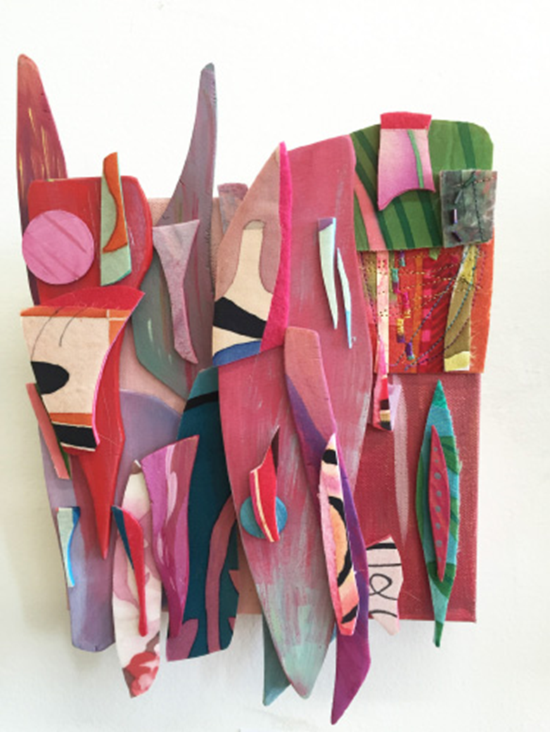
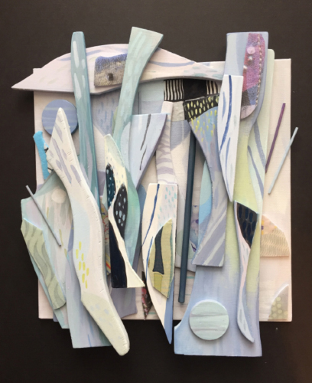
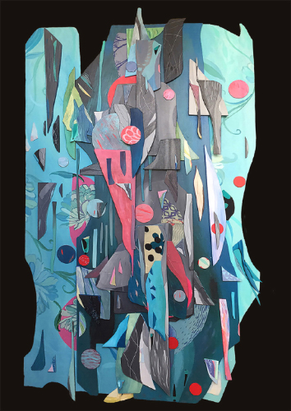
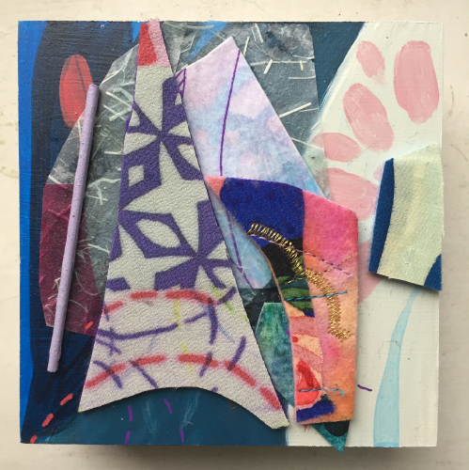
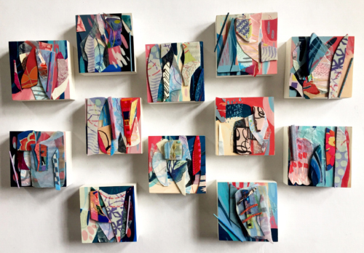
Katia Bulbenko
HIAS Art Team Home Learning Resource
Roam
Rosso
Lakeside
Ambient
Detail of Ambient

Slide 5
Journeys: Some ideas for you to investigate assemblage.
HIAS Art Team Home Learning Resource
Look at the work of the artist Katia Bulbenko.
Be creative, and plan ideas for your own assemblage. You could go on a trip around your house or a walk around your garden or nearby, look in cupboards, find magazines, take photos and get permission to use found things.
Look at the things you have collected. Is there a colour theme, object theme or something of interest to you. Arrange things and photograph. Do you need to add other things or create coloured pieces to insert? Take another photograph.
Decide how you could combine and permanently assemble your objects. You could stick, stitch, staple, nail etc.
Try out combining some bits before you finally fix them. Photograph these.
Write some notes about your use of: Colour/Tone/Shape/Line/Texture/Pattern/ Form and Space.
You could draw or paint a section or all of your assemblage – see Katia Bulbenko’s work on the next slide to inspire you.

Slide 6
Materials:
HIAS Art Team Home Learning Resource
A collection of found pieces, a camera, glue, scissors, masking tape, stitching materials (needle and thread), stapler etc. drawing or painting materials, collage materials, paper or card.

Slide 7
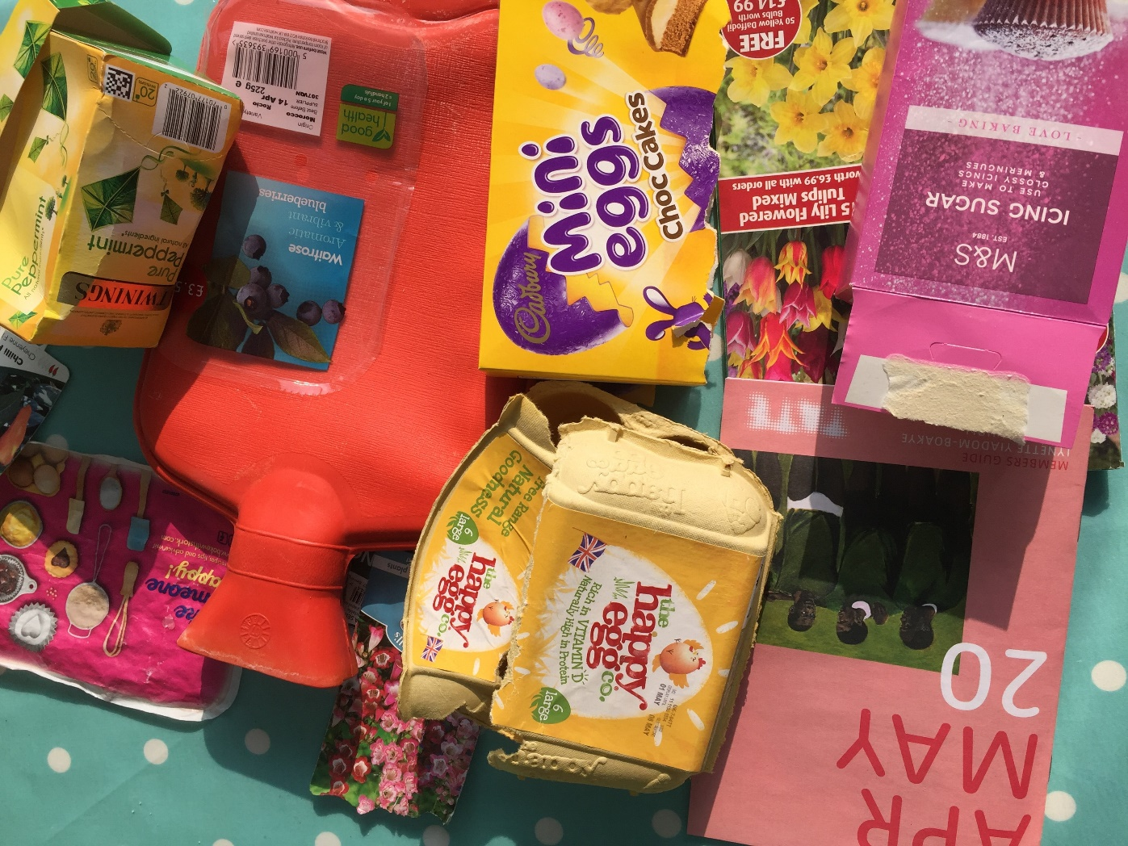
Things I collected over the Easter 2020 weekend!
HIAS Art Team Home Learning Resource
Other
Gardening
Baking
Food and drink

Slide 8
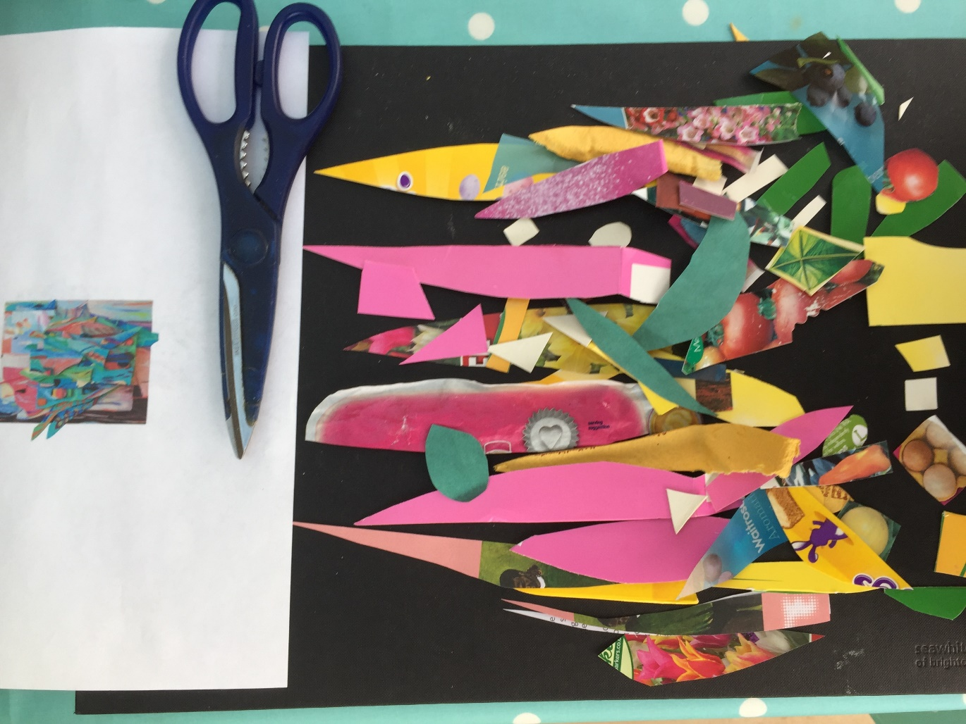
Inspired by Katia Bulbenko’s artwork, I cut shapes from the things I collected.
HIAS Art Team Home Learning Resource

Slide 9
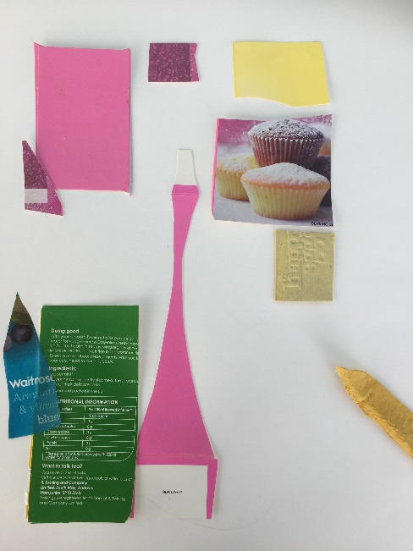
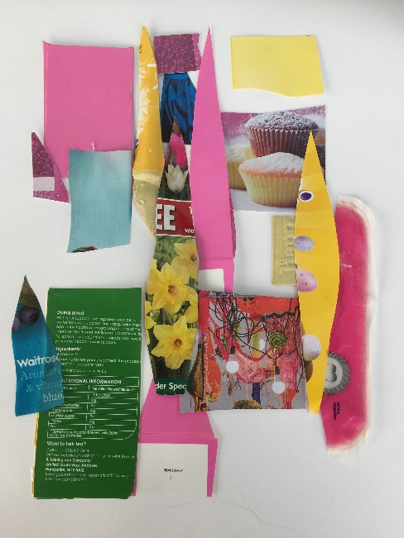
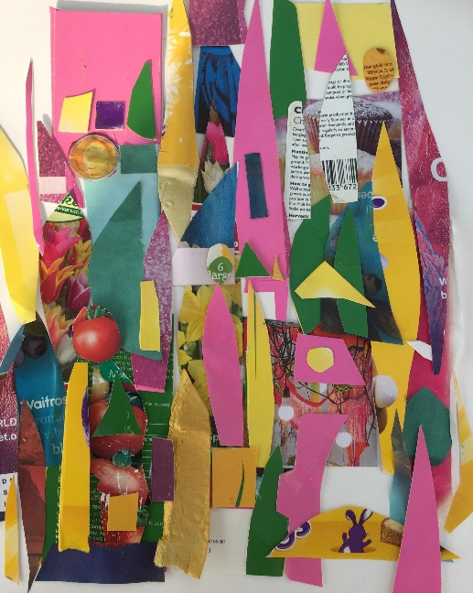
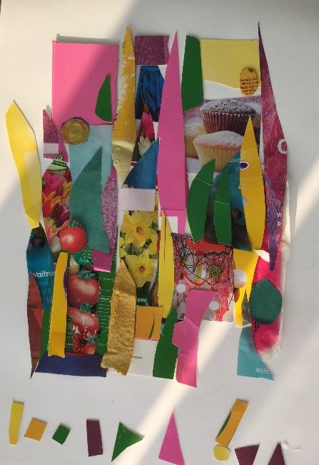
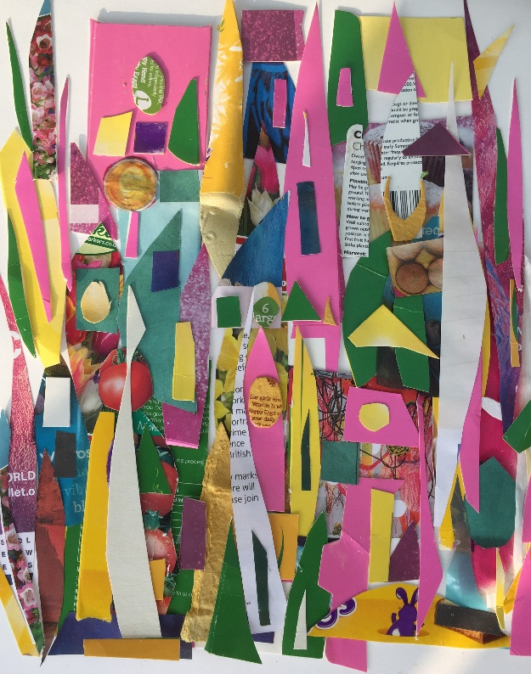
I then placed and arranged the cut pieces onto a sheet of paper and continued to layer these up and over each other. You can stick as you go.
HIAS Art Team Home Learning Resource

Slide 10
Colour / Tone / Shape / Line / Texture / Pattern
HIAS Art Team Home Learning Resource
Colour: I have used a variety of yellows, pinks, greens, blues and some black and white to create my assemblage.
Tone: My work has strong and bold tones.
Shape: I cut the larger pieces of cards and papers into ‘shard’ shape pieces, I also cut some regular and irregular shapes including egg shapes that reflected that I made it over Easter and that I was also baking!
Line: I did pencil and pen line drawings of my assemblage.
Texture: Some of the pieces I collected were rough and bumpy and other smooth and glossy to touch.
Pattern: When I arranged my work I was thinking of layering the papers and shapes to create a pattern similar to buildings in a cityscape.
Form: My work is mainly two- dimensional but I do have some raised three dimensional pieces such as the section of an egg carton.
Space: As I created my composition I thought about the space between the pieces. As I layered my work I thought about the arrangement using the whole space of my A3 page.

Slide 11
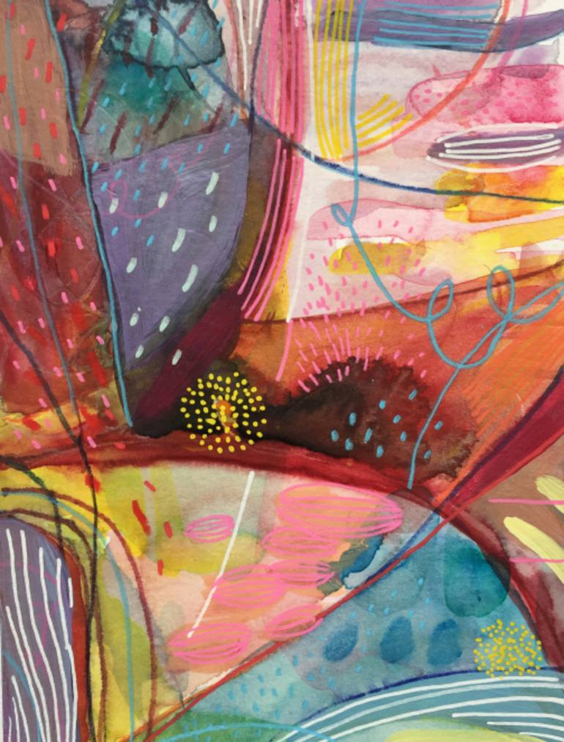
Journeys: Investigating Assemblage Painting of her assemblage – Horizon by Katia Bulbenko
HIAS Art Team Home Learning Resource

Slide 12
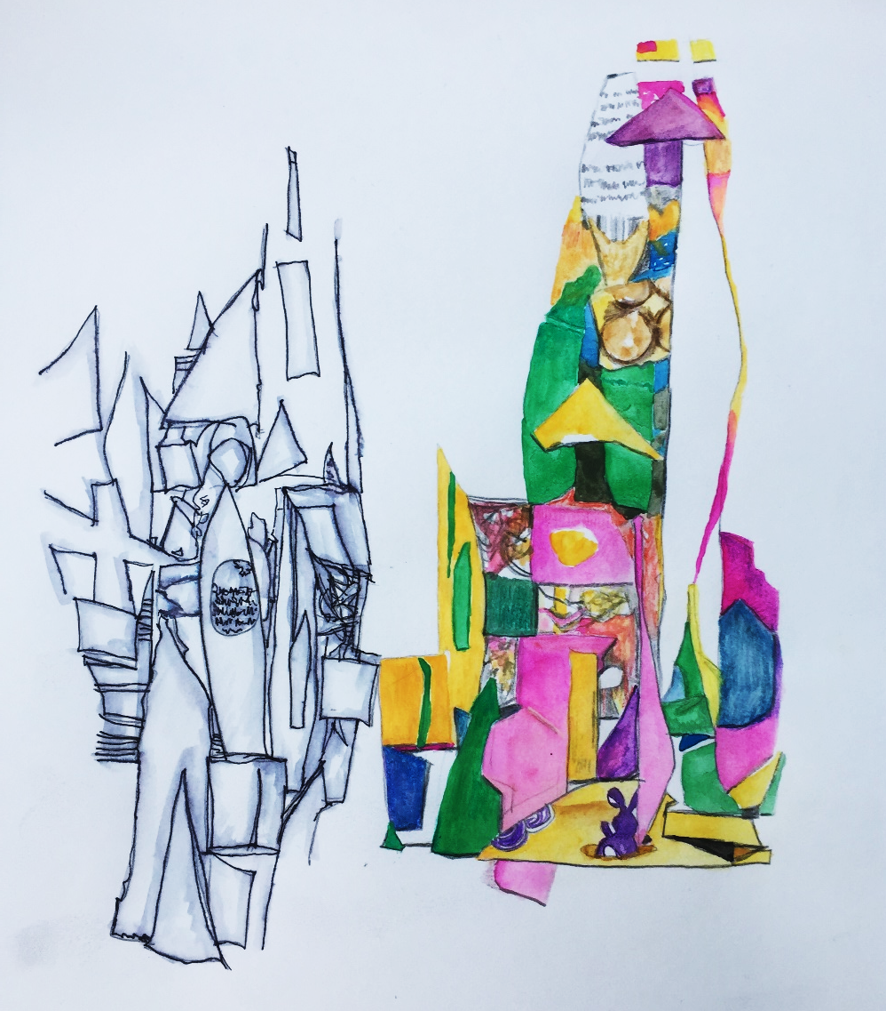
Drawing and Painting of my Assemblage I chose to draw different sections of my work and do a pen & wash study and a watercolour study.
HIAS Art Team Home Learning Resource
I selected a section of my assemblage and drew an outline in pencil.
Using a black handwriting pen I went over the pencil outline. Following this I used a paintbrush with some water to lightly wash over the line to create a ‘washed’ effect.
I selected a section of my assemblage and drew a light outline in pencil.
Using watercolour paints I gradually painted my drawing.
I matched and mixed the colours first and tried them out before painting the different shapes.
I also used watercolour pencils in some places to give sharp outlines and some shadow.
You might chose to do something else rather than a drawing or painting. You could take a photograph of your work and then cut and stitch into it, you might do a collage or whatever inspires you. Have fun and enjoy.

Slide 13
Journeys: Investigating Assemblage
HIAS Art Team Home Learning Resource
Collect up your artwork for this project and put it together to show your new art teacher when you get to secondary school.
Write any thoughts about how your work was inspired by Katia’s and what you might do next.

Slide 14
I hope pupils enjoy this project. Please share with me what pupils do and I will share on our Home Learning pages on the HIAS Art Moodle.
HIAS Art Team Home Learning Resource
Jayne Stillman
County Inspector / Adviser Art
Email: Jayne.Stillman@hants.gov.uk

