Slide 1
GCSE Photography Year 10: Spring Term 2
HIAS Art Team Home Learning Resource
The Choice of Colour

Slide 2
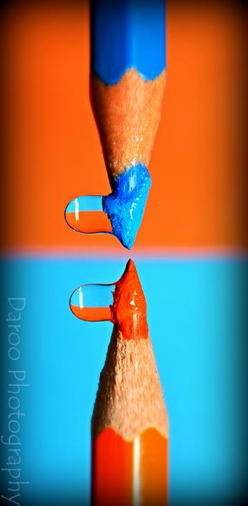
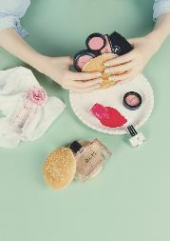
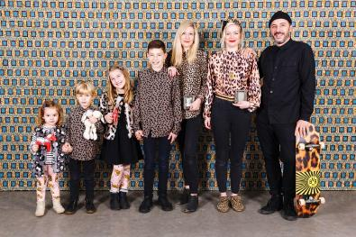
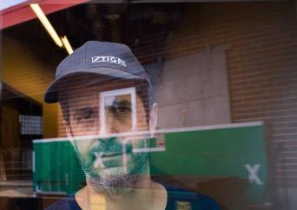
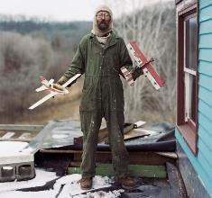
GCSE Photography Exam
The Choice of Colour
HIAS Art Team Home Learning Resource

Slide 3
GCSE Photography: The Choice of Colour
HIAS Art Team Home Learning Resource
For this project, you will be looking at The Choice of Colour, in terms of:
Still Life (Daroo Photography/Jacob Reichel/Matt Russell)
Portraiture/Documentary (Martin Parr/Alec Soth)
Your own choice of Photographer and Response (Mock Exam)

Slide 4
GCSE Photography: The Choice of Colour
HIAS Art Team Home Learning Resource
Still Life Photography (Daroo Photography/Jacob Reichel/Matt Russell)
For this section of the Choice of Colour project, you are going to focus on STILL LIFE PHOTOGRAPHY.
Task One: What is Still Life Photography?
Write a definition of Still Life Photography, in clear and simple terms, in no more than three sentences.

Slide 5
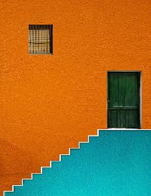
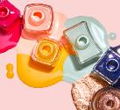
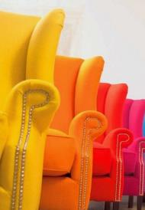
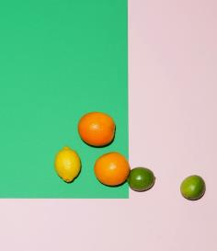
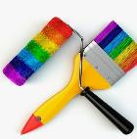
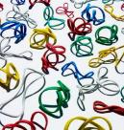
GCSE Photography: The Choice of Colour
HIAS Art Team Home Learning Resource
Still Life Photography (Daroo Photography/Jacob Reichel/Matt Russell)
Task Two: How can colour be incorporated into still life photography?
Produce a creative mood board of photographs from a variety of sources which show your understanding of this.

Slide 6
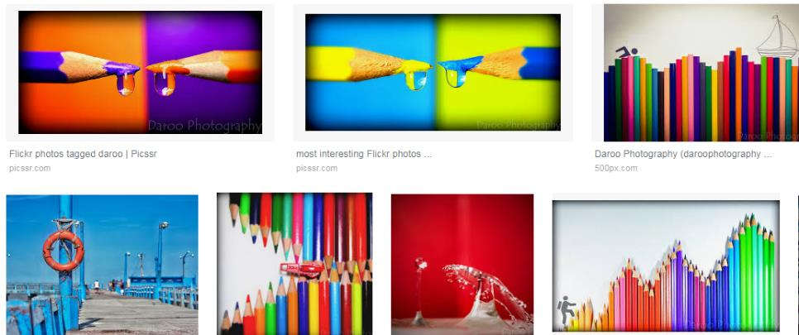
GCSE Photography: The Choice of Colour
HIAS Art Team Home Learning Resource
Task Three: Artist Research One - Daroo Photography
Google ‘Daroo Photography: images, and produce a creative mind map of photographs of his colour work

Slide 7
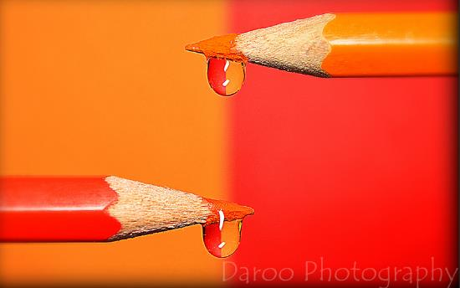
GCSE Photography: The Choice of Colour
HIAS Art Team Home Learning Resource
Task Four: Artist Research One - Daroo Photography
Choose one of his photographs and copy it and paste it on to the middle of the page. Use three of the Formal Elements descriptors to show your understanding of the photograph
Formal Elements words:
Colour
Tone
Space
Line
Texture
Composition
Pattern
Shape

Slide 8
GCSE Photography: The Choice of Colour
HIAS Art Team Home Learning Resource
Task Five: Artist Research One - Daroo Photography
Artist ‘Homage’ work. Choose one of his photographs and:
Reproduce the photograph as accurately as you can.
Using the photograph as a starting point, produce an interpretation in your own style (it’s your own idea, but I should be able to see a connection with the photographer’s work).
HOMEWORK: Take a set of 12 to 15 photographs which respond to Daroo Photography’s work. Think about:
Colour combinations and use of contrasting colours
Strength of colour (bold colours are good)
Which still life props to use.
Homework needs to be completed by Thursday’s lesson

Slide 9
GCSE Photography: The Choice of Colour
HIAS Art Team Home Learning Resource
Task Six: Submitting Photographs
Upload all the photographs you have taken for your ‘Daroo response’, and present as a contact sheet/thumbnail set.
Choose one of the photographs and explain why you have selected it.
Open the jPeg of the photograph in Photoshop/Affinity Photo.
Try the following:
Increase the saturation.
Increase the contrast.
Use the Posterize tool to make it more creative.

Slide 10
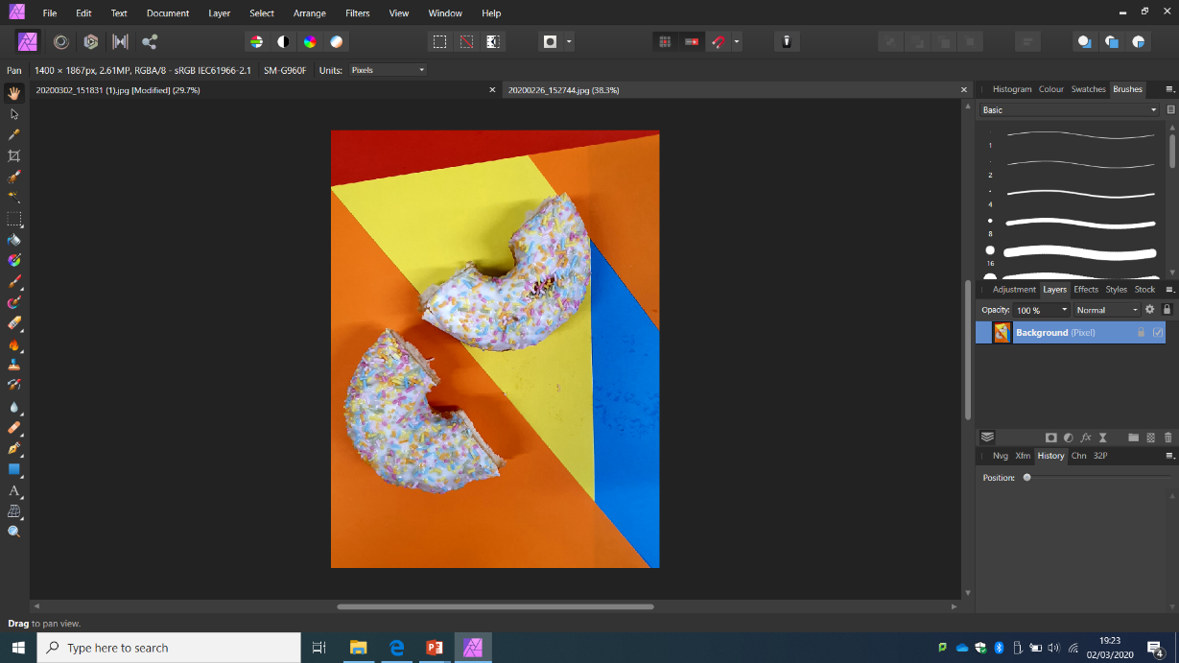
Original-unedited

Slide 11
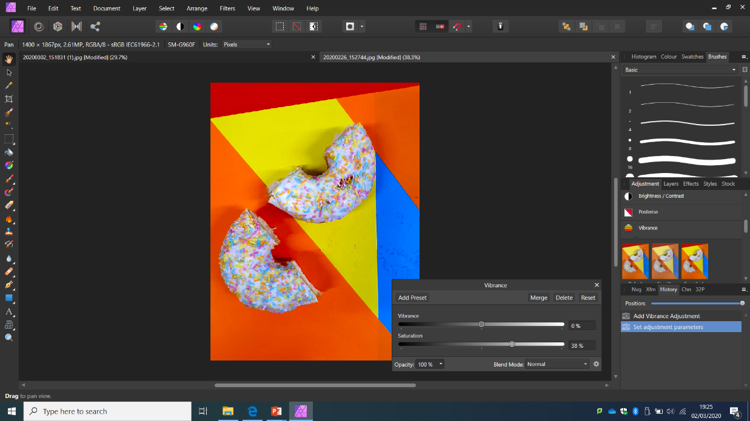
Increase saturation

Slide 12
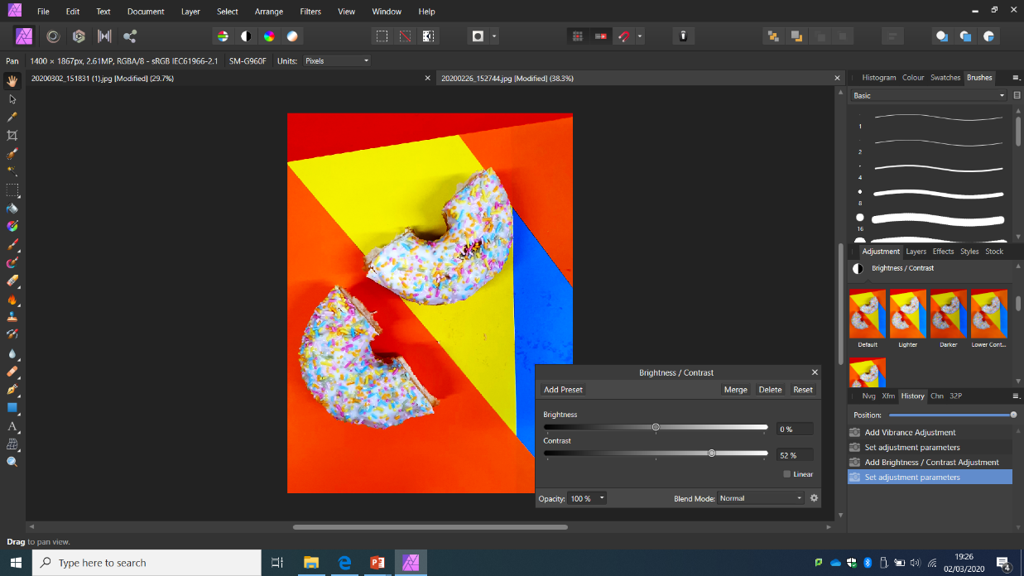
Increase contrast

Slide 13
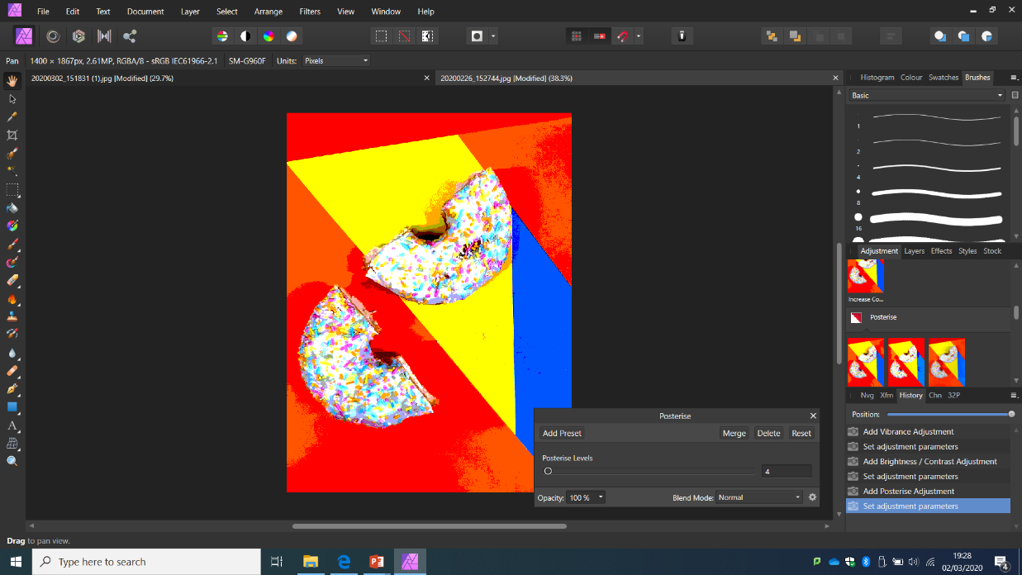
Posterize

Slide 14
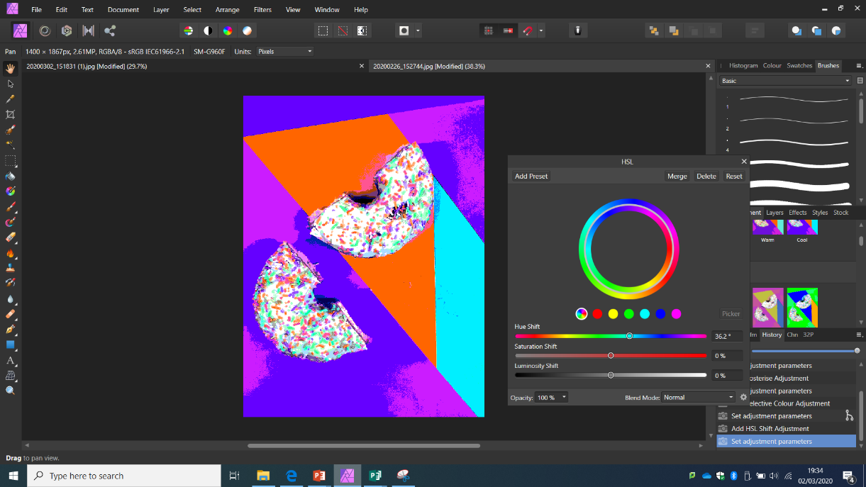
Change hue

Slide 15
GCSE Photography: The Choice of Colour
HIAS Art Team Home Learning Resource
Task Seven: Making a Background and photographing
Use the hue tool to create different colour versions of your photograph. For each version, use the snipping tool to snip, copy and paste on to an A3 Publisher page. Do this eight times to create a background.
Print the background on A3 paper.
Add coloured objects to the background and re-photograph. Tear holes/poke pencils through/scrunch/weave/roll… be creative with your outcomes.

Slide 16
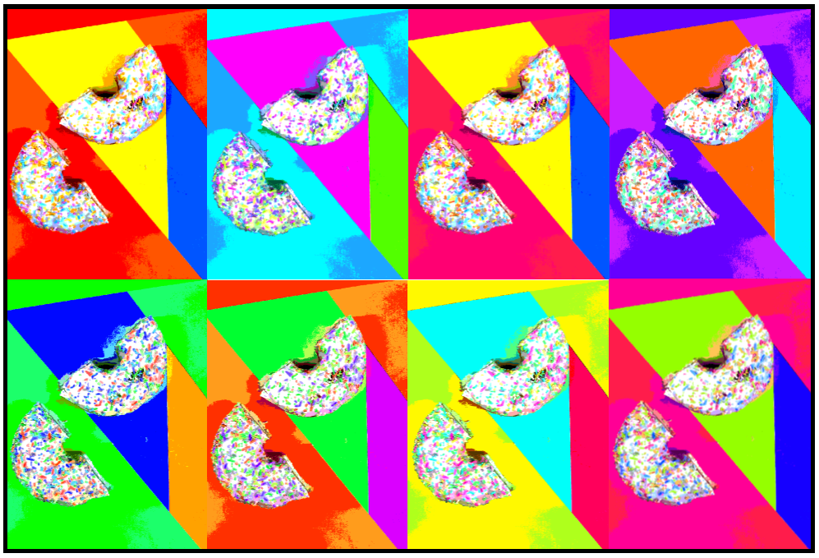

Slide 17
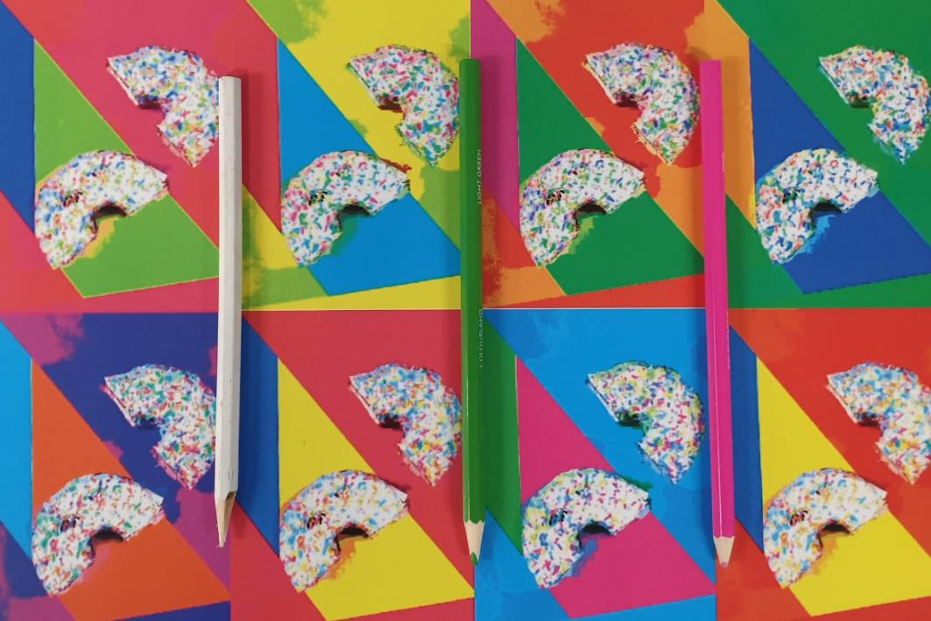

Slide 18
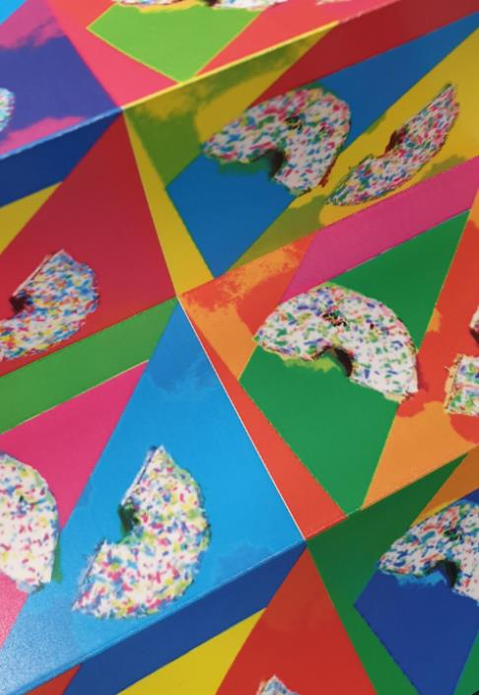
HIAS Art Team Home Learning Resource

Slide 19
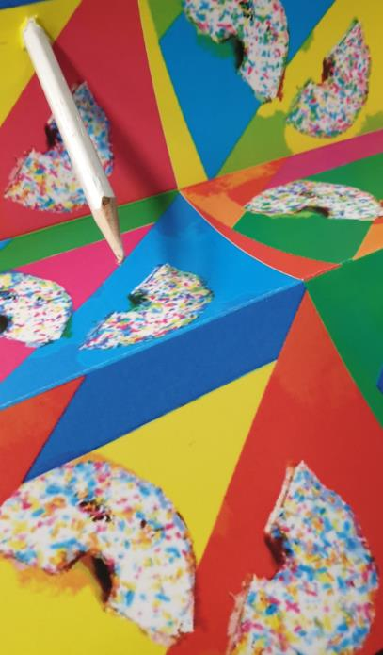
HIAS Art Team Home Learning Resource

Slide 20
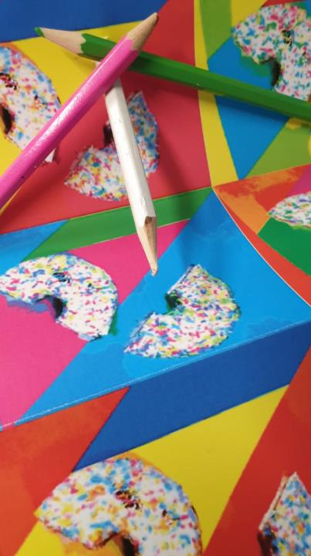
HIAS Art Team Home Learning Resource

Slide 21
HIAS Art Team Home Learning Resource

Slide 22
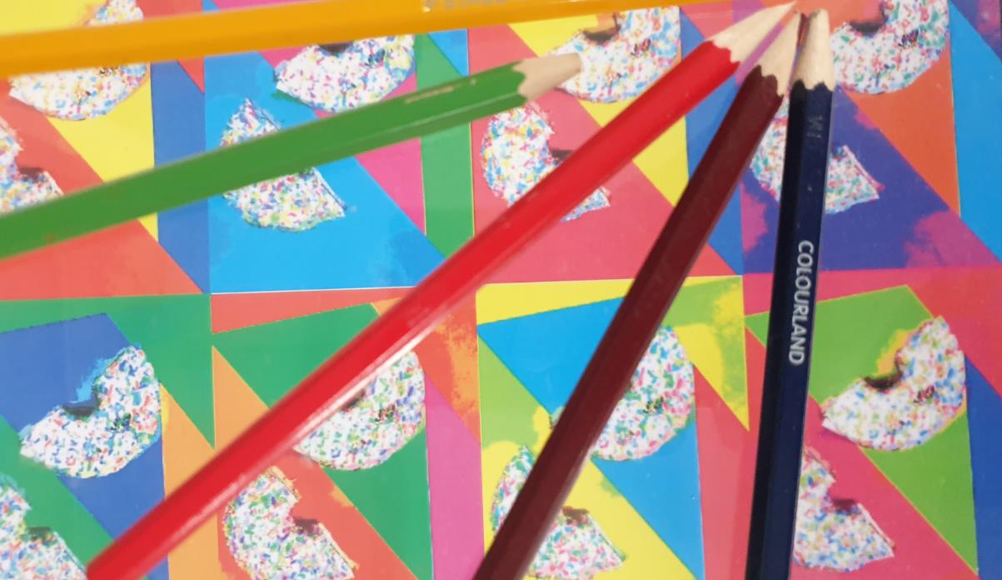

Slide 23
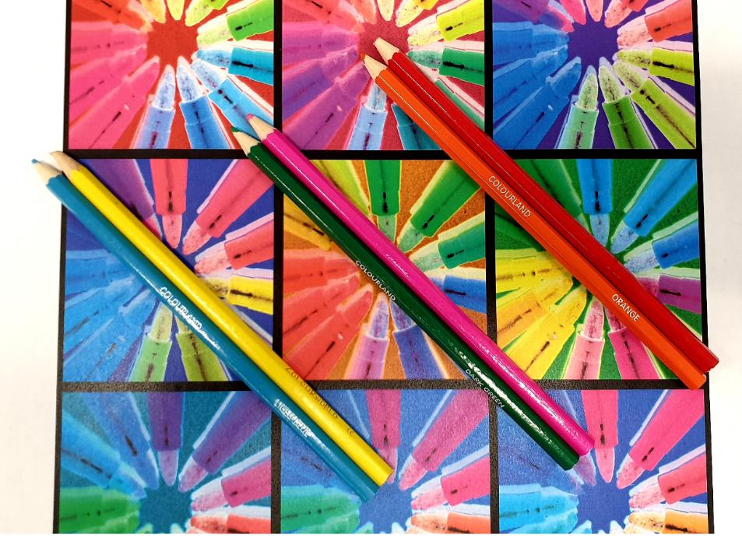
HIAS Art Team Home Learning Resource

Slide 24
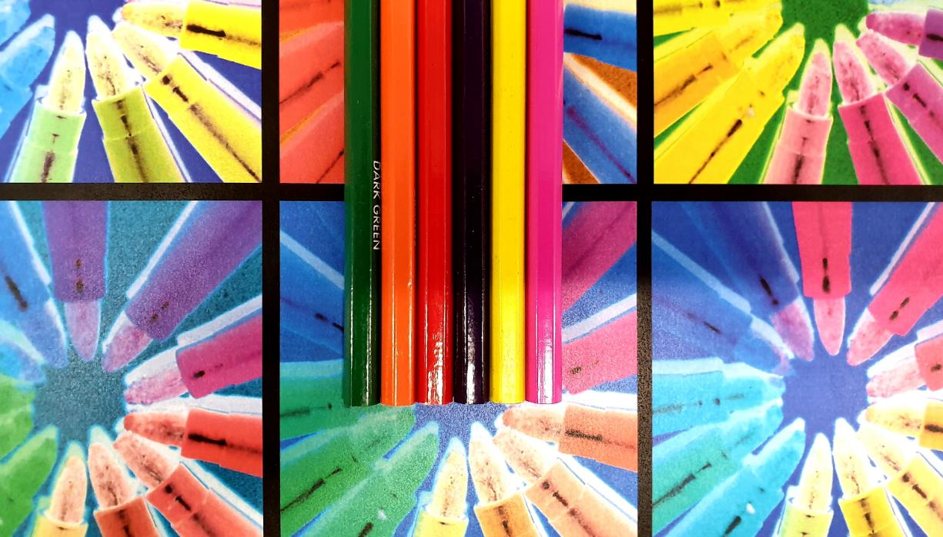

Slide 25
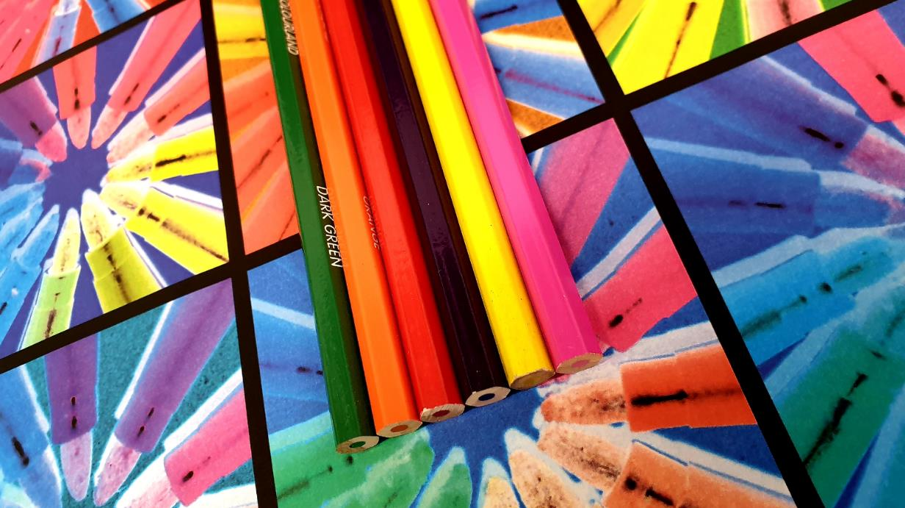

Slide 26
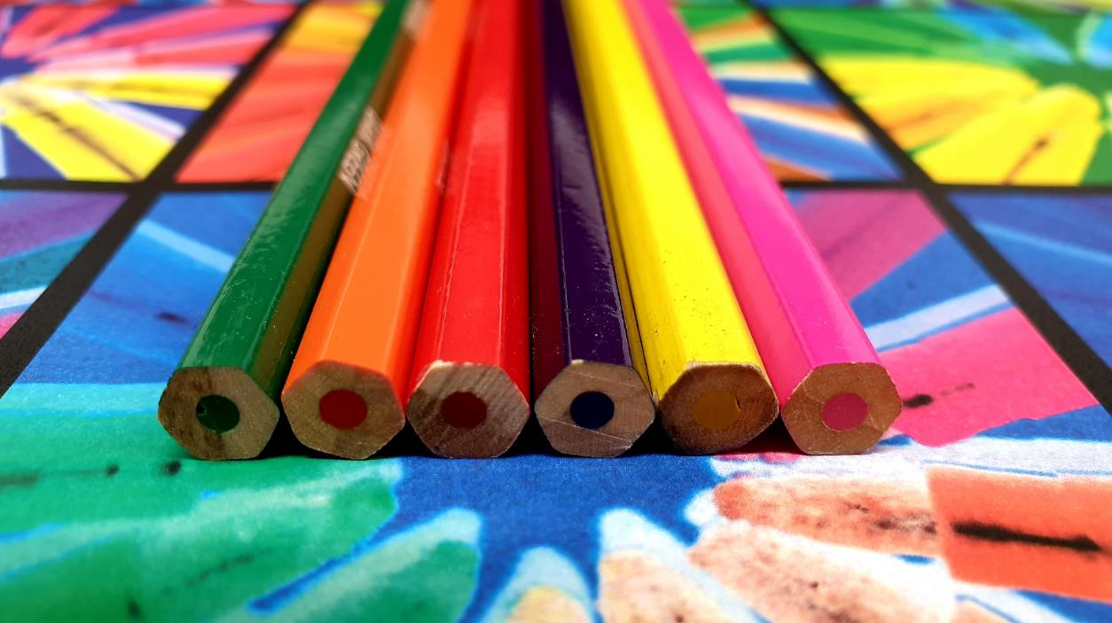

Slide 27
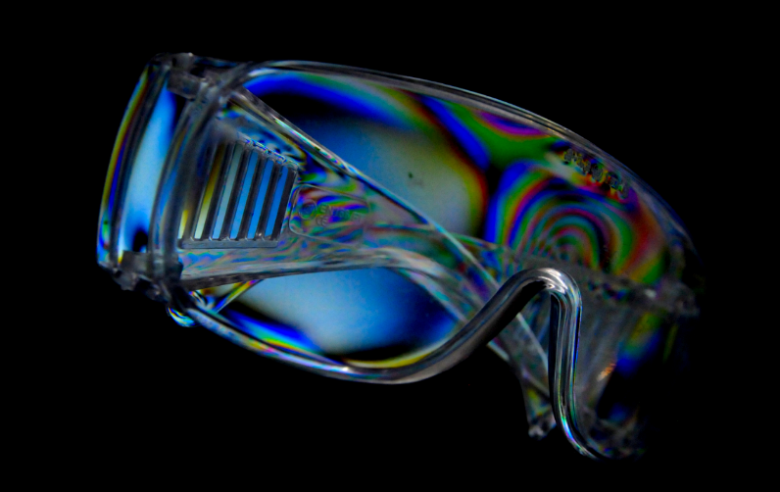
Cross Polarisation Photography
HIAS Art Team Home Learning Resource

Slide 28
Cross Polarisation Photography
HIAS Art Team Home Learning Resource
https://digital-photography-school.com/make-funky-images-plastic-objects-polarizing-filter/
Task One: Copy and paste the hyperlink above on to your task bar.
Task Two: How does this method of photography work? Read and make a step by step guide, based on the information on the website above. Do this task on a new PowerPoint slide/s
Task Three: Google ‘cross polarisation photography’ and produce a mood board of images.
Task Four: Plan a set of photographs for next lesson. Think about the plastic object you are going to bring in and how you are going to compose your photograph.

Slide 29
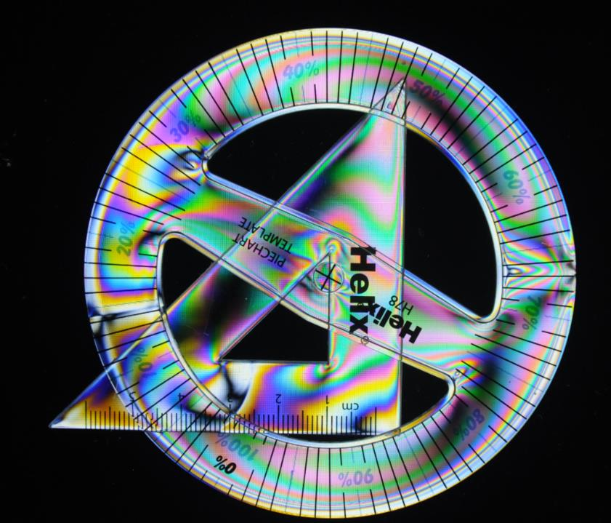

Slide 30
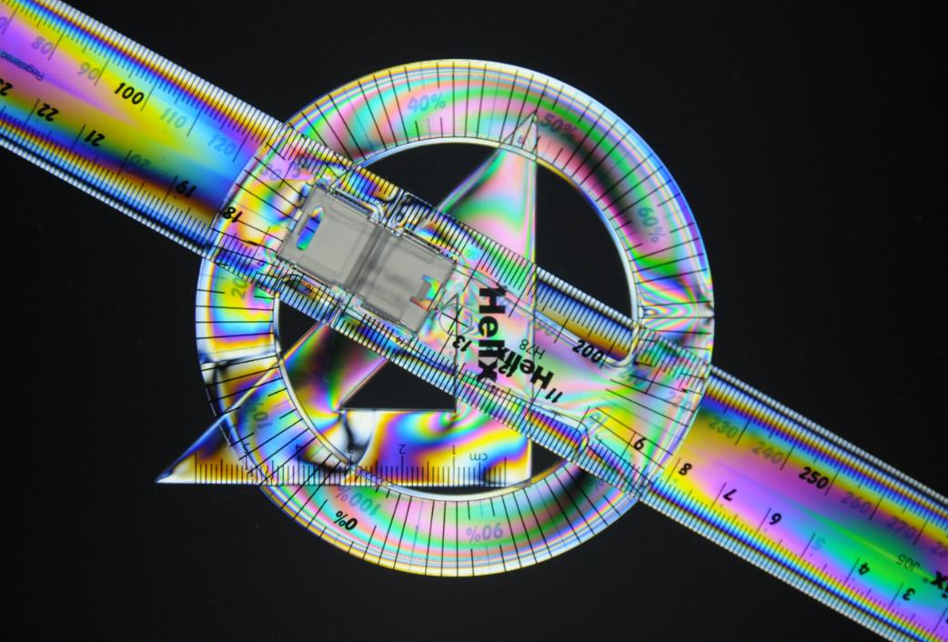

Slide 31
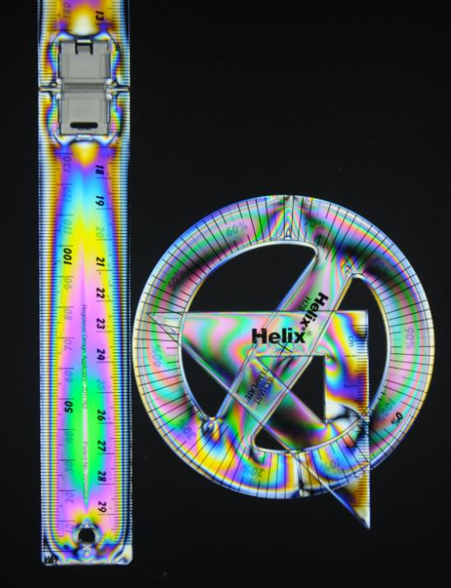

Slide 33
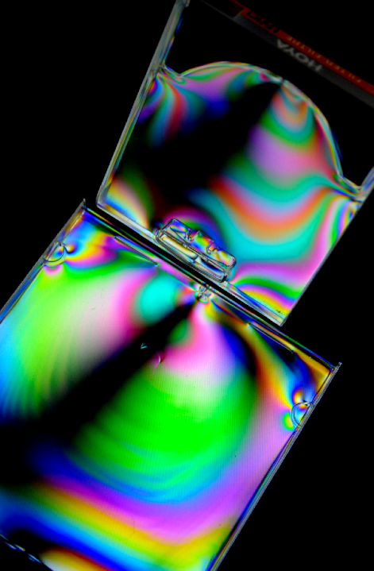

Slide 34
GCSE Photography: The Choice of Colour
HIAS Art Team Home Learning Resource
Task List for Today: STILL LIFE PHOTOGRAPHY
Complete your Daroo Photography response:
Artist research: Mind Map/Mood Board/Critical Analysis
Planning a set of photographs
Still life colour photographs (15-20) as a thumbnail set.
Select and Reject one.
Editing using Photoshop/Affinity Photo.
Present final piece.
Make background by changing the hue and repeat copying.
Set of photos using the background.
Select and Reject one.
Editing using Photoshop/Affinity Photo.
Present final piece.
Cross Polarisation photos.
Select and Reject one.
Editing using Photoshop/Affinity Photo.
Present all final pieces. Compare and select best photo
REMEMBER TO SNIP/PRINT SCREEN YOUR STAGES

Slide 35
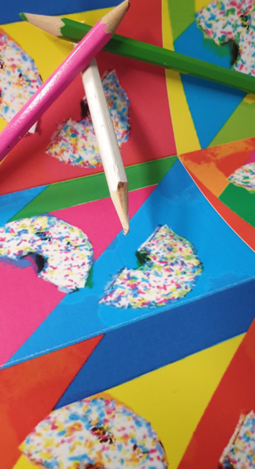
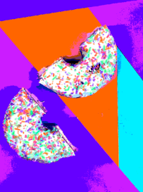
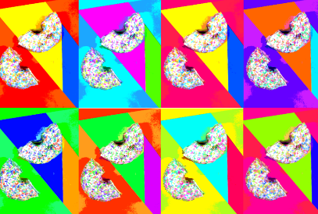
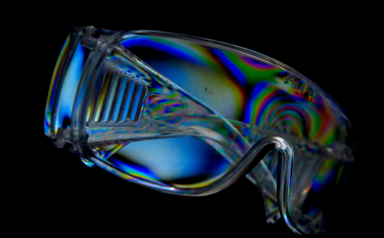

Slide 36
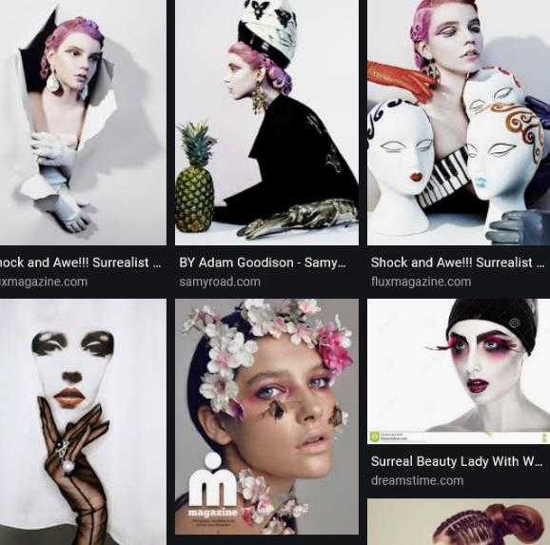
GCSE Photography: The Choice of Colour
HIAS Art Team Home Learning Resource
Portraiture:
Surreal Fashion Photography
Surreal means strange/unbelievable/ dreamlike.
I would like you to create a surreal fashion photograph, using a photograph of a polystyrene head, which you will decorate with colouring pencils. You will then use this photograph to create a fashion photograph from a magazine.

Slide 37
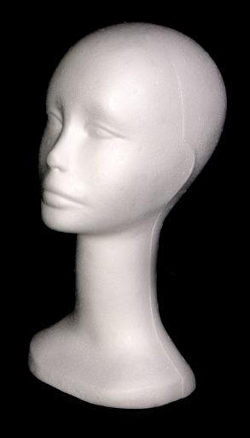
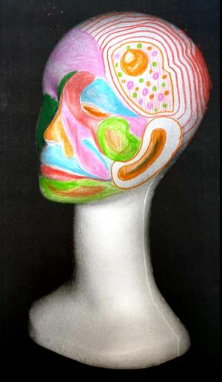
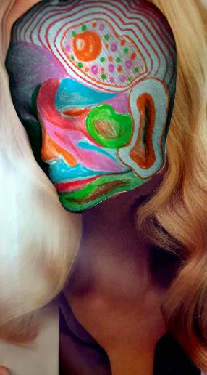
GCSE Photography: The Choice of Colour
HIAS Art Team Home Learning Resource

Slide 38
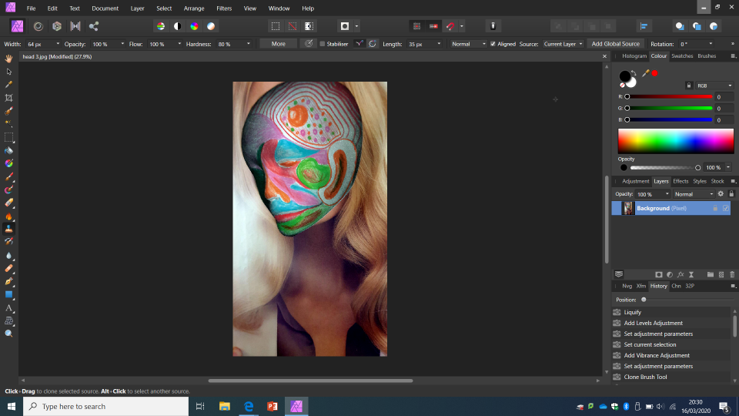
GCSE Photography: The Choice of Colour
HIAS Art Team Home Learning Resource
Original

Slide 39
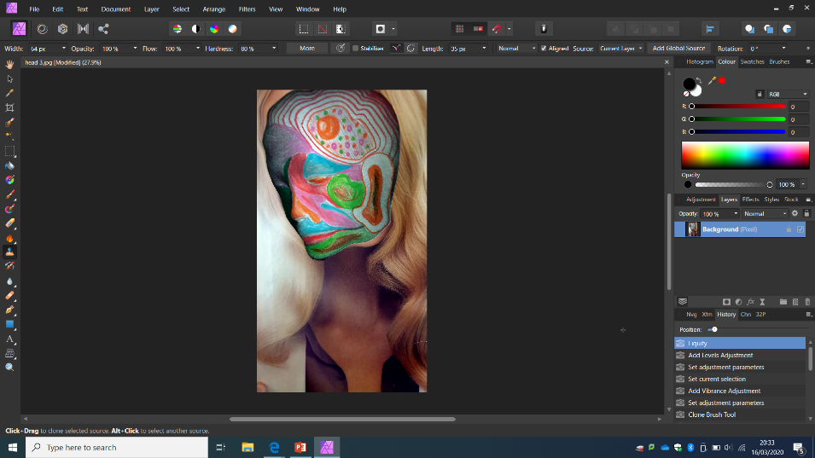
GCSE Photography: The Choice of Colour
HIAS Art Team Home Learning Resource
Liquify

Slide 40
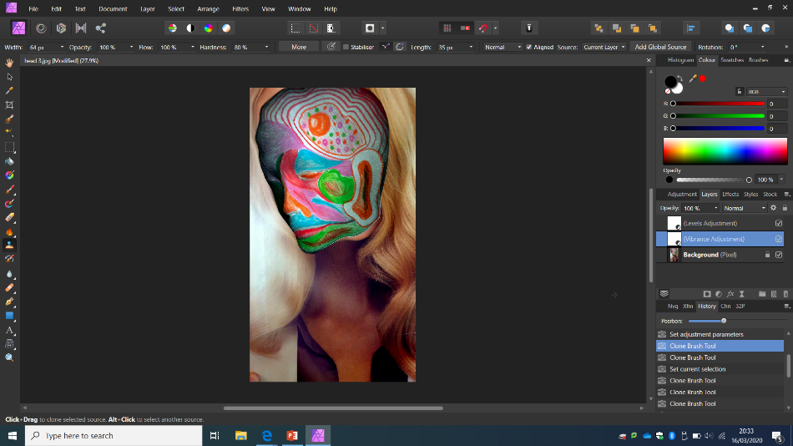
GCSE Photography: The Choice of Colour
HIAS Art Team Home Learning Resource
Saturation

Slide 41
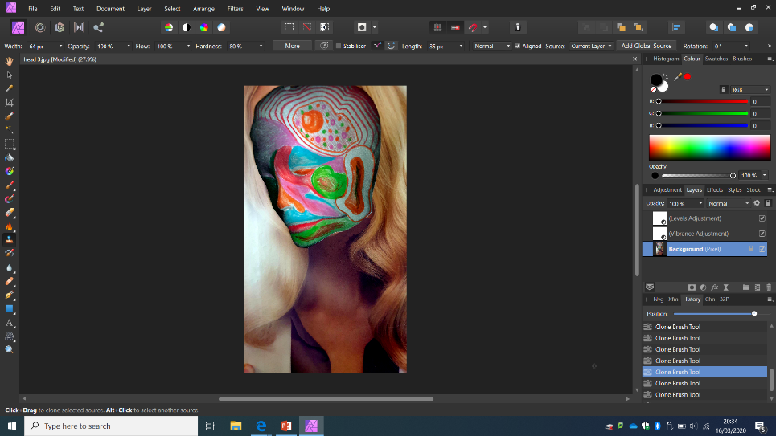
GCSE Photography: The Choice of Colour
HIAS Art Team Home Learning Resource
Clone

Slide 42
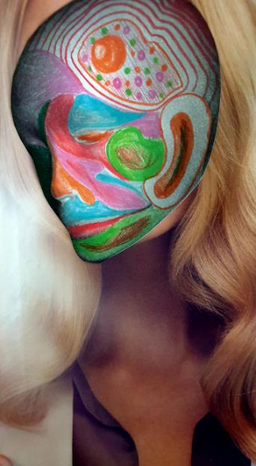
GCSE Photography: The Choice of Colour
HIAS Art Team Home Learning Resource

Slide 43
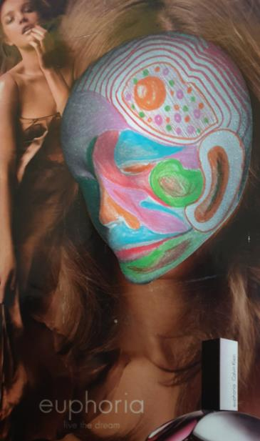
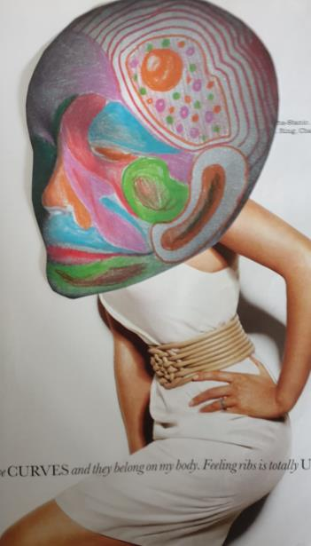
GCSE Photography: The Choice of Colour
HIAS Art Team Home Learning Resource

Slide 44
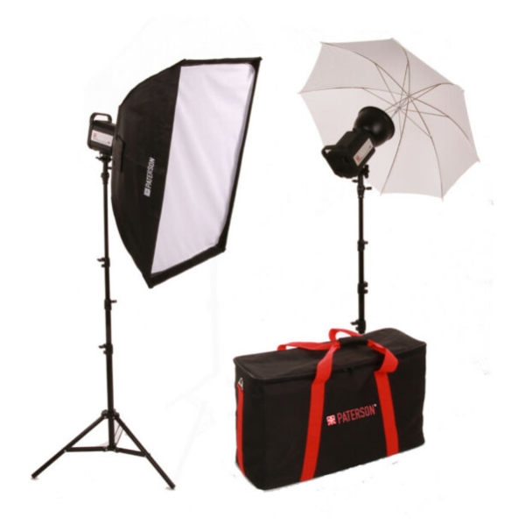
Studio Lighting: The Basics
HIAS Art Team Home Learning Resource

Slide 45
Studio Lighting: The Basics
HIAS Art Team Home Learning Resource
Studio Lighting is a form of artificial lighting. This means that the lighting is produced from bulbs rather than the sun, which is natural Lighting.
Artificial lights could be the flash on your camera, a torch or a flashgun or larger studio lights.
Studio lights usually come in a kit with two lights and two stands. You will also need a background which is usually a roll of paper or fabric.
There are several different types of lighting set ups.

Slide 46
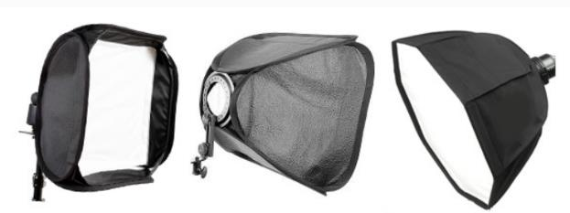
Studio Lighting: The Basics
HIAS Art Team Home Learning Resource
There are several different types of lighting set ups.
1. Softbox: This provides a contained light which is not as harsh as a direct light. It has a translucent cover which softens the light, so is great for portraits. The light points towards the subject.

Slide 47
Studio Lighting: The Basics
HIAS Art Team Home Learning Resource
There are several different types of lighting set ups.
2. Umbrella: This type of lighting spreads the light over a greater distance. The light points towards the subject or reflected in the umbrella.

Slide 48
Studio Lighting: The Basics
HIAS Art Team Home Learning Resource
There are several different types of lighting set ups.
3. Snoot: This type of lighting focuses the light over a specific area. The photographer controls the radius of the light. The light points towards the subject.

Slide 49
Studio Lighting: The Basics
HIAS Art Team Home Learning Resource
Task One: Explain what studio lighting is, and what makes it different to natural lighting.
Task Two: List the three main types of studio lighting.
Task Three: Explain how each works, show as diagram/s and how the light is distributed.
Task Four: Find examples of portrait photographs taken using studio lighting/have a go at taking photographs using the set up and put on your PowerPoint.

Slide 50
Studio Lighting: The Basics
HIAS Art Team Home Learning Resource
Task Four: Find examples of portrait photographs taken using studio lighting/have a go at taking photographs using the set up and put on your PowerPoint.

Slide 51
Photography Mini-Tasks
HIAS Art Team Home Learning Resource
During the time that you are studying from home, I will set you a series of weekly Mini-Tasks. Could you please complete at least one mini-task each week (feel free to do more!). The Mini Task work consists of the following:
Photographer or Artist Research. Find out about the photographer or artist and produce a fact file about them/a mind map of words which relate to their work/a mood board of images which show the kind of work they do, and some critical analysis of their work, using the Formal Elements words.
Each mini-task has at least one ‘Things I can do’ task. Either complete the photographic task by taking at least 15 photographs, or come up with a task of your own which relates to the artist’s work and take at least 15 photographs.
Upload the photographs as a thumbnail set.
Edit one or more of the photographs using whatever editing package you have on your computer. Paint.net is an example. Or you can download free ones, like GIMP.
Present your weekly ‘mini-task’ final piece.
Evaluate/analyse your work. Explain how you have responded to your artist’s work, how it links, but also how it has your own identity.

Slide 52
Photography Mini-Tasks: 23.03-27.03 20
HIAS Art Team Home Learning Resource

Slide 53
GCSE Photography: The Choice of Colour
HIAS Art Team Home Learning Resource
PHOTOGRAPHY MINI TASKS: Matt Russell
Things I could do: Take Close-ups of food or arrange food on interesting ways (a rainbow of food/food types/food deteriorating over time)

Slide 54
GCSE Photography: The Choice of Colour
HIAS Art Team Home Learning Resource
PHOTOGRAPHY MINI TASKS: Jacob Reischel
Things I could do: Photograph everyday objects around the house in a ‘still-life’ way. Shoes/ make-up/cutlery/stationery etc.

Slide 55
GCSE Photography: The Choice of Colour
HIAS Art Team Home Learning Resource
Martin Parr: PHOTOGRAPHY MINI TASKS
Things I could do: Take close-ups of people without showing their faces. Holding something/hands in different situations/back of the head portraits.

Slide 56
GCSE Photography: The Choice of Colour
HIAS Art Team Home Learning Resource
Alec Soth: PHOTOGRAPHY MINI TASKS
Things I could do: Take photographs of areas around my house and print them out. Cut out people from magazines and overlay them in your house.

