Slide 1
Marnell Infants

Slide 2
Year 1

Slide 3
Year 2

Slide 10
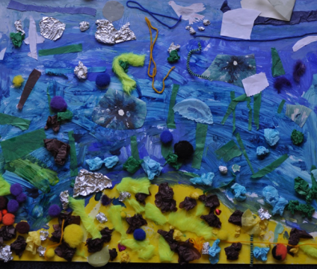

Slide 11
St Mary’s Bentworth

Slide 12
Year 5

Slide 13
Cupernham Junior

Slide 14
Year 4

Slide 15
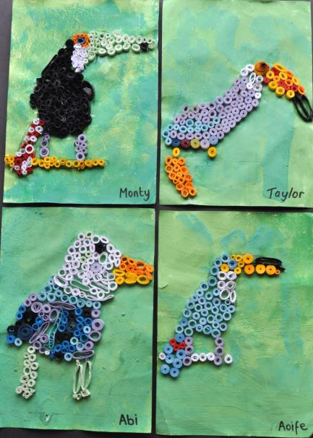

Slide 17
Cranbourne School

Slide 18
Year 11

Slide 27
St Marks Primary School

Slide 28
Year 2

Slide 31
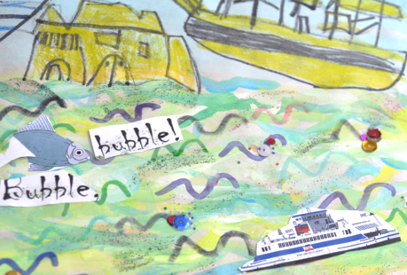

Slide 34
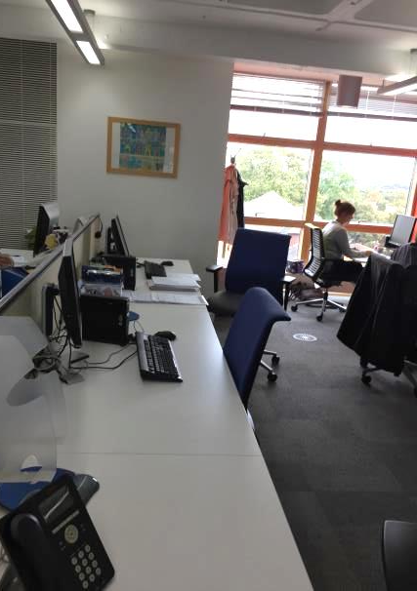

Slide 36
Year 1

Slide 37
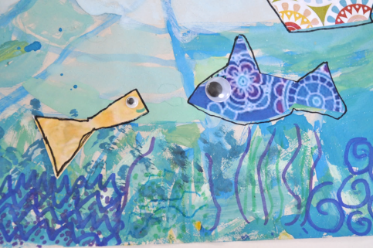

Slide 51
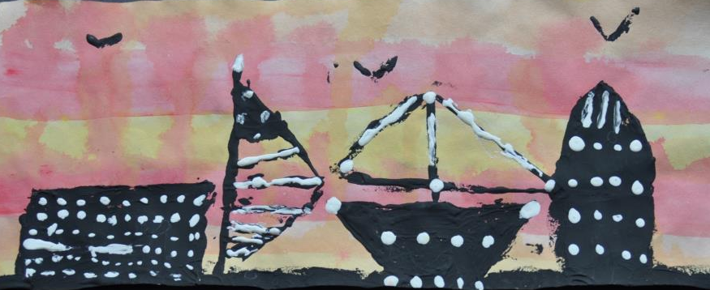

Slide 54
Aldworth School

Slide 55
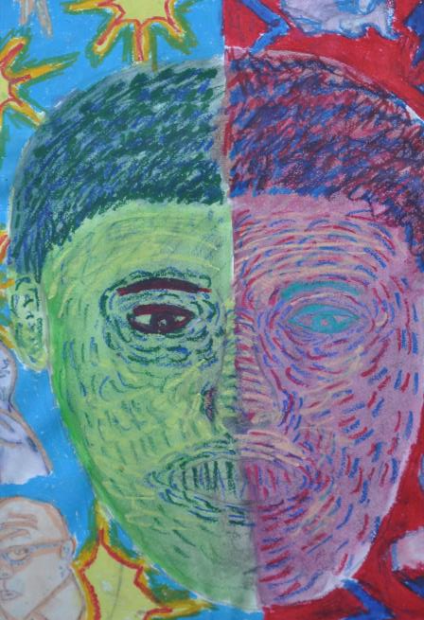

Slide 58
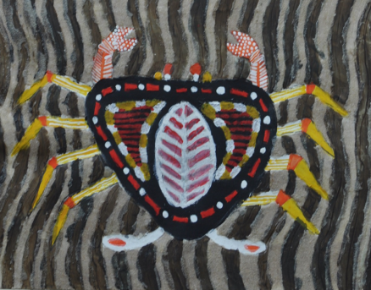

Slide 61
Balksbury Junior

Slide 62
Year 3

Slide 64
jayne.stillman@hants.gov.uk

