Slide 1
Basic Camera Considerations A template to use.
Photography

Slide 4
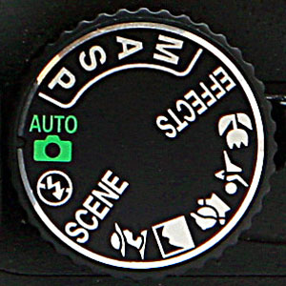

Slide 5
Aperture
Depth of Field
Exposure
Focus
ISO
Long Exposure
Manual
Shutter Speed

Slide 6
Shutter Speed
Fill slide with images

Slide 7
Fill slide with your research/ theory
AO3 Reflection
What have you learned about shutter speed?
What went well?
What would you focus on next time to improve your use of shutter speed?

Slide 8
Shutter Speed Experiment

Slide 9
Long Exposure
Fill slide with images

Slide 10
Light Drawing shoot

Slide 11
Light Drawing shoot

Slide 12
Light Drawing shoot
Describe the process of light drawing:
What camera setting did you use and why?
What type of light did you use and why
What kind of lighting did you have in the room?
2. Which was your best photo and why?
3. Did you enjoy long exposure drawing? Why?
4. If you were to repeat the process, what would you do to improve your photos?

Slide 13
Aperture
Fill slide with images

Slide 14
Aperture
What is the F stop
Fill slide with your research/ theory
AO3 Reflection
What have you learned about Aperture/ depth of field?
What went well?
What would you focus on next time to improve your use of Aperture/ depth of field?

Slide 15
Aperture Experiment

Slide 16
Macro
Fill slide with images

Slide 17
Macro
Fill slide with your research/ theory

Slide 18
Macro Experiment

Slide 19
Macro before and after
AO3 Reflection
What have you learned about the macro setting?
What went well?
What would you focus on next time to improve your use of the macro setting?

Slide 20
Rule of Thirds
Fill slide with images

Slide 21
Rule of Thirds
Fill slide with your research/ theory

Slide 22
Rule of Thirds Experiment

Slide 23
Rule of Thirds
AO3 Reflection
What have you learned about the macro setting?
What went well?
What would you focus on next time to improve your use of the macro setting?

