Slide 1
KS4 GCSE grade examples -various schools

Slide 2
Level 9

Slide 14
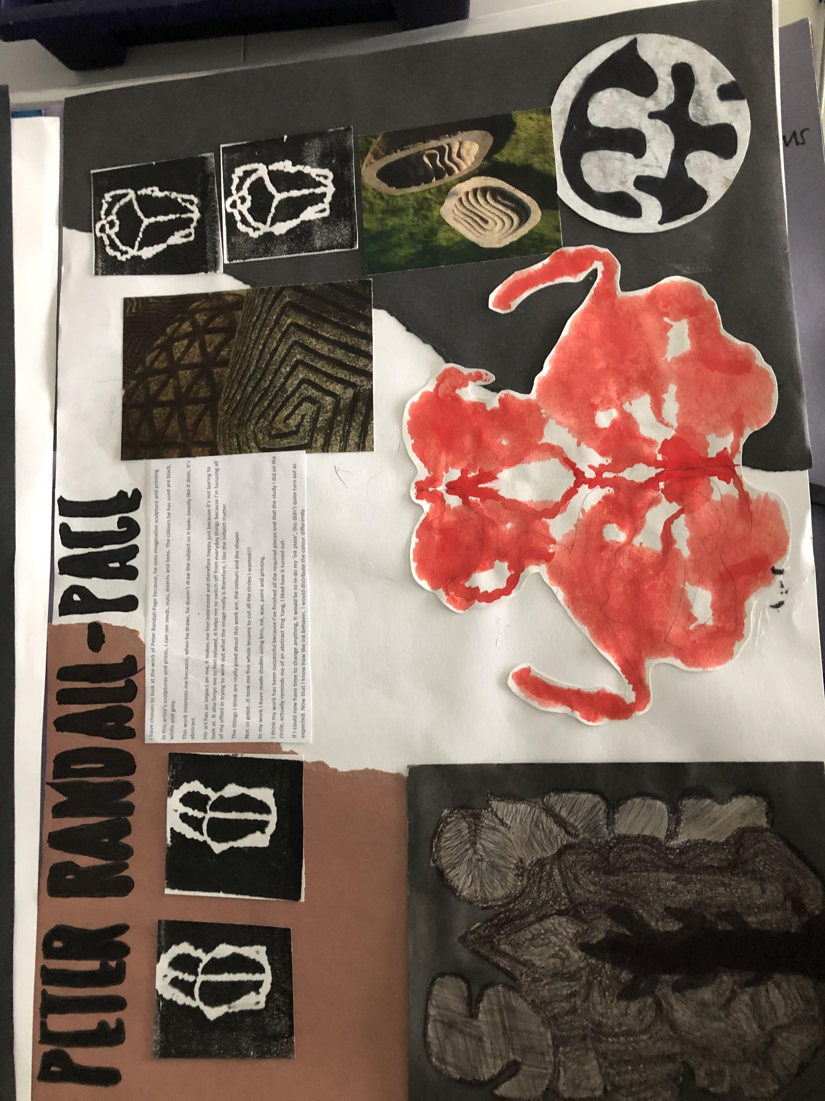
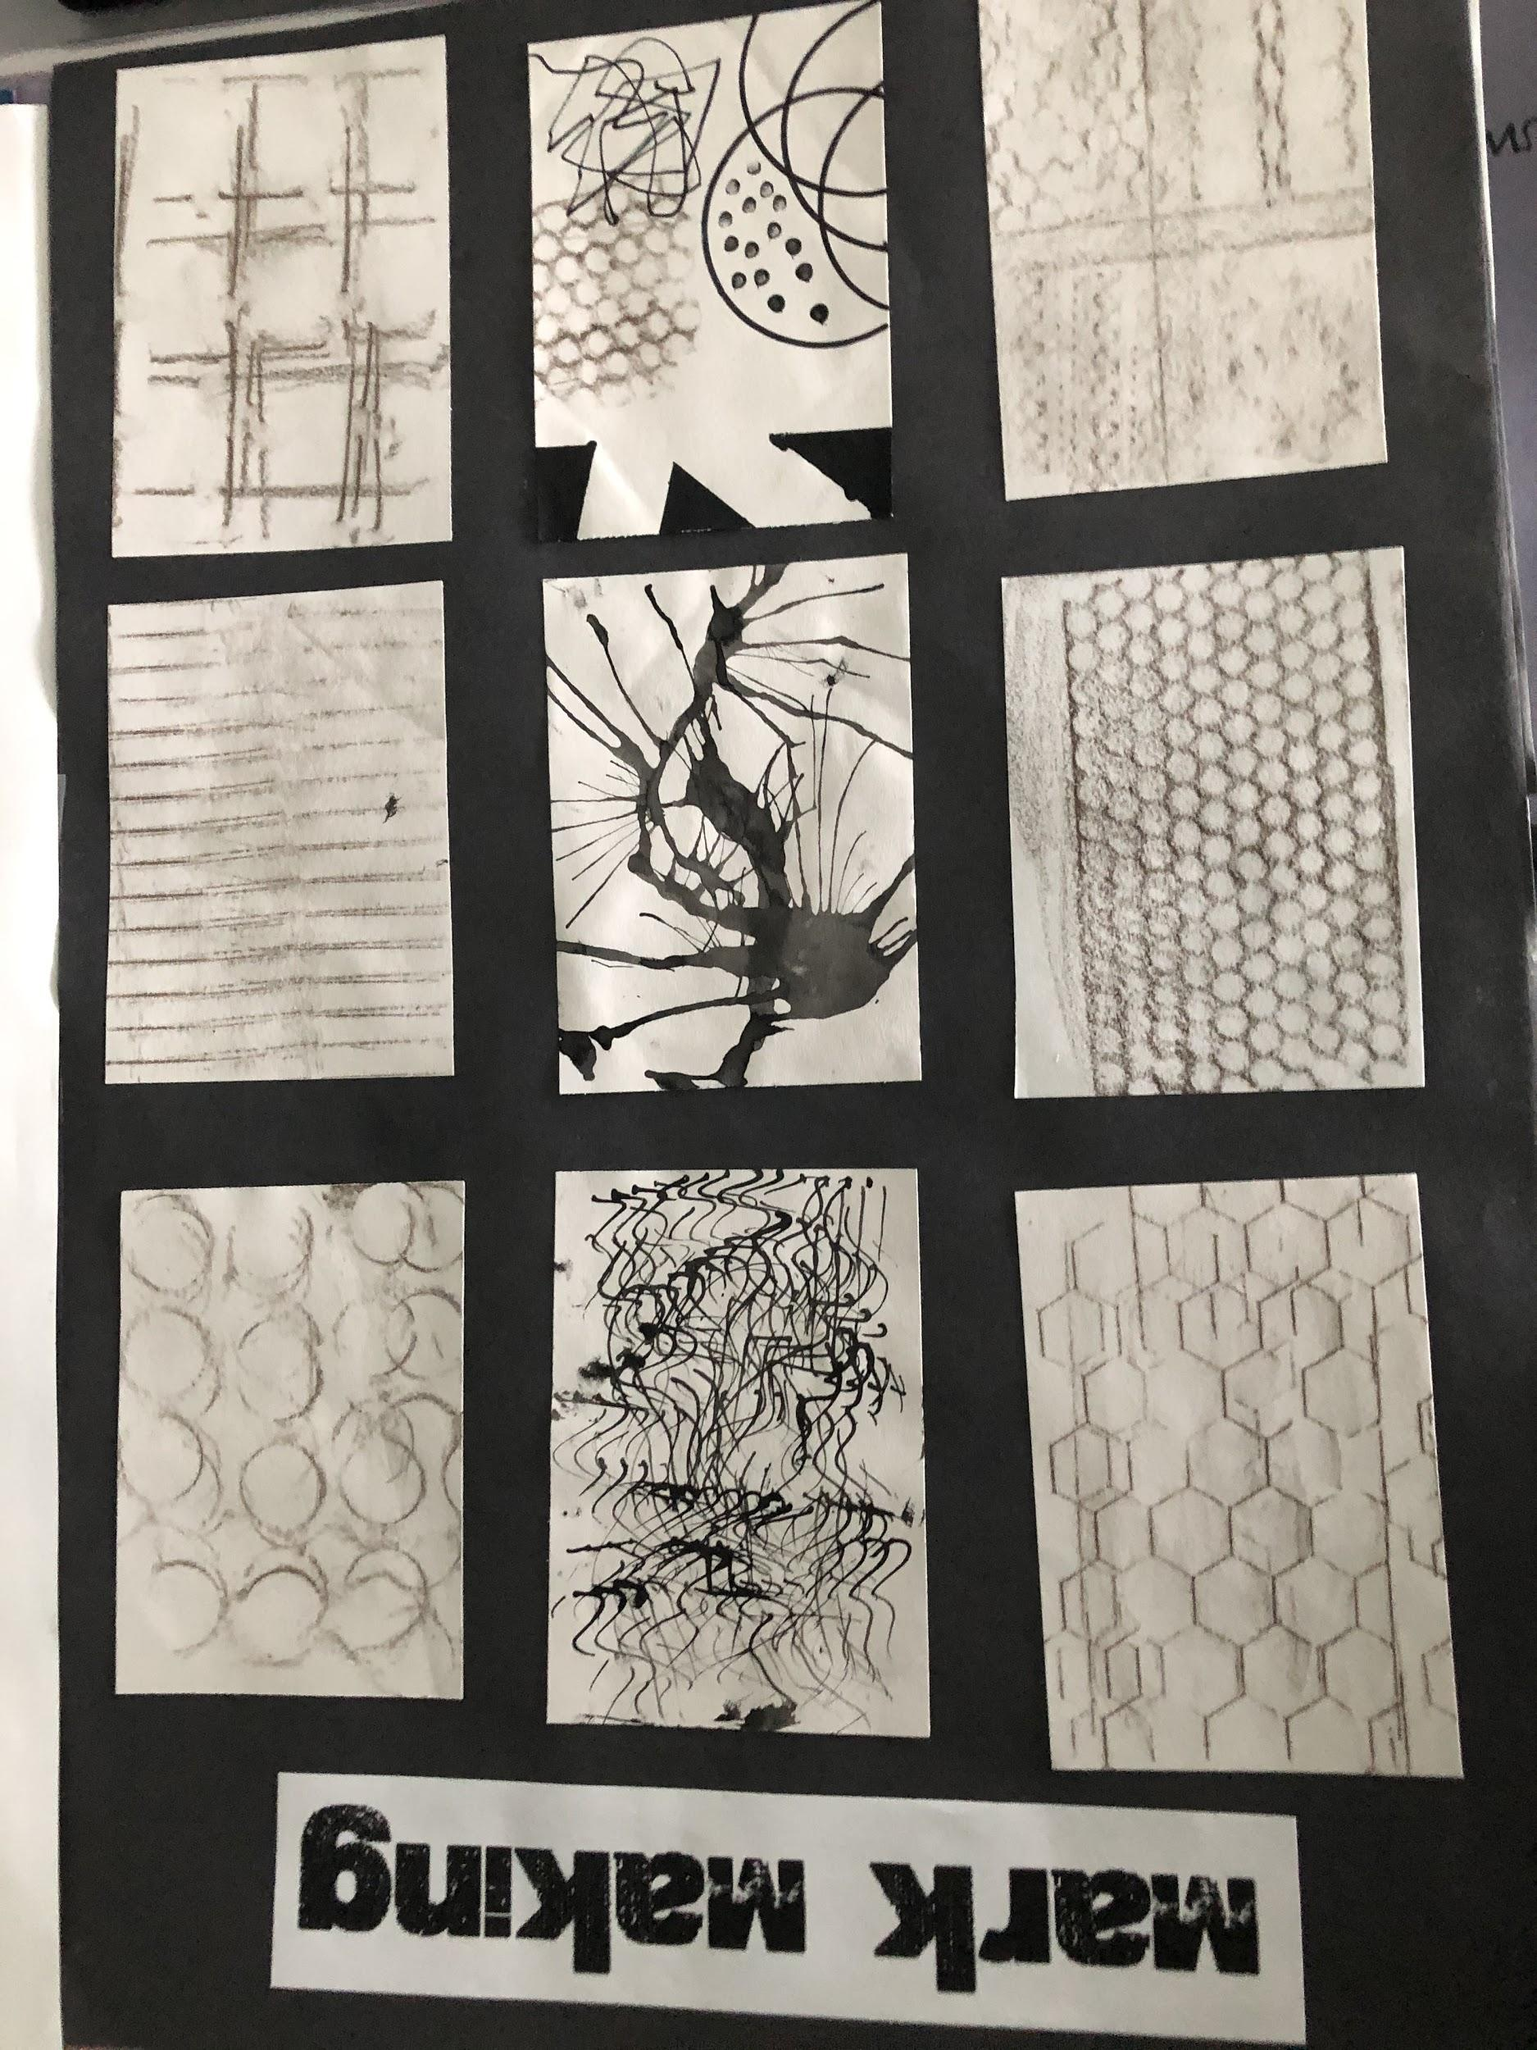
Currently working at 4

Slide 15
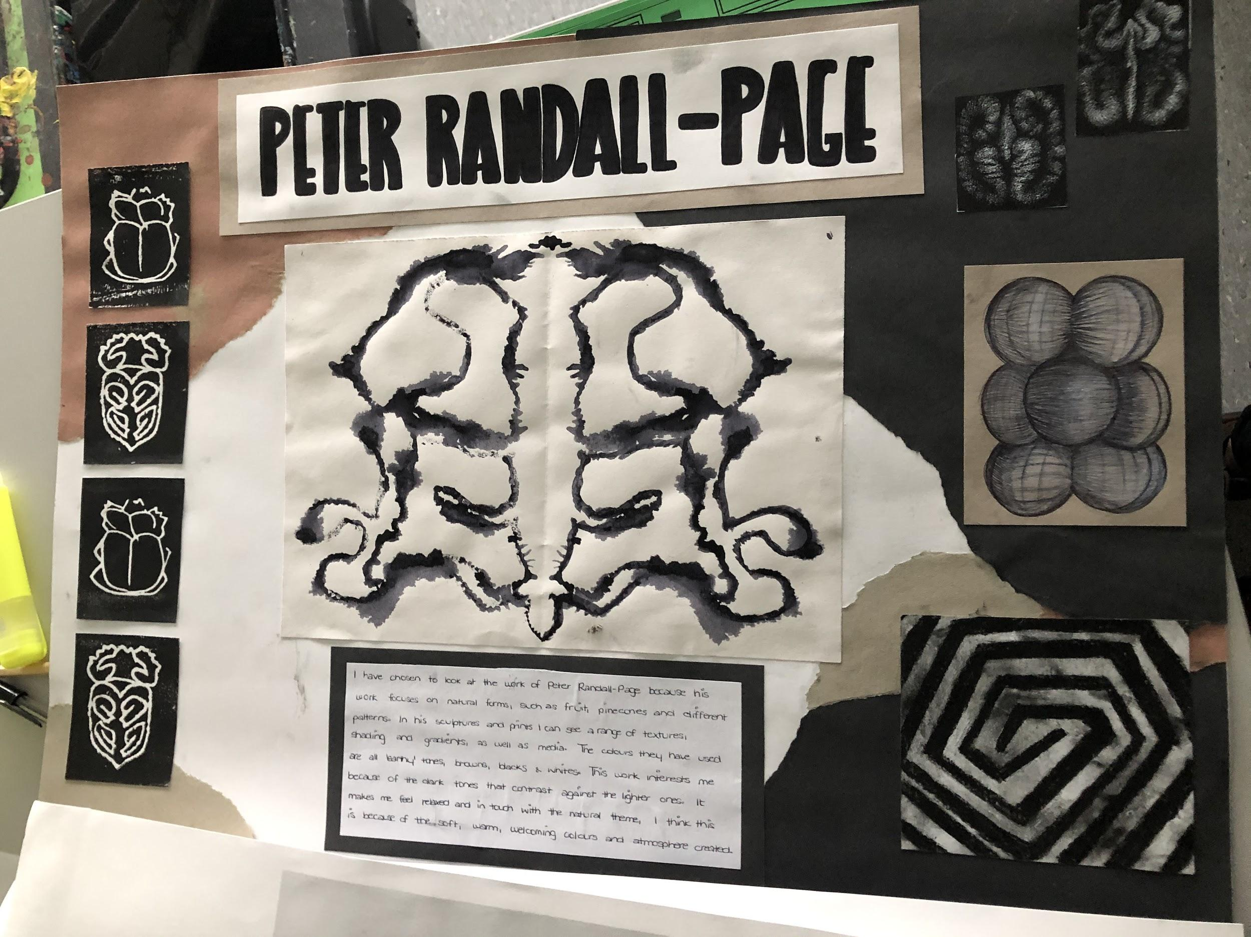
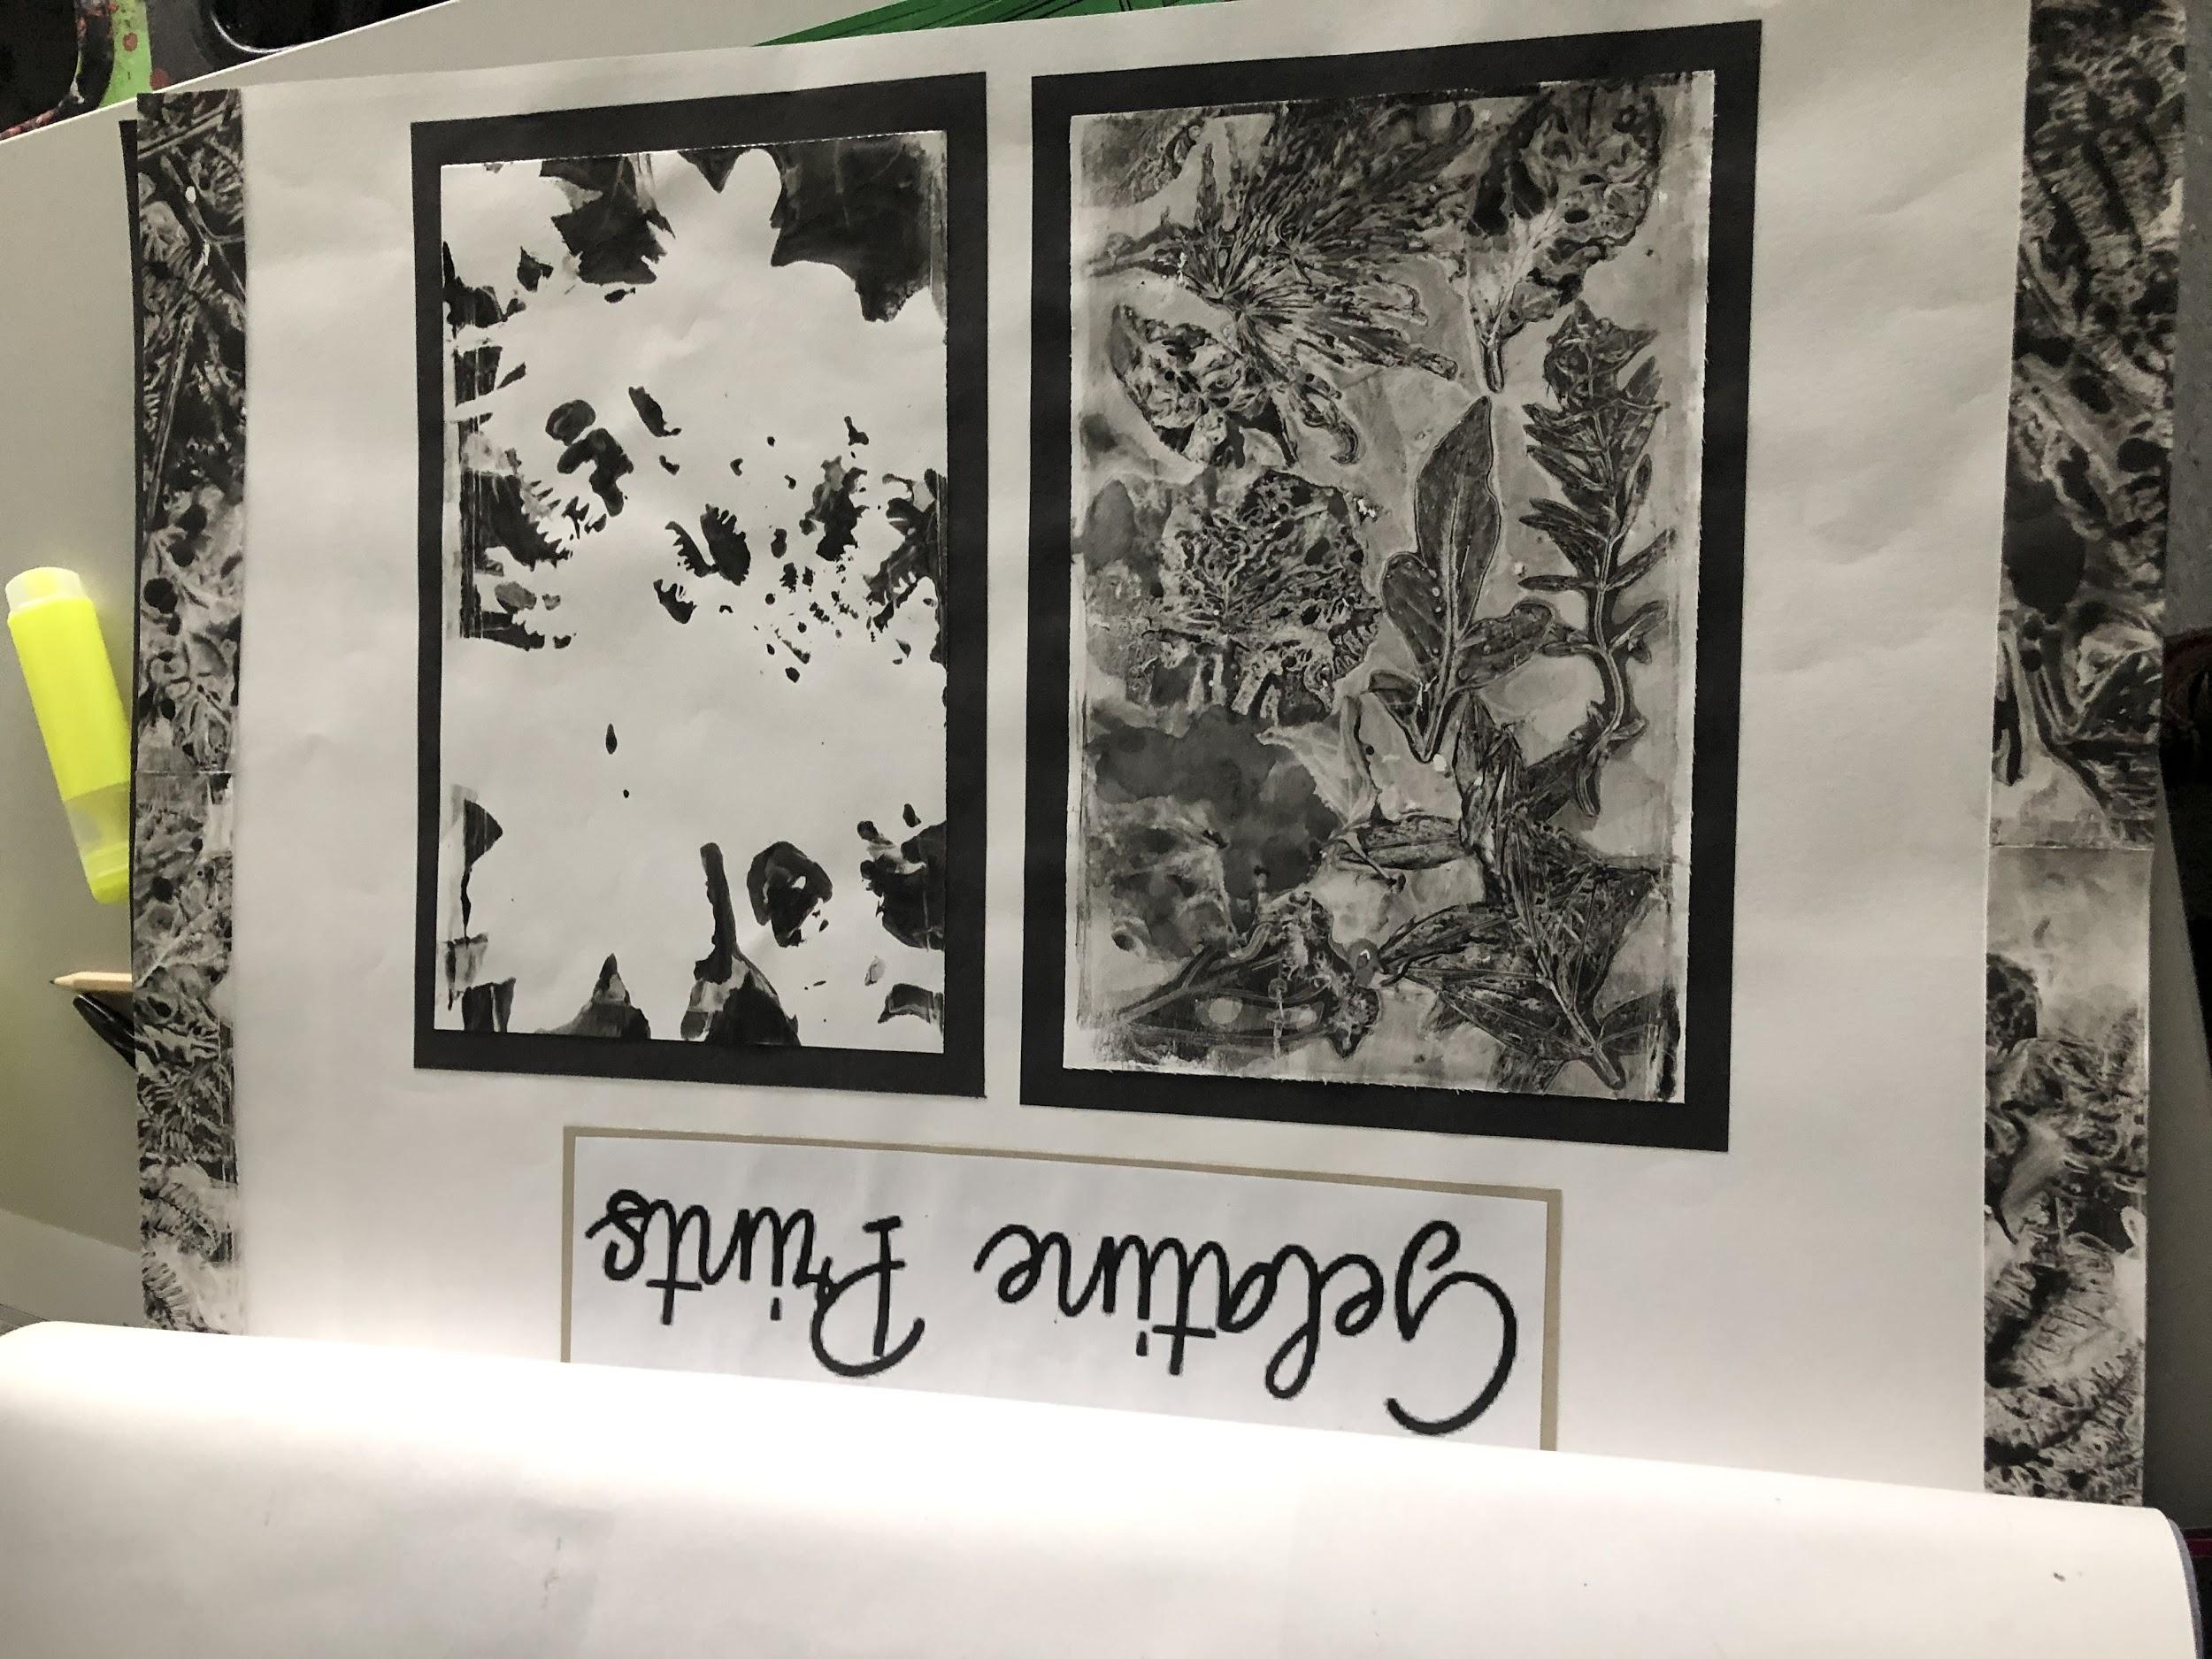
Currently working at 5

Slide 16
Currently working at 5+

Slide 17
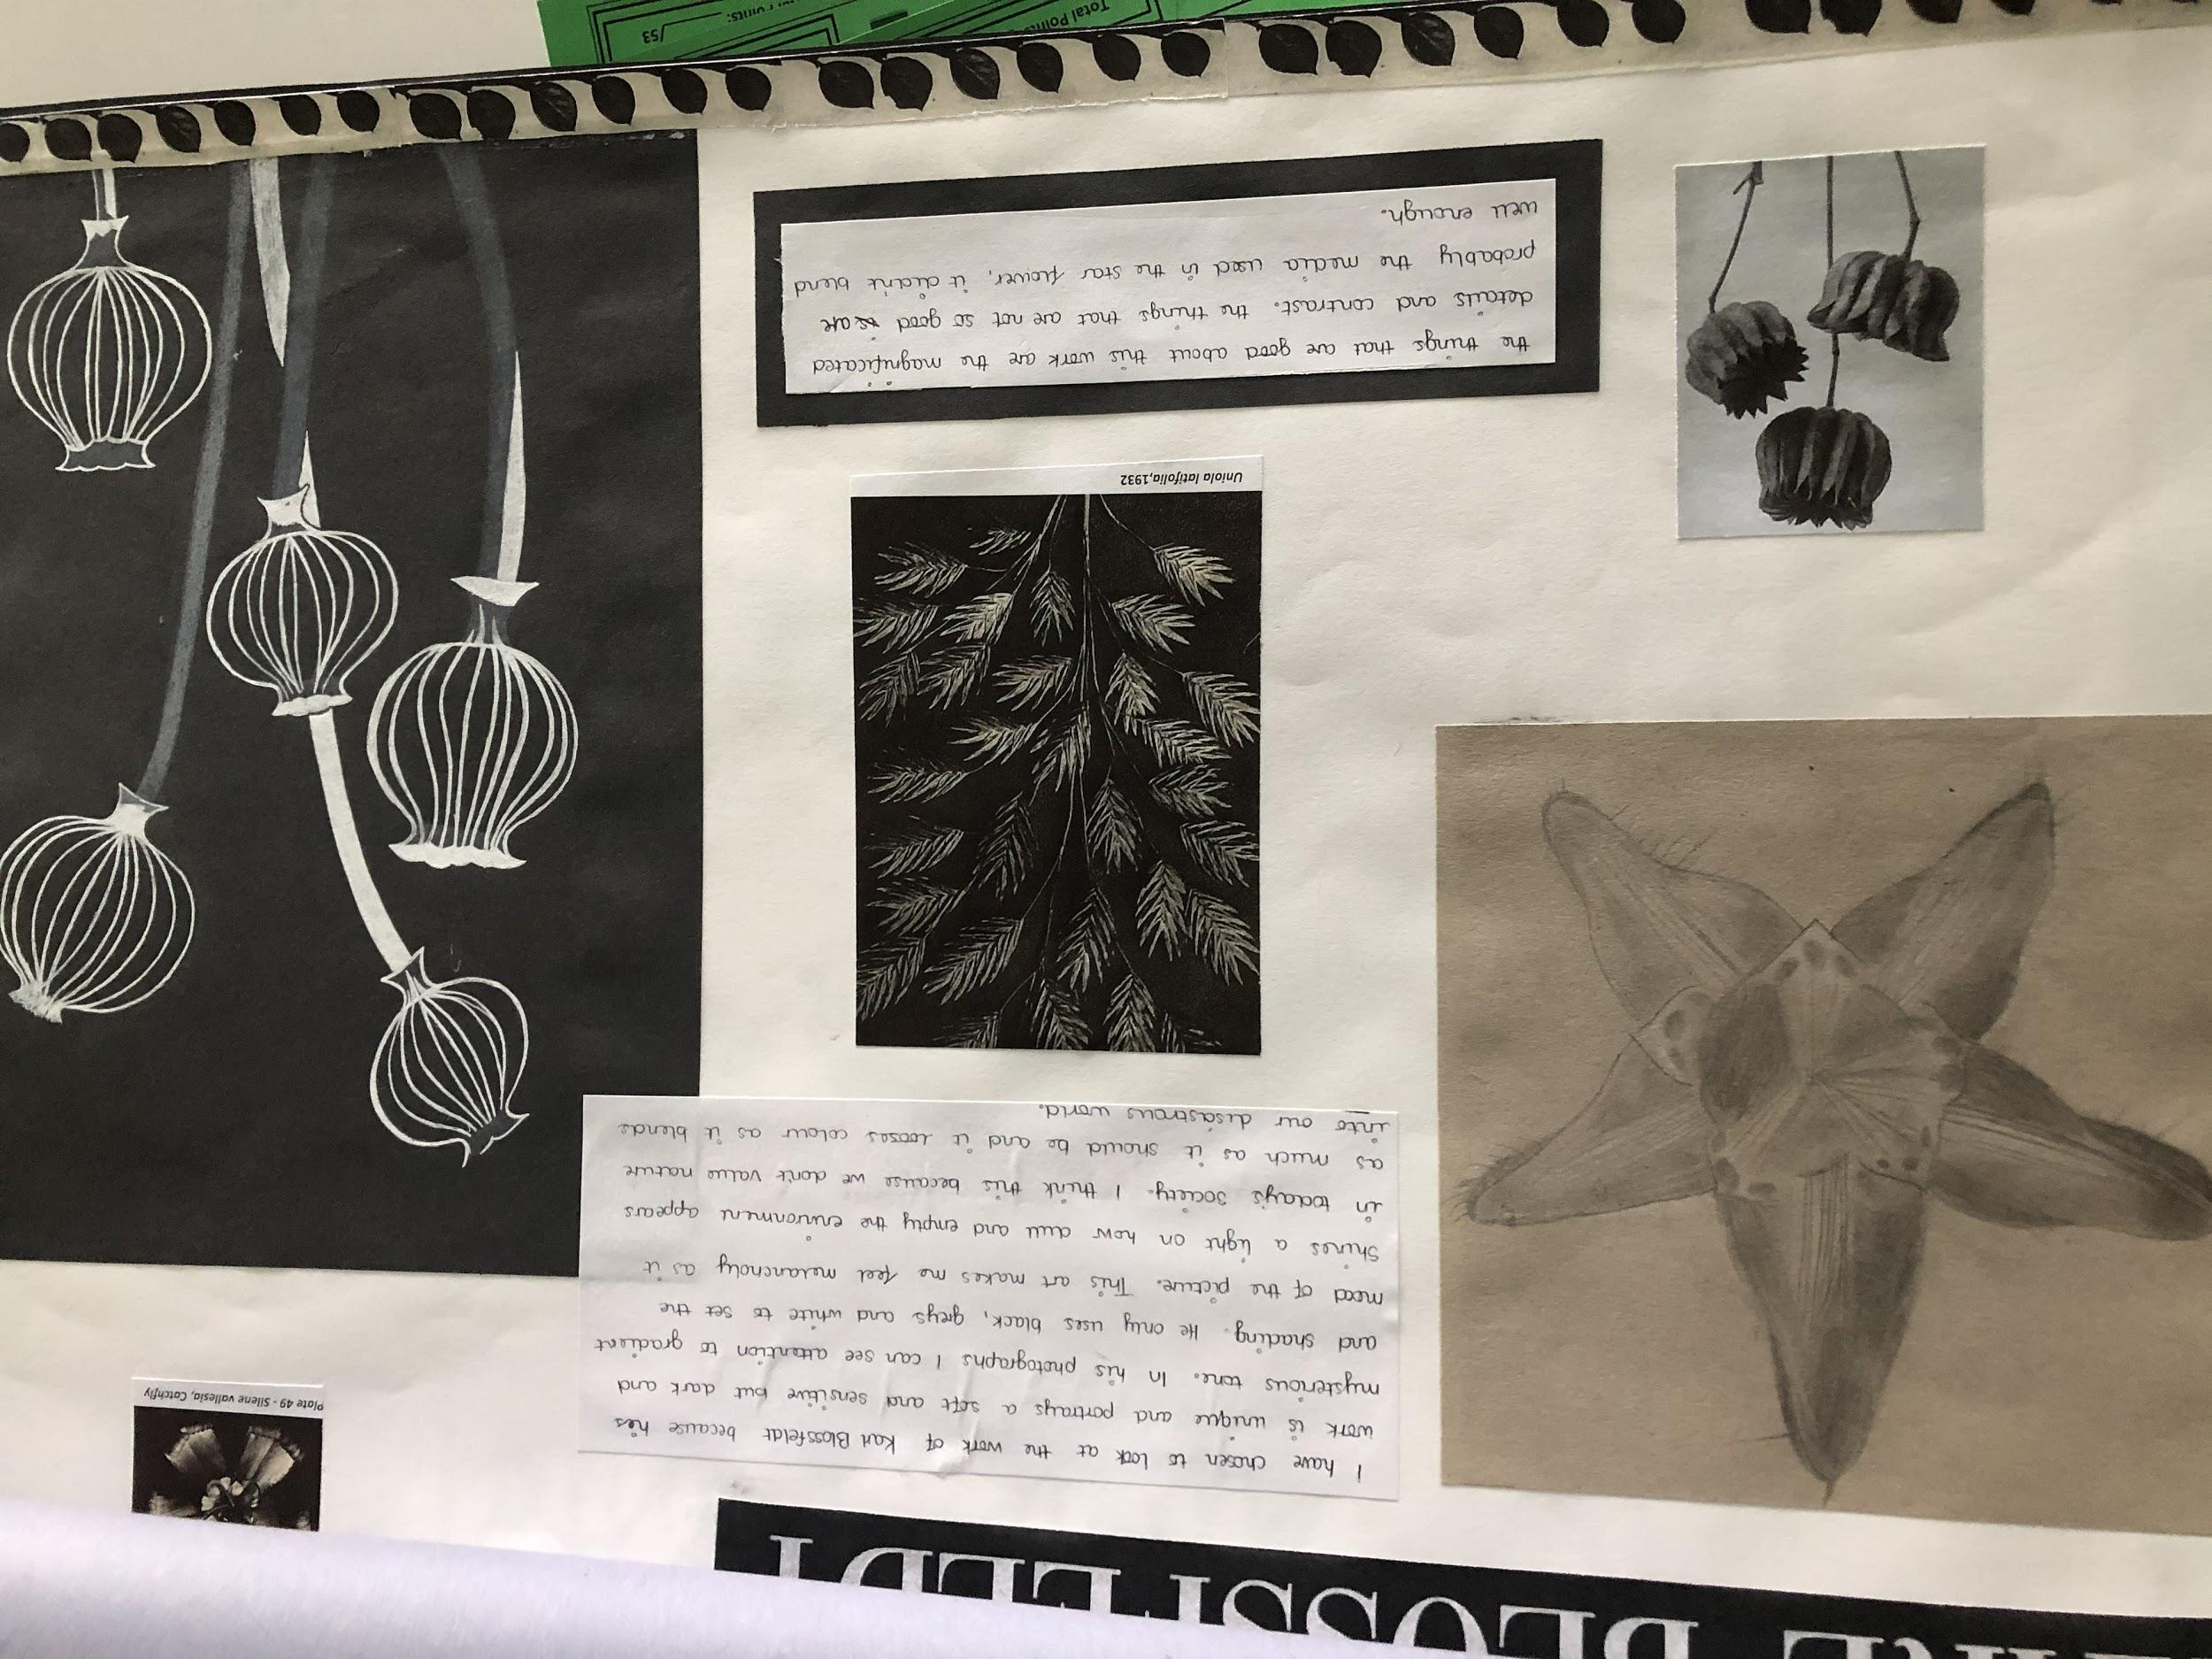
Currently working at a 5+

