Slide 1
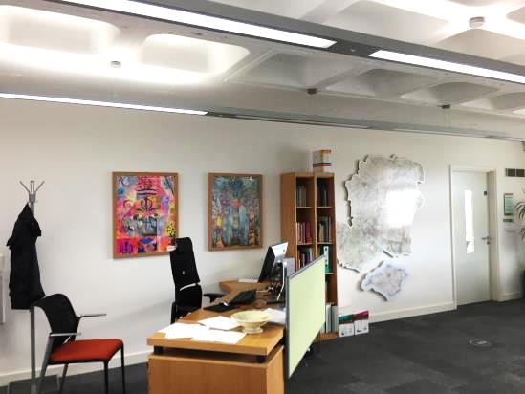
Art Exhibition at E11 offices 2017
Jayne Stillman
County Inspector/Adviser for Visual Arts

Slide 2
The Markway School

Slide 3
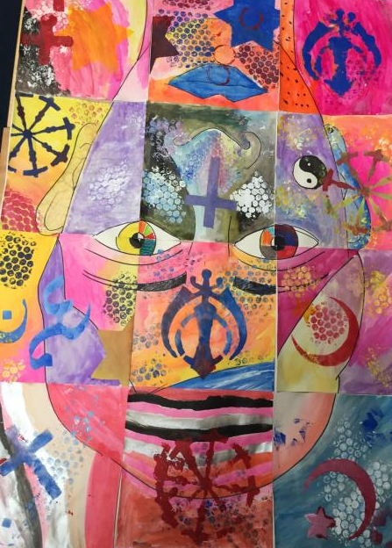
Mixed ages 11-16

Slide 4
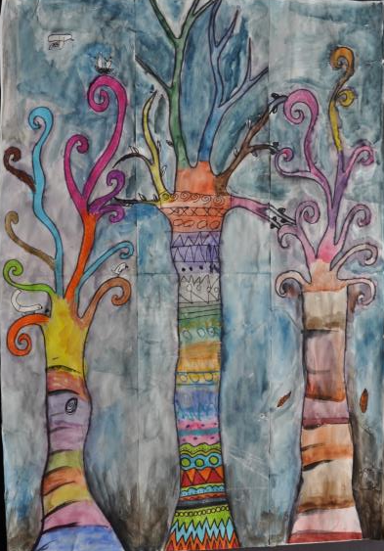

Slide 5
Farnborough Grange

Slide 6
Aged 3

Slide 7
Aged 4

Slide 8
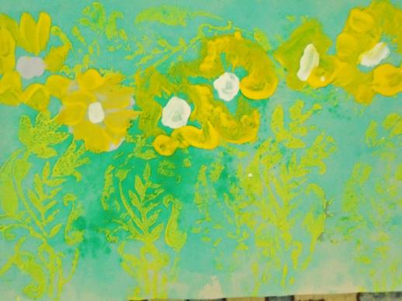
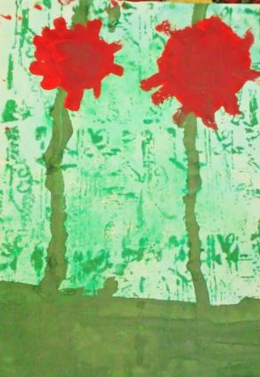
Aged 4

Slide 9
Colden Common Primary

Slide 10
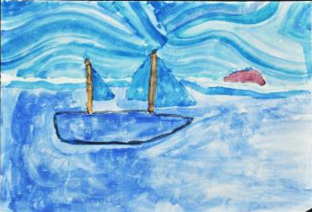
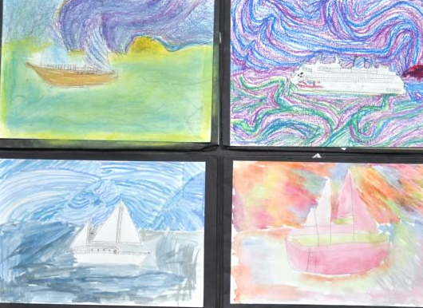
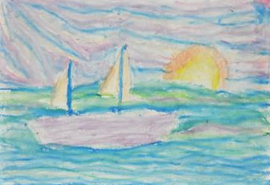
Year 5

Slide 12
Wildern School

Slide 13
Year 11

Slide 14
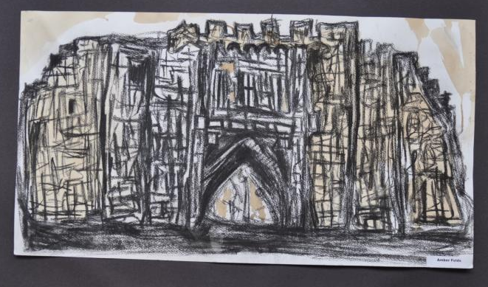

Slide 15
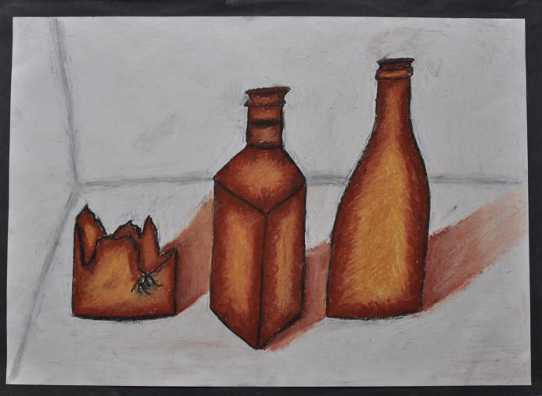

Slide 20
The Gregg School

Slide 21
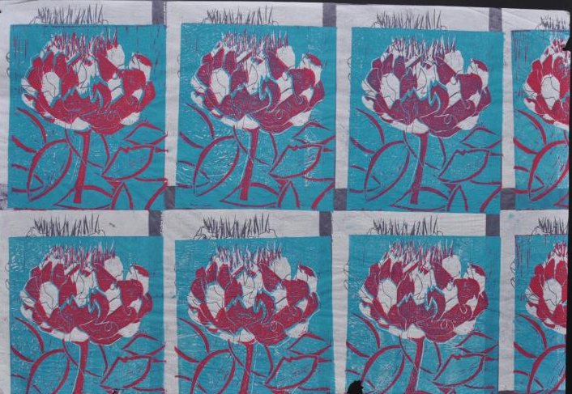
Year 11

Slide 22
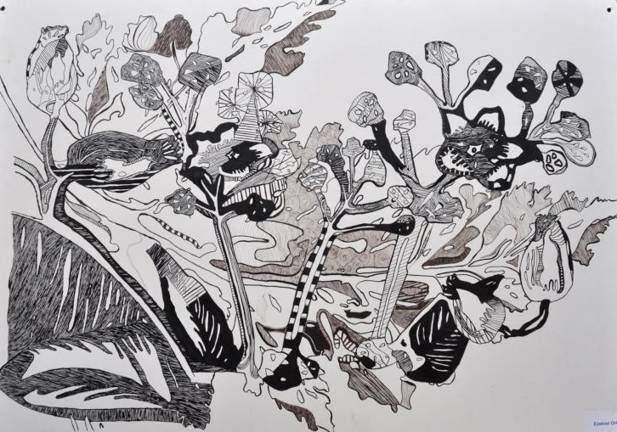

Slide 23
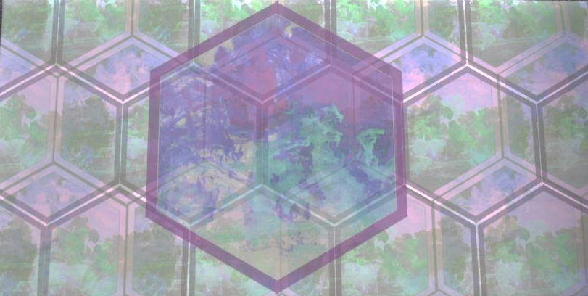

Slide 24
The Mounbatten School

Slide 25
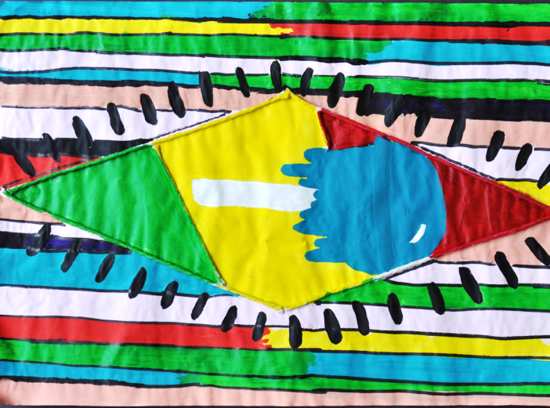
Year 9

Slide 26
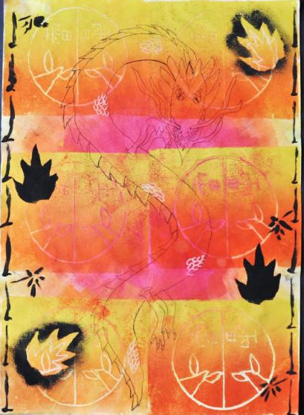

Slide 27
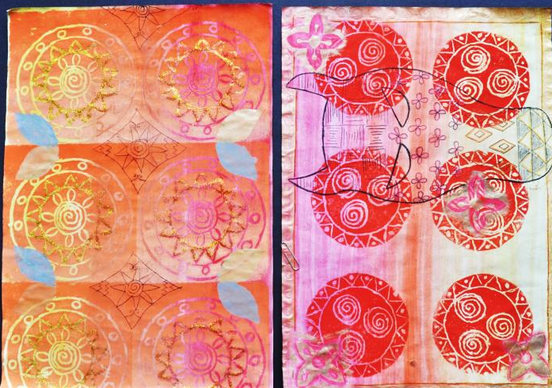

Slide 30
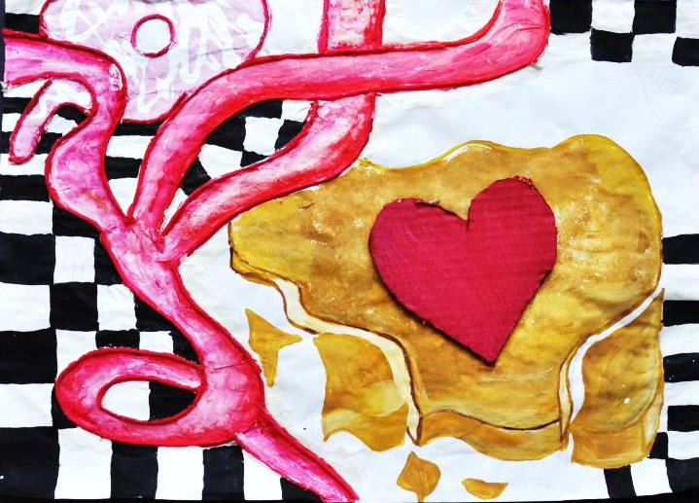

Slide 31
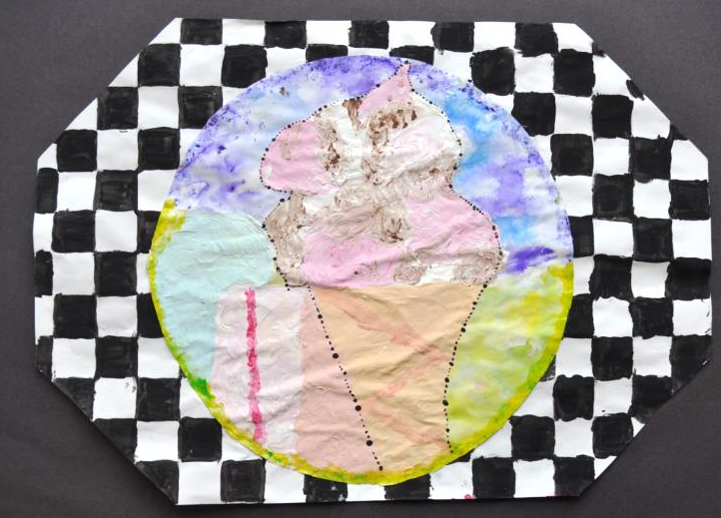

Slide 32
Hordle Primary

Slide 33
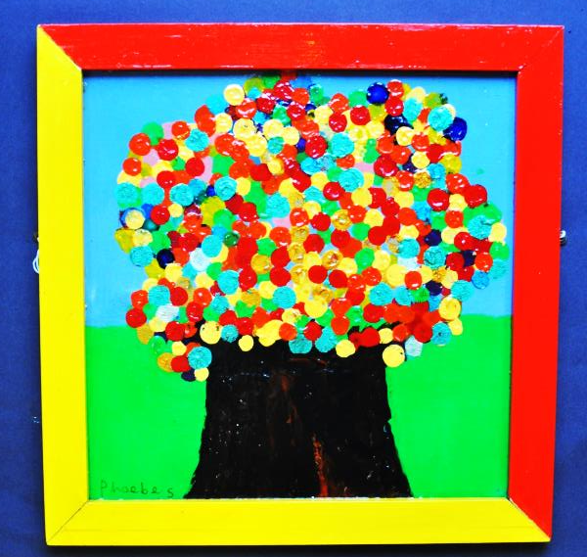

Slide 34
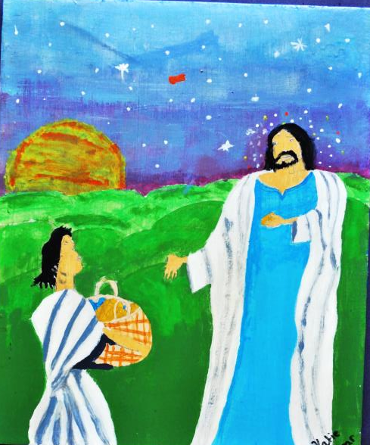

Slide 35
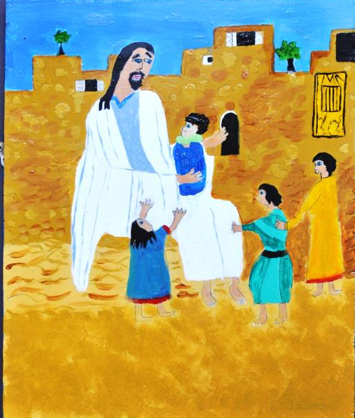

Slide 36
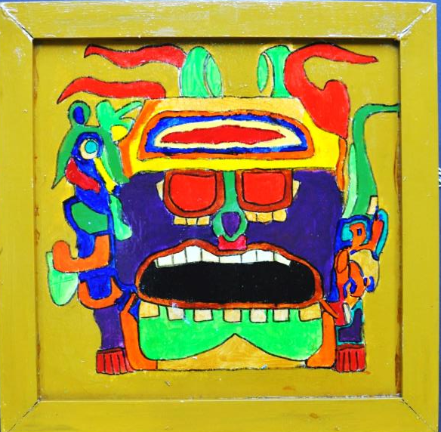

Slide 37
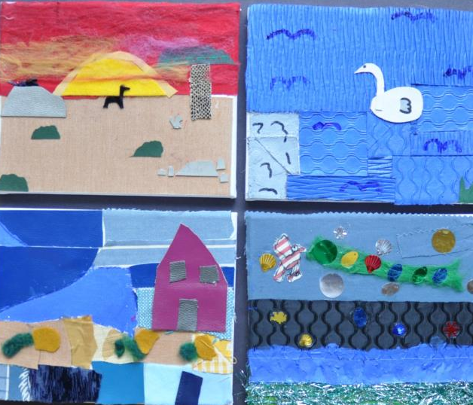

Slide 39
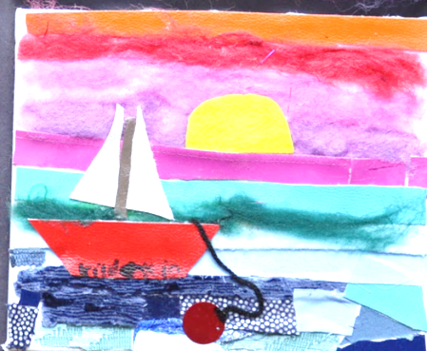

Slide 40
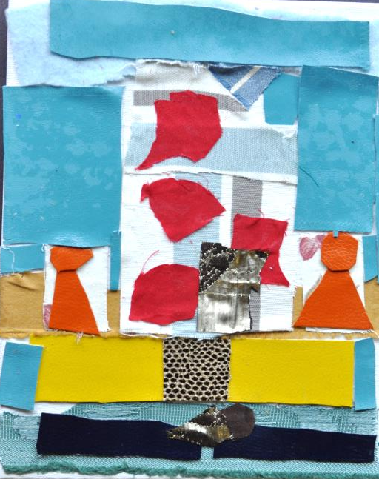

Slide 41
Mill Chase

Slide 42
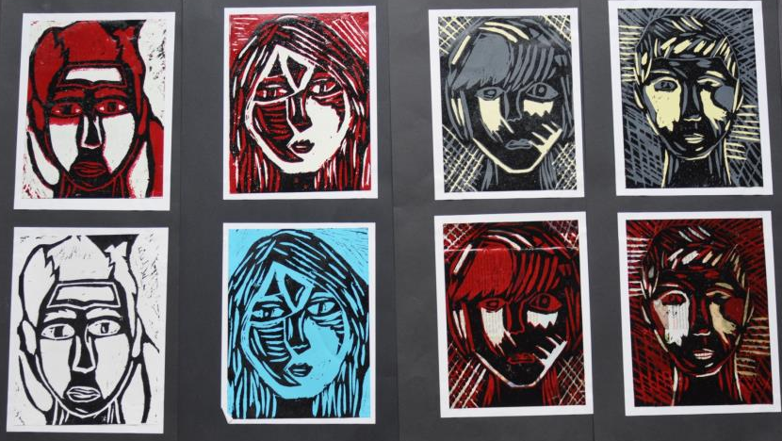
Year 10

Slide 43
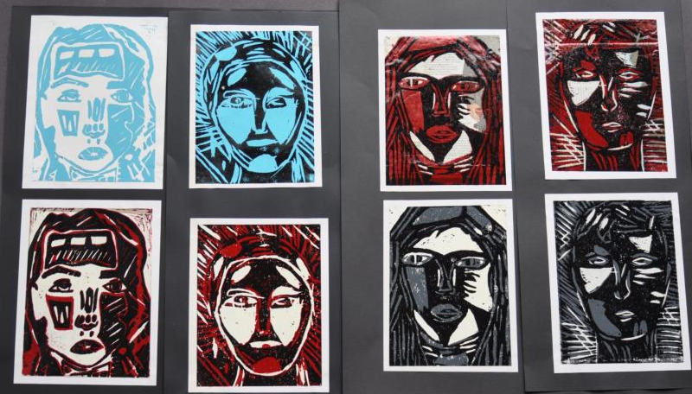

Slide 44
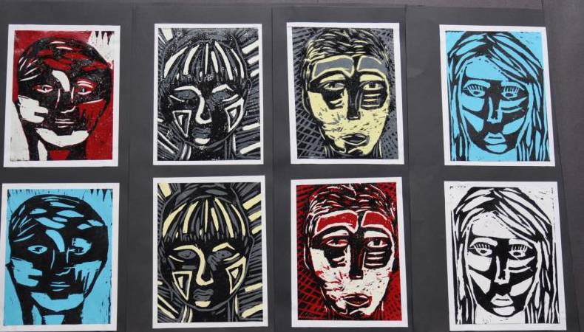

Slide 45
St Albans Primary

Slide 46
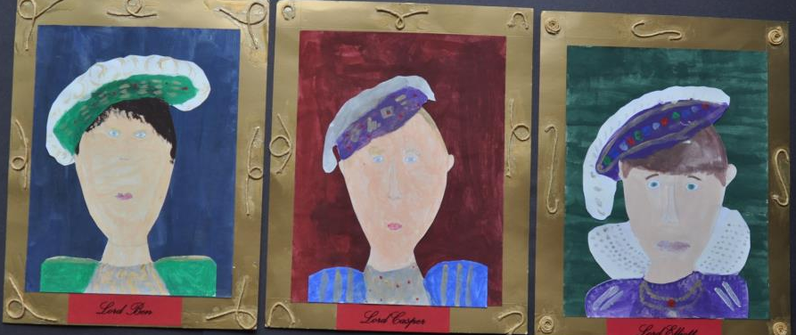
Year 4

Slide 47
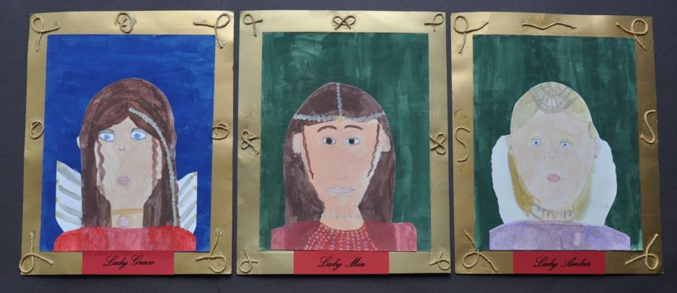

Slide 48
Year 5

Slide 49
Awbridge Primary School

Slide 51
Year 6

Slide 57
Brune Park

Slide 58
Year 9

Slide 64
Year 11

