Slide 1
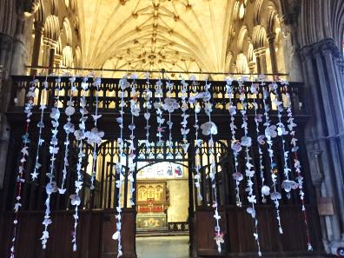
Hope, Peace and Remembrance 2018
The Discovery Centre, Gosport.
Winchester Cathedral
The Iron Age Museum, Andover.

Slide 2
Gosport Discovery Centre.

Slide 3
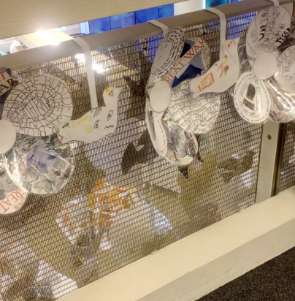

Slide 5
The Iron Age Museum, Andover.

Slide 9
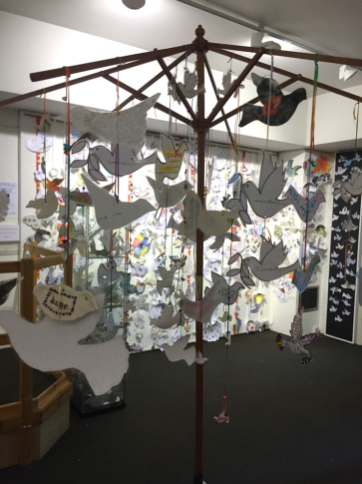

Slide 17
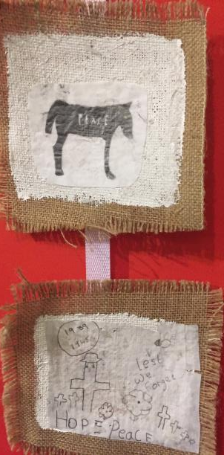

Slide 18
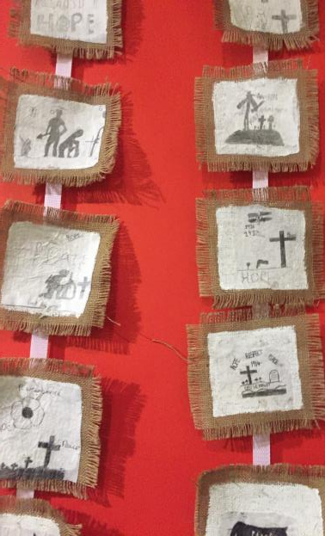

Slide 19
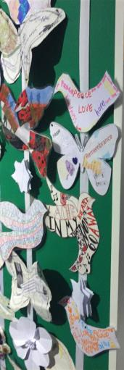

Slide 20
Winchester Cathedral

Slide 21
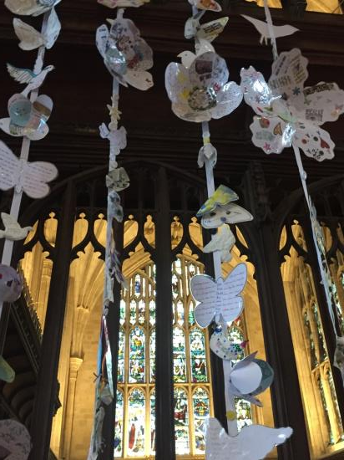

Slide 22
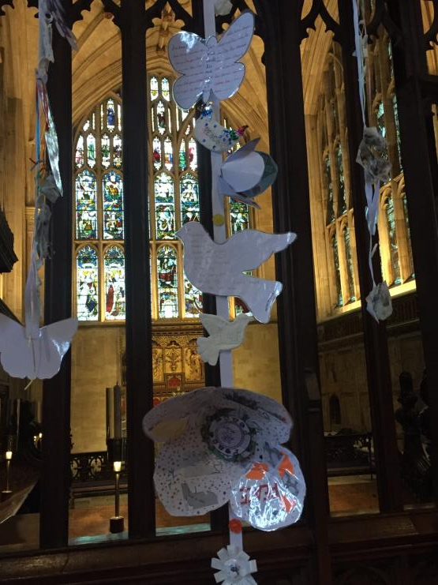

Slide 26
