Slide 1
KS3
Project examples: Thanks to COVE Secondary School- Emily

Slide 2
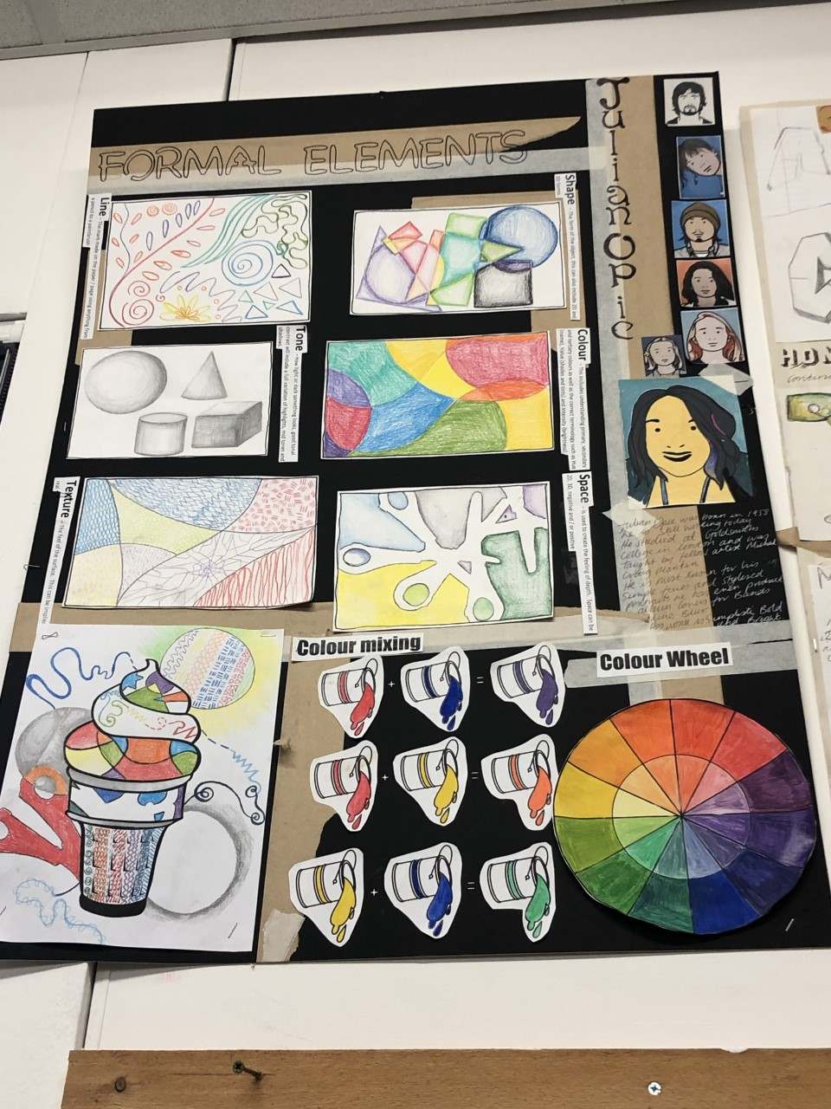
Year 7: Formal elements
Intro to the formal elements of art
Line, shape, tone, colour, texture, space: 2 per lesson
Fill in shape with each of the formal elements
Colour wheel
Colour sums
Mixing skin tones
Julian Opie study
Julian Opie self portrait

Slide 3
Assessment
Artwork / Assessment | Formal Elements Drawing | Artist Study | Painted Self Portrait
Foundation | I can attempt a basic drawing. | I have looked at the work of an artist. | I have added some colour using the poster paint.
Emerging | I have attempted to use the formal elements to create a drawing. I have tried to use tone / colour. | I have attempted to study the work of an artist. I have included basic information including keywords. | I have attempted to use the poster paint with limited accuracy and control of the paintbrush.
Developing | I can complete a drawing whilst using some of the formal elements. I have attempted to use tone and colour. | I have tried to produce an accurate artist study looking at copying the colours. I have researched basic information and I have given an opinion. | I have used the poster paint showing some accuracy and control of the paintbrush.
Secure | I can create a drawing using all of the formal elements. I have added a range of tone and have blended colour. | I have produced an accurate artist study. I can discuss why / how an artist has created their work. I have included a competent opinion. | I have used the poster paint with accuracy and control and have tried to achieve flat paintwork. I mostly have good control of the paintbrush.
Mastery | I can create a drawing using all of the formal elements effectively. I used a wide range of tone and well blended colour to enhance my drawing. | I have produced an accurate artist study showing my skill in using the media. I have included informative information and an insightful opinion. | I have produced a poster paint painting in which I have successfully achieved flat colours in the style of Julian Opie. I have excellent control of the paintbrush.
Date completed

Slide 4
Year 8 : Circus
Recap on the formal elements looked at in year 7 apply them to a circus performer
Tonal biro drawing into to mark making
Cultural study: look at history of circus/ traveler community/animal cruelty: including artwork.
Biro circus lettering
Painted Big top
Mono prints.
Combined final piece.

Slide 5
Assessment
Artwork / Assessment | Formal Elements Drawing | Context Study | Painted Circus Tent / Final Collage
Foundation | I have used the biro to complete a basic line drawing adding some tonal areas to the drawing. | I have attempted to study the Circus Culture. I have included basic information including keywords. | I have attempted to use the paint with limited accuracy and control of the paintbrush. I have attempted to collage together different elements.
Emerging | I have completed a line drawing showing some accuracy and control of the biro whilst adding a limited range of tone. | I have tried to produce an accurate drawing looking at copying the colours. I have researched basic information and I have given an opinion. | I have used the paint showing some accuracy and control of the paintbrush. I have collaged together different elements with some creativity.
Developing | I have considered perspective and proportion to complete an accurate line drawing and effectively used a full range of tone. | I have produced an accurate drawing. I can discuss facts about the Circus Culture. I have included a competent opinion. | I have used the paint with accuracy and control and have tried to achieve blended paintwork. I mostly have good control of the paintbrush. I have considered layout and composition when collaging together the different elements.
Secure | I have produced an accurate, realistic line drawing clearly showing details, whilst effectively using a full range of tone and a clearly defined light source. | I have produced an accurate drawing showing my skill in using the media. I have tried to present the page in the style of the Circus. I have included informative information and an insightful opinion. | I have produced a paint painting in which I have successfully achieved blended colours. I have excellent control of the paintbrush. I have very good control of the paintbrush. I have creatively used the background, painted circus tent and other elements to create a successful collaged composition.
Mastery | I have created an accurate, realistic line drawing which is enhanced by competent use of the biro, also demonstrating excellent understanding of proportion and perspective. | I have produced a quality accurate drawing showing my skill in using the media. I have successfully presented the page reflecting the style of the Circus. I can reflect on the work of the Circus Culture and have included an insightful opinion. | I have used the paint with accuracy and control and have tried to achieve a variety of paintwork styles. I have excellent control of the paintbrush. I have considered layout and creatively used the background, painted circus tent and other elements to create a successful original collage.
Date completed

Slide 6
Year 9: dip pen
Drawing timed experiments: insects
Tonal drawing: amphibians
Dip pen practice: wings and legs (mark making)
Artist study: Rachel Walker/ Irene Meniconi / Nunzio Pachi watercolour and dip pen
Gridding, enlargement chosen animal picture.
Watercolour wash/ coloured inks
Black dip pen.

Slide 7
Assessment
Artwork / Assessment | Tonal drawing | Artist Study | Dip Pen Drawing
Foundation | I have tried to complete a drawing showing some accuracy and control whilst attempting to add a range of tone. | I have tried to produce an accurate artist study. I have researched basic information. | I can complete a line drawing showing some accuracy and control of the dip pen and ink.
Emerging | I have attempted to complete an accurate drawing and have tried to add a range of tone and details. | I have produced a fairly accurate artist study. I can discuss why / how an artist has created their work. I have included an opinion. | I have used the gridding method to complete a relatively accurate line drawing and have attempted to use a range of mark making techniques.
Developing | I can draw an accurate line drawing and effectively add a full range of tone and details. | I have produced an accurate artist study showing some skill in using the media. I have included informative information and a competent opinion. | I can produce an accurate, realistic line drawing clearly showing details, whilst using a full range of marking making techniques and have attempted to demonstrate a range of tone.
Secure | I can create an accurate, realistic drawing and can competently add a range of tone, details and mark making which enhances the finished drawing. | I have produced a quality accurate artist study showing my skill in using the media. I can make connections between my own work and that of others. I can reflect on the work of the artist and have included an insightful opinion. | I can produce an accurate, realistic line drawing which is enhanced by competent use of the dip pen and ink, also demonstrating excellent use of mark making techniques and a range of tone.
Mastery | I can skilfully use the tonal pencils to create a range of highlights and shadows, ensuring the finished accurate drawing is realistic considering proportion and perspective. | I have confidently produced an artist study which is true to the style of the artist showing my skill in using the media. I can interpret and explain how ideas and meaning are conveyed by the artist. I can evaluate my artwork and that of others in a meaningful and purposeful way with critical understanding. | I can skilfully use the dip pen and ink to create a detailed, accurate line drawing demonstrating personal style and understanding of the technique and subject content.
Date completed

