Slide 1
Knowledge organiser for photography
HIAS MOODLE OPEN RESOURCE
A glossary of vocabulary relating to terms and processes
Jayne stillman
March 2023
Final version

Slide 2
Knowledge Base: Photography Basic Theory Year 10
1. Aperture
1.1 | Aperture Priority | AV (Aperture Value) – The mode that lets you control how open the aperture is within the lens.
1.2 | F number | The setting for the size of the aperture. The lower it is, the more light is let into the camera and adds to the background blur. The higher it is, the less light is let into the camera and more focus an image has.
1.3 | Depth of Field | It can isolate a subject from its background and foreground (when using a shallow depth of field) or it can put the same subject in context by revealing it’s surrounds with a larger depth of field.
1.4 | bokeh | A camera technique where the background is intentionally blurred.
3.ISO
3.1 | ISO | Originally referred to the sensitivity of the film in no-digital cameras, but now refers to the sensitivity of the DSLR’s sensor (signal gain) to light.
3.2 | noise / grain | Digital noise consists of random pixels scattered over the photo, producing a similar effect as the grain in film photography. Seen when shooting with high ISO settings.
3.3 | exposure | The balance of light within an image. From under-exposed (dark) to over-exposed (light).
Key Knowledge
aperture | An aperture is a small hole behind the camera lens that controls the amount of light that enters the camera. The aperture changes the depth of field of the camera.
shutter speed | This controls the time that the shutter in the camera is open. (The shutter is inside the camera and opens when you take a photo to allow light into the camera.
ISO | The ISO controls how sensitive the light detector is inside the camera.
2. Shutter
2.1 | Shutter Priority | TV (Time Value) – The mode that lets you control the speed of the shutter within the camera.
2.2 | shutter speed | Determines how fast or slow the shutter opens and closes.
2.3 | Freeze Frame | A camera technique usually use in sports that uses a very fast shutter speed to freeze motion of a subject.
2.4 | Light Painting | A technique that uses a very slow shutter speed to enable the camera sensor to pick up the movement of light.

Slide 3
Knowledge Base: Photography Compositional Theory Year 10
5. Composition
5.1 | Compositional Elements | Key things to consider when setting up a shot. Used to describe how a photograph works. Are not all used at the same time. However some can be more prominent than others in a photograph.
5.2 | Pattern | There are patterns all around us if we only learn to see them. Emphasizing and highlighting these patterns can lead to striking shots – as can high lighting when patterns are broken.
5.3 | Texture | Photographs of two dimensional objects yet with the clever use of ‘texture’ they can come alive and become almost three dimensional. You want the viewer to imagine how the object feels.
5.4 | Symmetry | Can create a balanced composition that leaves the viewer with a feeling the photograph is staged in some way. Can add a striking effect depending on the subject/ object photographed.
5.5 | Rule of Thirds | A 3x3 grid used by photographs to create a composition that feels right. Objects that fall on or near the lines are considered to have the best impact.
5.6 | Shape | The way subjects connect to each other in a photo forms shapes that draw the eye from subject to subject. If your subject is already triangular or diamond-shaped (like a pyramid), the viewer's eye will automatically focus on that shape.
5.7 | Focal Point | The main focus of a photograph/artwork. There is usually a line/ shape/ space of some form leading to it.
5.8 | Restful / Dynamic Composition | If there is space around an object in a composition then it is considered restful. Photographs that are zoomed in and objects touch the edges of the composition are considered dynamic. It dictates how much the viewer’s eyes have to move around the photograph to see everything.
5.9 | Lines | Lines can be powerful elements in an image. They have the power to draw the eye to key focal points in a shot and to impact the ‘feel’ of an image greatly.
4. Elements of Art​
4.1​ | line​ | The visible and formed lines in a photograph. Can be vertical or horizontal. Created by physical objects or formed by the direction of the eye.​
4.2​ | shape​ | This element is the creation of two dimensional shapes within a photograph. These can be naturally formed or intentionally created.​
4.3​ | form​ | Like shape, this element works with the three dimensional forms in the photograph.​
4.4​ | space​ | How the photograph uses space within the image. This can be within the composition or the use of empty space.​
4.5​ | colour​ | How colour is used in the photograph, for example: complementary colours red and green are used to show contrast and drama. Can also add meaning to an image ​
Canon Mode Dial Settings
Assessment Objectives
AO1 | Critical Understanding - Develop ideas through investigations, demonstrating critical understanding of sources.
AO2 | Creative Making - Refine work by exploring ideas, selecting and experimenting with appropriate media, materials, techniques and processes.
AO3 | Reflective Recording - Record ideas, observations and insights relevant to intentions as work progresses.
AO4 | Personal Presentation - Present a personal and meaningful response that realises intentions and demonstrates understanding of visual language.

Slide 4
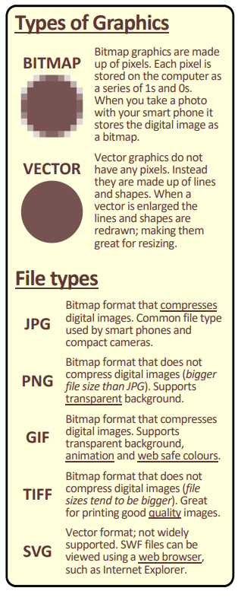
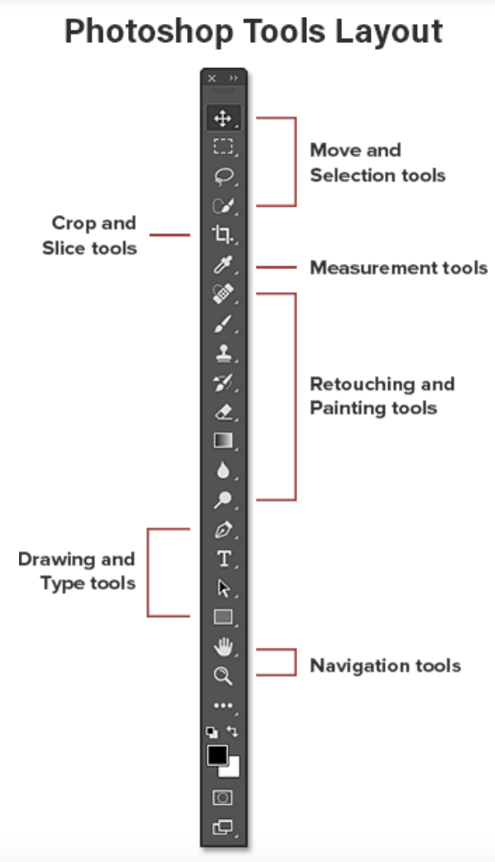
Knowledge Base: Photography Photoshop Editing Basics Year 10
6. Photoshop Tools
6.1 |  | Move Tool – This allows you to move (and resize) each layer around the page.
6.2 |  | Rectangular Marquee Tool – Allows you to select parts of a layer to edit and move.
6.3 |  | Magic Wand Tool – Allows you to select similar colours by clicking on them.
6.4 |  | Crop Tool – Allows you to make your canvas (whole document) smaller.
6.5 |  | Brush Tool – Like a normal paint brush, allows you to ‘paint’ in whatever colour you have selected. Useful with masking.
6.6 |  | Clone Stamp Tool – Allows you to copy and paint pixels or areas of your image. Remember to select your source with ‘Alt’ before cloning.
6.7 |  | Eraser Tool – Allows you to delete parts of a layer.
6.8 |  | Dodge Tool – This tool will lighten any pixel that you click on.
6.9 |  | Burn Tool – This tool will darken any pixel that you click on.

Slide 5
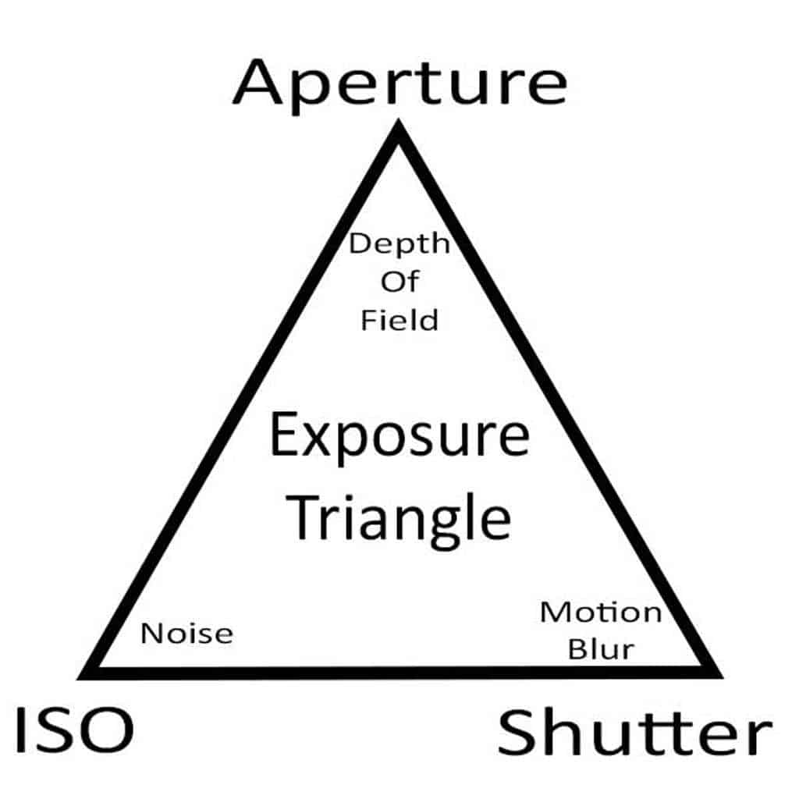
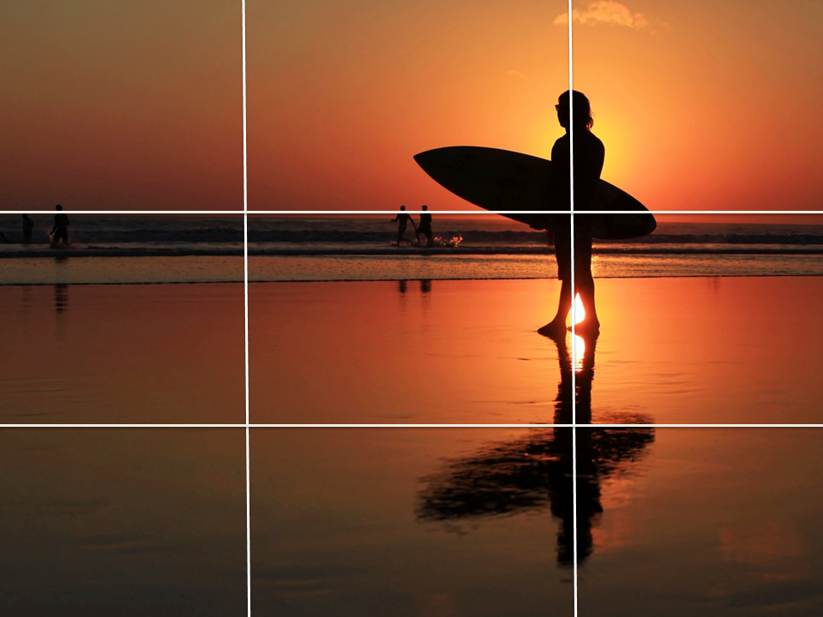
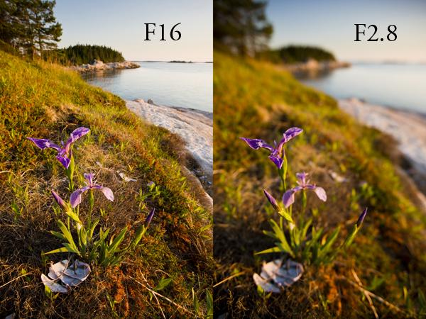
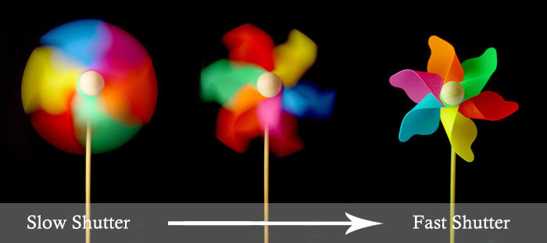
Knowledge Base: Photography Examples Year 10
Exposure Triangle
Rule of Thirds
Depth of Field
Shutter Speed

Slide 6
Art (photography)
HIAS MOODLE OPEN RESOURCE
Jayne.stillman@hants.gov.uk
For further details on the full range of services available please contact us using the following email:
htlcdev@hants.gov.uk

Slide 7
Upcoming courses
HIAS MOODLE OPEN RESOURCE
Keep up-to-date with our learning opportunities for each subject through our Upcoming Course pages linked below. To browse the full catalogue of learning offers, visit our new Learning Zone. Full details of how to access the site to make a booking are provided here.
English
Maths
Science
Geography
RE
History
Leadership
Computing
Art
D&T
Assessment
Support Staff
SEN

