Slide 1
A guide across the assessment objectives to create a portfolio of work for KS4 art
HIAS MOODLE OPEN RESOURCE
Jayne Stillman
February 2023
Final version

Slide 2
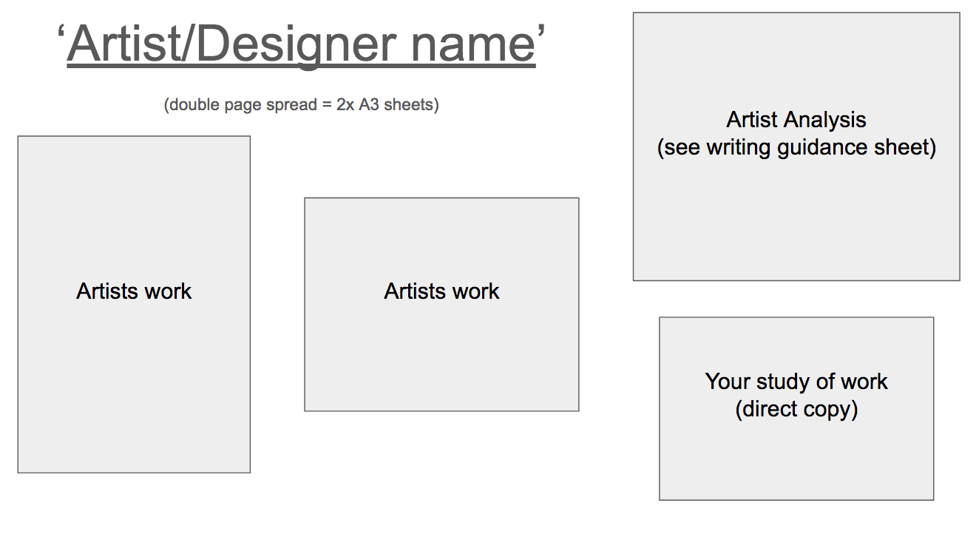
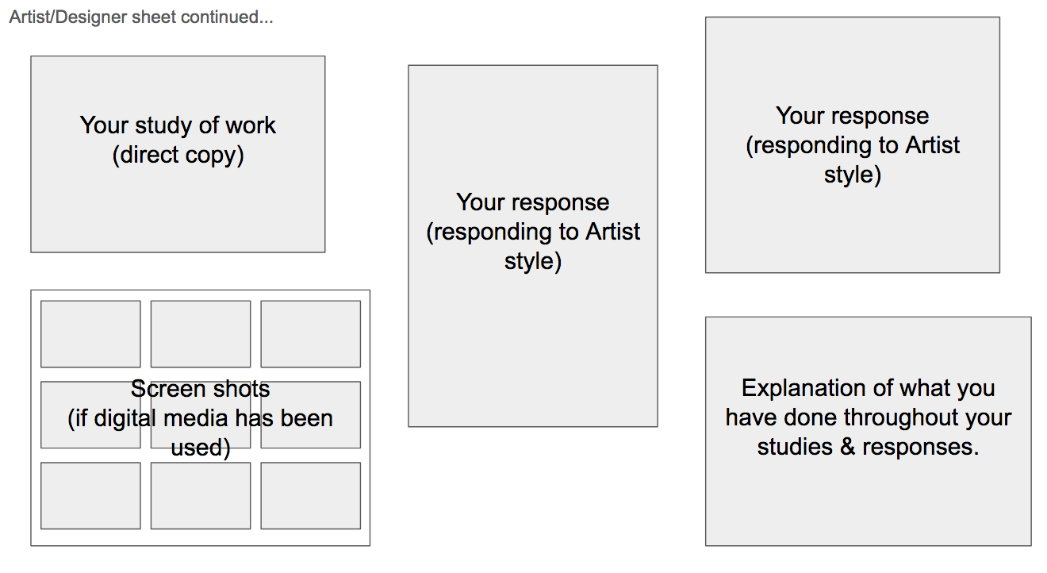
Lesson Objective: To produce a series of outcomes that link to one or more of your chosen artists, showing similarities in both content and/or technique.
Assessment Objective 1 (AO1)
Develops ideas and responses through investigations informed by other artists and/or art forms, demonstrating analytical and cultural understanding.
Each artist page should consist of...
A title clearly labelling the artists name
Detailed analysis about your artists style
3-4 different images that you have created that relate to your artists work.
Study =
A direct copy
Response =
Taking the artists style or theme and making your own work from it.
2-5 examples of the artists work
Success Criteria: To produce 1 or more images that reflect the style, technique or media use as your chosen artist / designer.
A description about your work - what you did / why
Screenshots where digital media has been used

Slide 3
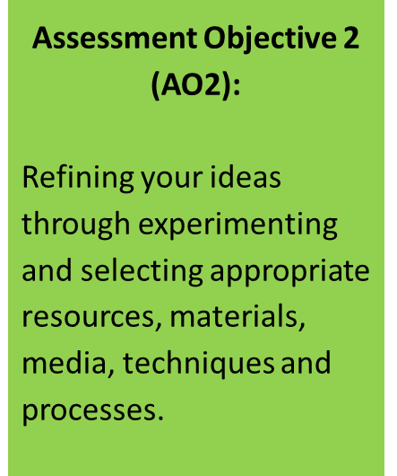
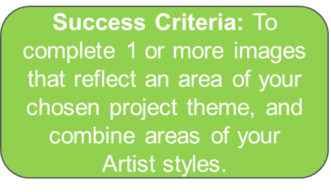
Lesson Objective: To create a series of images for the ‘ideas’ section of your coursework, which uses or combines one or more types of media. Work should reflect original and successful imagery, as well as linking to your chosen project theme and artists.
Idea 1: Surface, pattern and texture
A title clearly labelling the theme
An image of your own exploring surface, pattern and texture.
I have chosen to study surface pattern and texture as an idea because…
This could form my final piece and my ideas are…
I plan to research, experiment and explore the theme of surface pattern and texture whilst combining it with artistic styles of……………….
Explanations about your developments
Supporting photographs, from the internet, or taken yourself
Small recording, analysis responses to research, using different media.
An image of your own exploring surface, pattern and texture
You might inset screenshots if digital media has been used.
This will be repeated with each idea, the number of responses and images may vary.
Recording specific Media and Materials used within your Idea.

Slide 4
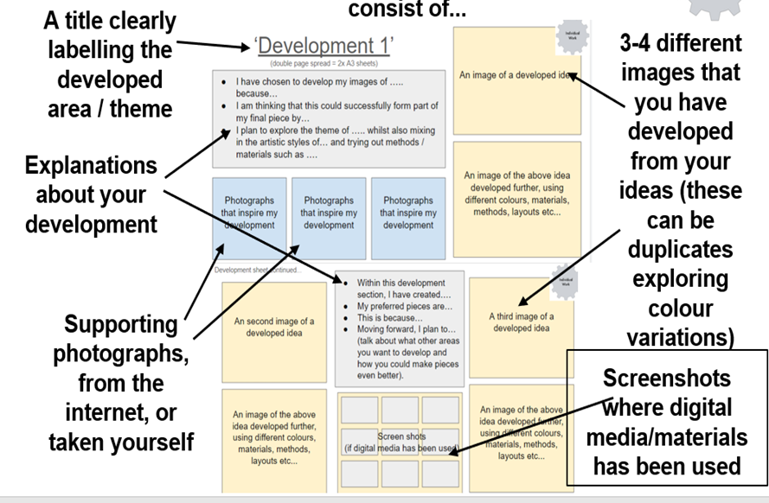
Lesson Objective: To create a series of images for the ‘development’ section of your coursework, which uses or combines one or more types of media. Work should reflect original and successful imagery, and developed images from your ideas section and should link to your chosen project theme and artists.
Assessment Objective 3 (AO3):
Record ideas, observations and insights, relevant to your intentions, through visual and or / other forms.
Each idea should consist of...
Success Criteria: To complete 1 or more images that reflect an area of your chosen project theme executed to a high standard.

Slide 5
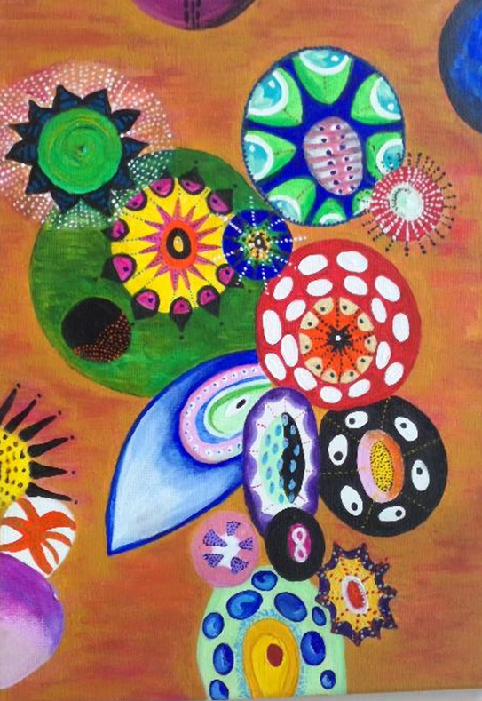
Refinement / Final Piece Layout
Lesson Objective: To understand what ‘Refinement’ is and how you expand and refine your best developed ideas into a final piece.
All of your preparatory work leads up to your personal response or final piece. To make a successful final piece, you must:
Clearly link your final piece with the rest of your project (your preparatory work).
Make sure your final piece links to your Artists.
Finish all of your preparatory work before you start your final piece - it's worth a lot more marks.
Make sure your personal response isn't simply a larger version of your preparatory work.
Review and refine your ideas so that you are completely happy with them.
Complete your experiments with materials, composition and construction so that you feel in control of what you are doing before you start your final piece.
Annotate your intentions.
Ensure that the work is of high quality, neaten edges, considerate presentation.

Slide 6
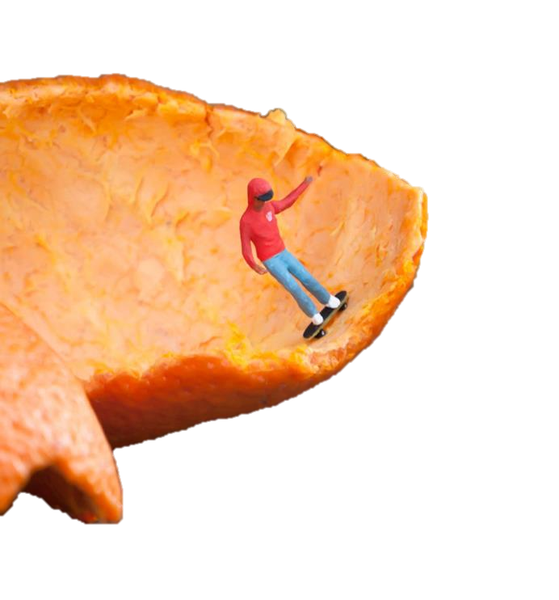
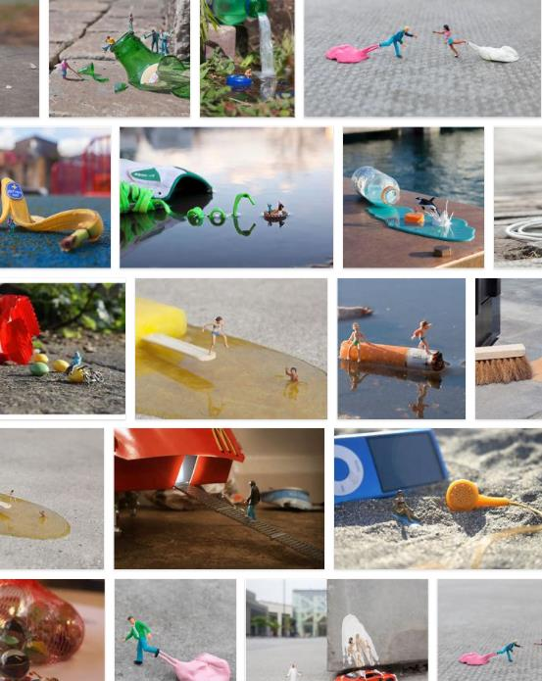
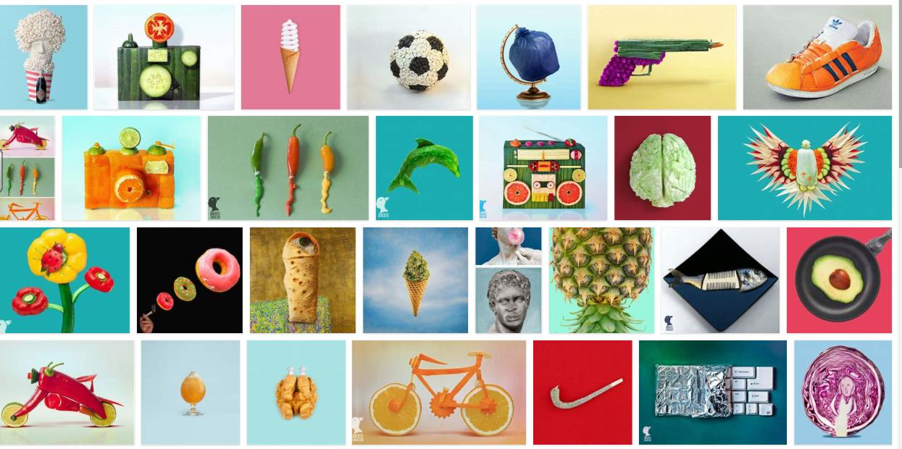
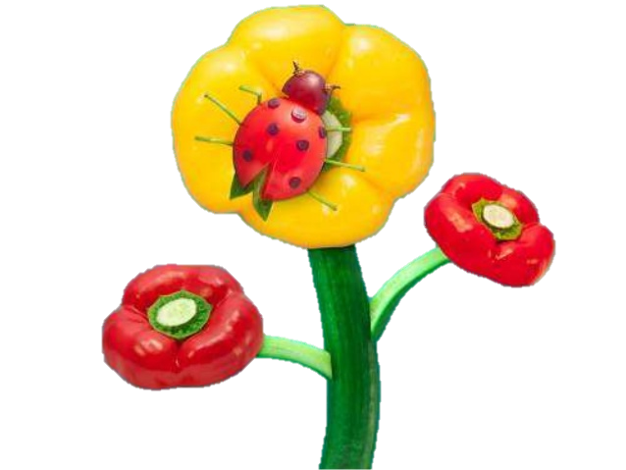
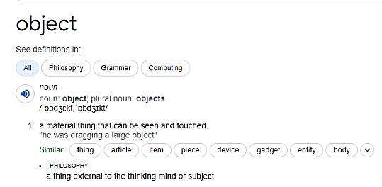
Object
AO4- Outcome Development
dan cretu

Slide 9
Art
HIAS MOODLE OPEN RESOURCE
jayne.stillman@hants.gov.uk
For further details on the full range of services available please contact us using the following email:
htlcdev@hants.gov.uk

Slide 10
Upcoming courses
HIAS MOODLE OPEN RESOURCE
Keep up-to-date with our learning opportunities for each subject through our Upcoming Course pages linked below. To browse the full catalogue of learning offers, visit our new Learning Zone. Full details of how to access the site to make a booking are provided here.
English
Maths
Science
Geography
RE
History
Leadership
Computing
Art
D&T
Assessment
Support Staff
SEN

