Slide 1
The Coronation of King Charles III
HIAS MOODLE OPEN RESOURCE
Ideas for art for the coronation
Jayne Stillman
April 2023
Final version
© Hampshire County Council

Slide 2
Overview
HIAS MOODLE OPEN RESOURCE
This document contains…
Some ideas and starting points for artwork to celebrate The King’s Coronation.
Points to consider when using this resource
These can be adapted for any year group.

Slide 3
The Coronation of King Charles III
HIAS MOODLE OPEN RESOURCE
Painting
Portraits, menus, gardens, flowers
Some ideas to start you off…
Textiles
Bunting, outfits.
Drawing
King and Queen, gardens, party food.
The Coronation of King Charles III
Printing
Coins
Collage
Create an outfit, castle, palace, food etc.
ICT
A poem
Photography of dressing up, cakes etc.
Sculpture
Coins, bust of King, crown.

Slide 4
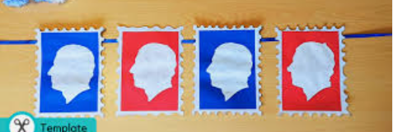
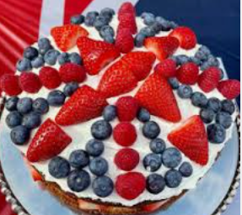
King Charles III Coronation

Slide 5
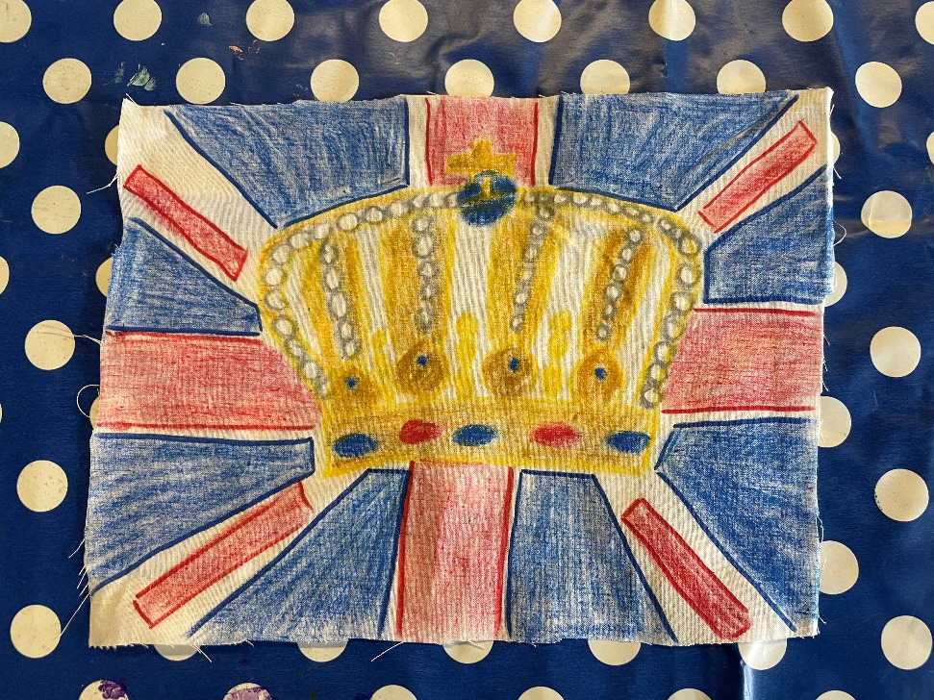
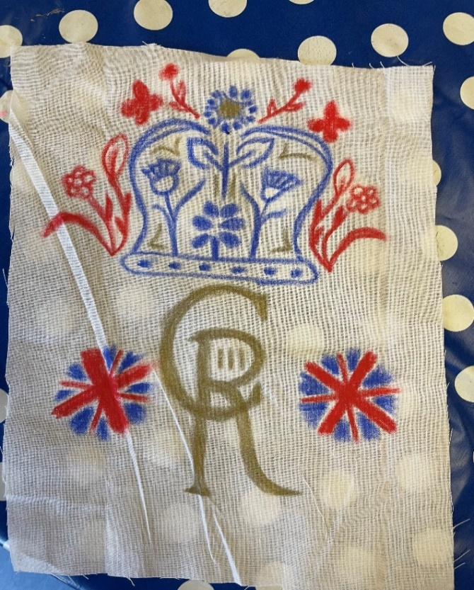
Katie and Holly
HIAS MOODLE OPEN RESOURCE

Slide 6
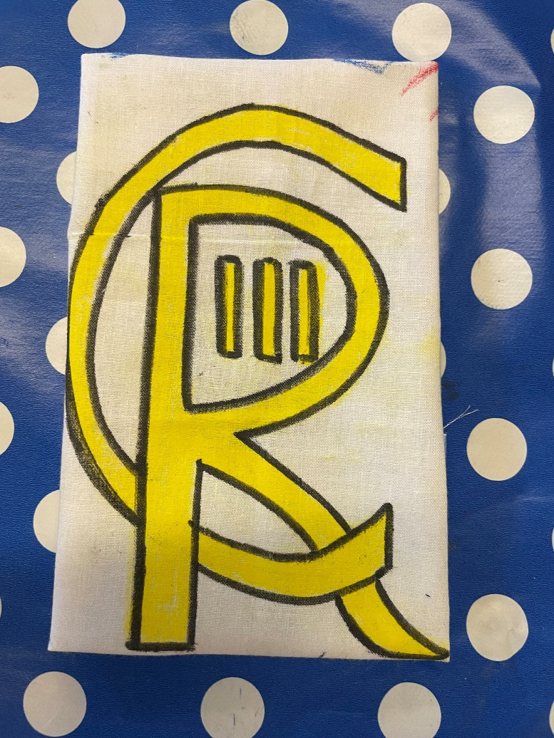
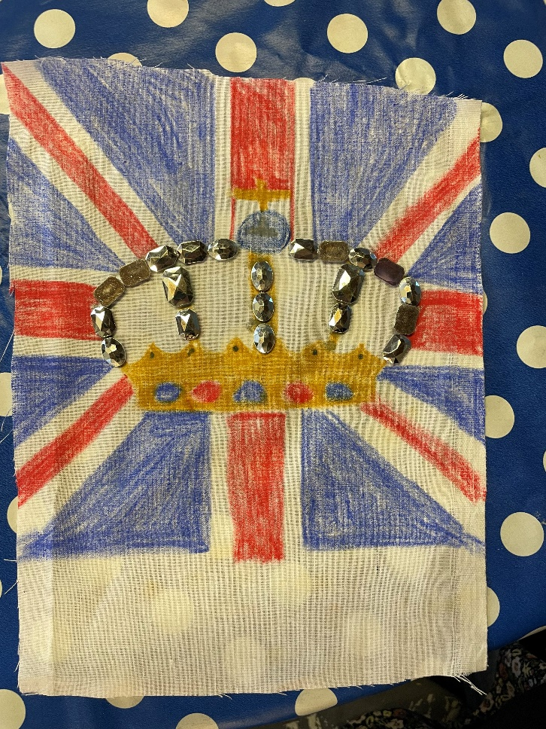
Jo and Melissa
HIAS MOODLE OPEN RESOURCE

Slide 7
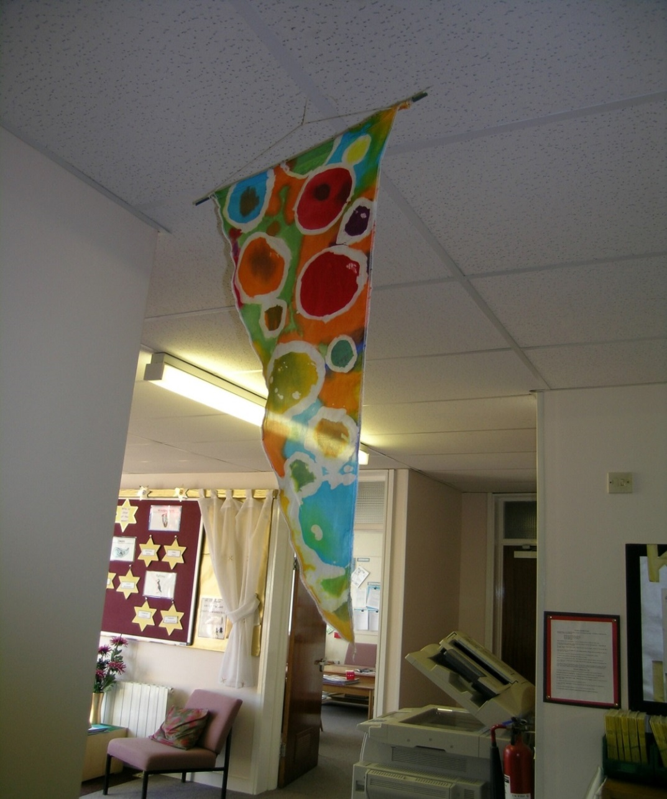
HIAS MOODLE OPEN RESOURCE

Slide 8
Hot wax batik https://theartofeducation.edu/2016/04/05/step-step-guide-batik/
HIAS MOODLE OPEN RESOURCE

Slide 9
Gutta Resist https://www.youtube.com/watch?v=KpZO8y4Az_Q
HIAS MOODLE OPEN RESOURCE

Slide 10
Oil pastel and ink https://www.youtube.com/watch?v=XrsD4oa-gb0
HIAS MOODLE OPEN RESOURCE

Slide 11
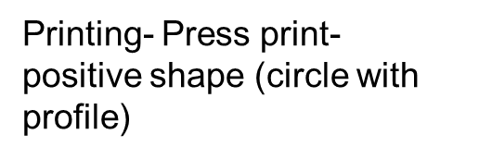
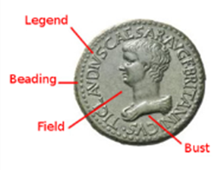
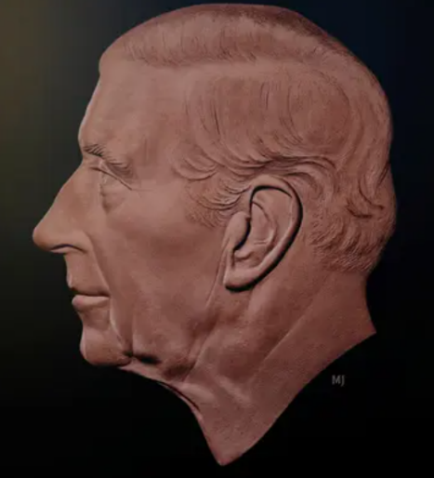
HIAS MOODLE OPEN RESOURCE
Martin Jennings
Born 31 July 1957 in Chichester, West Sussex).
He is a British sculptor.
His sculpture is often finished in in bronze and stone.
He has been asked to create the first official coin of King Charles III.
Jennings has created many large sculptures to commemorate people including Charles Dickens and Mary Seacole.
Mould malleable materials
Use simple techniques for building and joining clay
Use a wider range of simple tools to cut, shape and impress patterns and textures.
Plan to clay work and select the materials and tools to use.
Talk about the work and relate to others.
https://en.wikipedia.org/wiki/Martin_Jennings

Slide 12
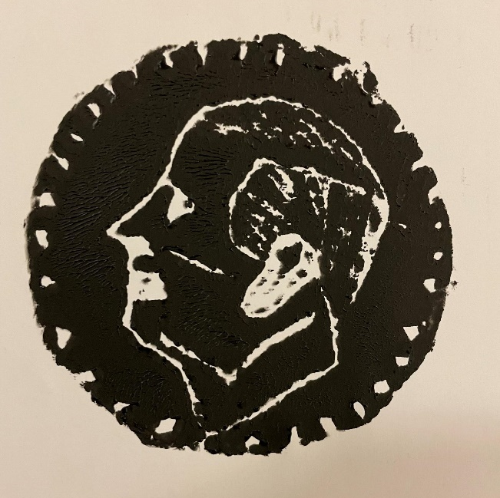
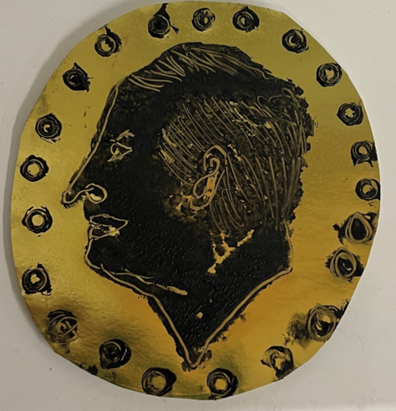
King Charles III coin
HIAS MOODLE OPEN RESOURCE

Slide 13
ART
HIAS MOODLE OPEN RESOURCE
Jayne.stillman@hants.gov.uk
For further details on the full range of services available please contact us using the following email: htlcdev@hants.gov.uk

Slide 14
Upcoming Courses
HIAS MOODLE OPEN RESOURCE
Keep up-to-date with our learning opportunities for each subject through our Upcoming Course pages linked below. To browse the full catalogue of learning offers, visit our new Learning Zone. Full details of how to access the site to make a booking are provided here.
English
Maths
Science
Geography
RE
History
Leadership
Computing
Art
D&T
Assessment
Support Staff
SEN
TED
MFL

Slide 15
Terms and Conditions
HIAS MOODLE OPEN RESOURCE
Terms of licence
Moodle+ subscribers are licenced to access and use this resource and have agreed to pay the annual subscription fee. This authority starts when the fee is paid and ends when the subscription period expired unless it is renewed. This file is for personal or classroom use only. By using it, you agree that you will not copy or reproduce this file except for your own personal, non-commercial use. HIAS have the right to modify the terms of this agreement at any time; the modification will be effective immediately and shall replace all prior agreements.
You are welcome to:
download this resource
save this resource on your computer
print as many copies as you would like to use in your school
amend this electronic resource so long as you acknowledge its source and do not share as your own work.
You may not:
claim this resource as your own
sell or in any way profit from this resource
store or distribute this resource on any other website or another location where others are able to electronically retrieve it
email this resource to anyone outside your school or transmit it in any other fashion.

