Slide 1
KS4

Slide 2
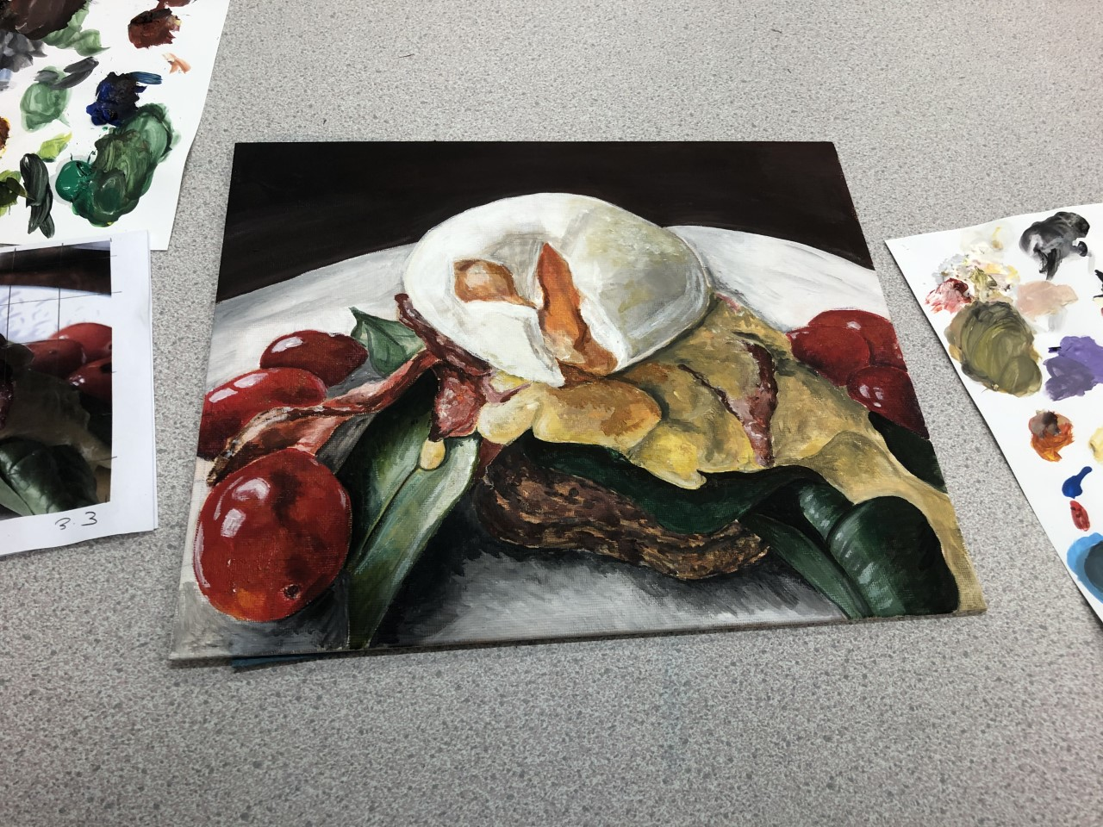
Year 10: Food
Tonal pencil
Biro and Brusho
Gouache/ gridding
Mono prints and watercolour
Artist postcards
Acrylic canvas board.
Exceptional Ability
Highly Developed Ability
Consistent Ability
Moderate Ability
Some Ability

Slide 3
Year 11-3D
Poly print/ sugar paper
Stick and ink
Collage
Card relief
Clay
3 designs
Breeze block carving.
2 week project based on cultural patterns, Similar to be done with year 11 fine art. To boost AO2/3

Slide 4
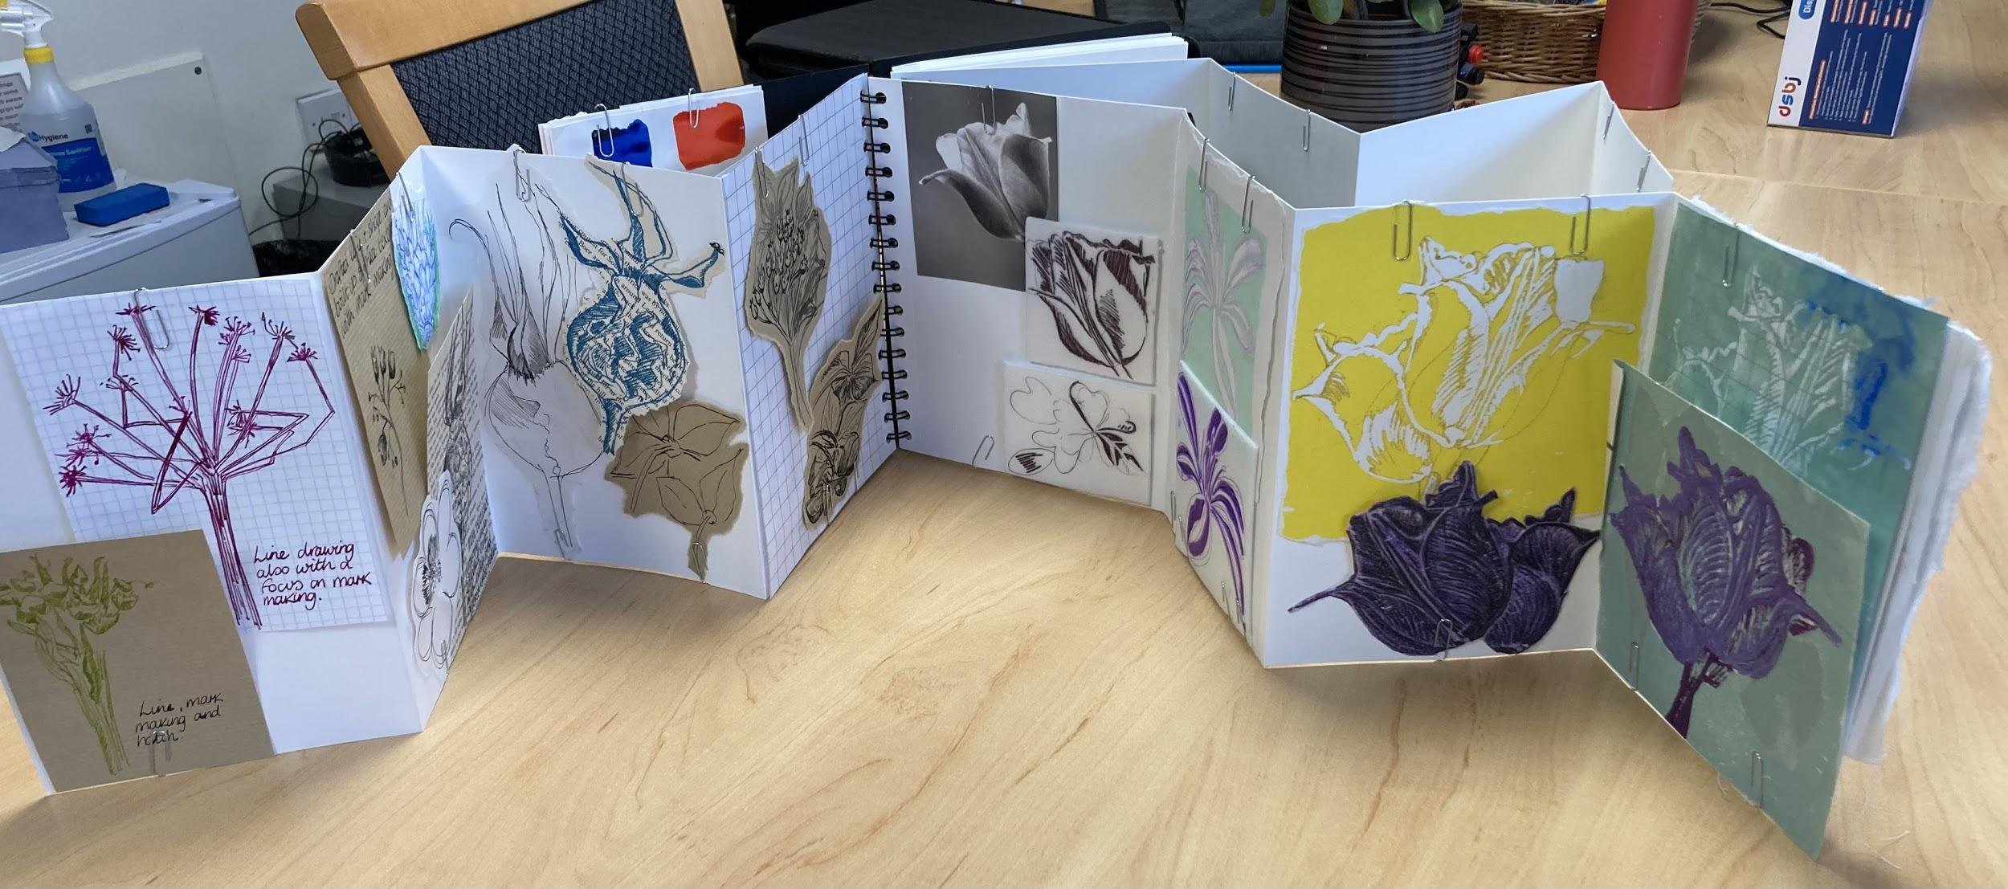
Year 10 textiles design
Pinning in stage prior to committing to final presentation:
-Sequence
-Organise
-Make/show connections
-Review journey
-Consider gaps
-Annotate

Slide 6
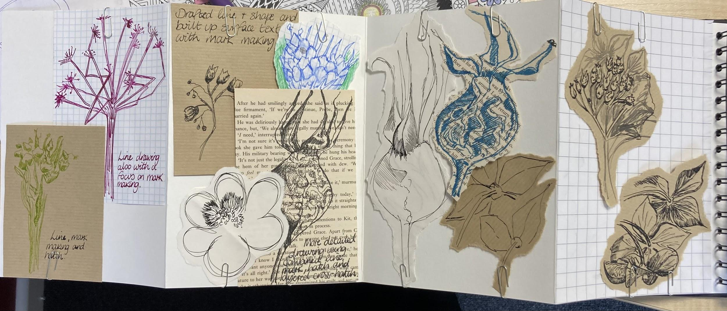
Initial recording outside in school gardens
Exploration of varied drawing media

Slide 7
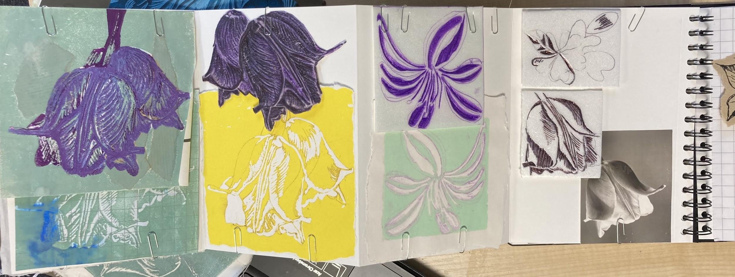
Exploration of poly-print

Slide 8
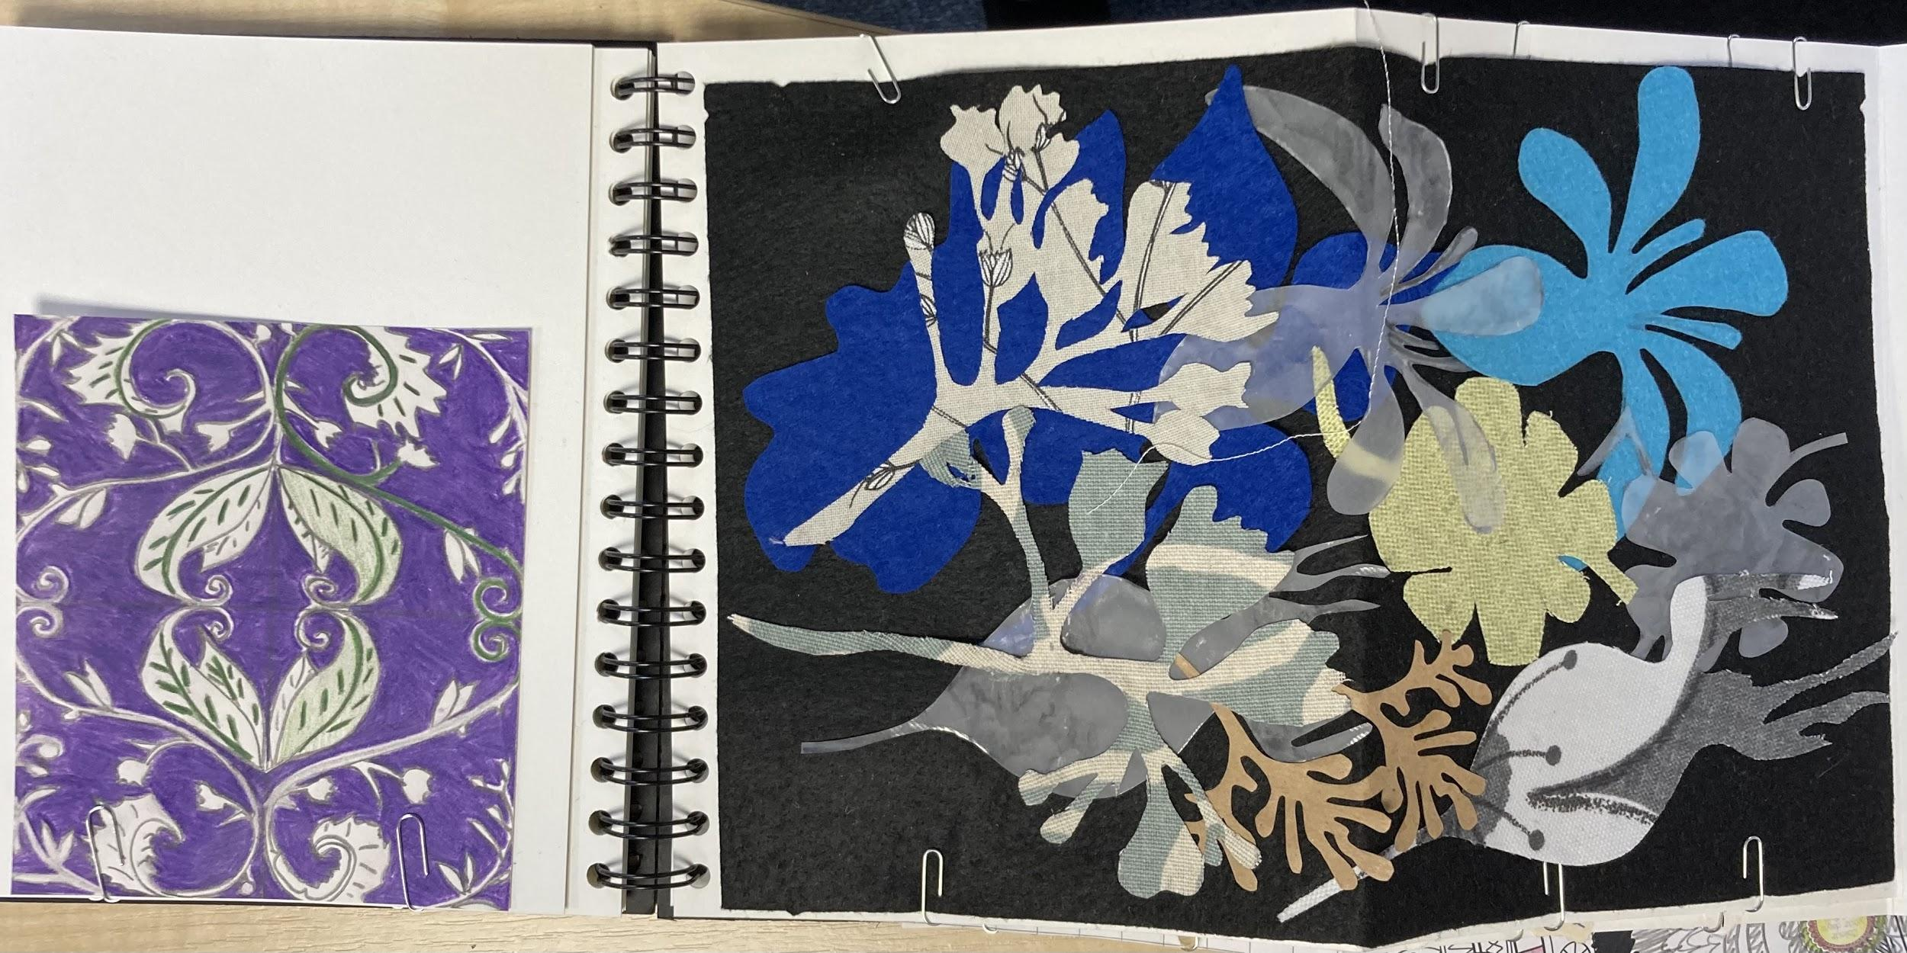
Developing ideas informed by artists (Morris and Pfaff)

Slide 9
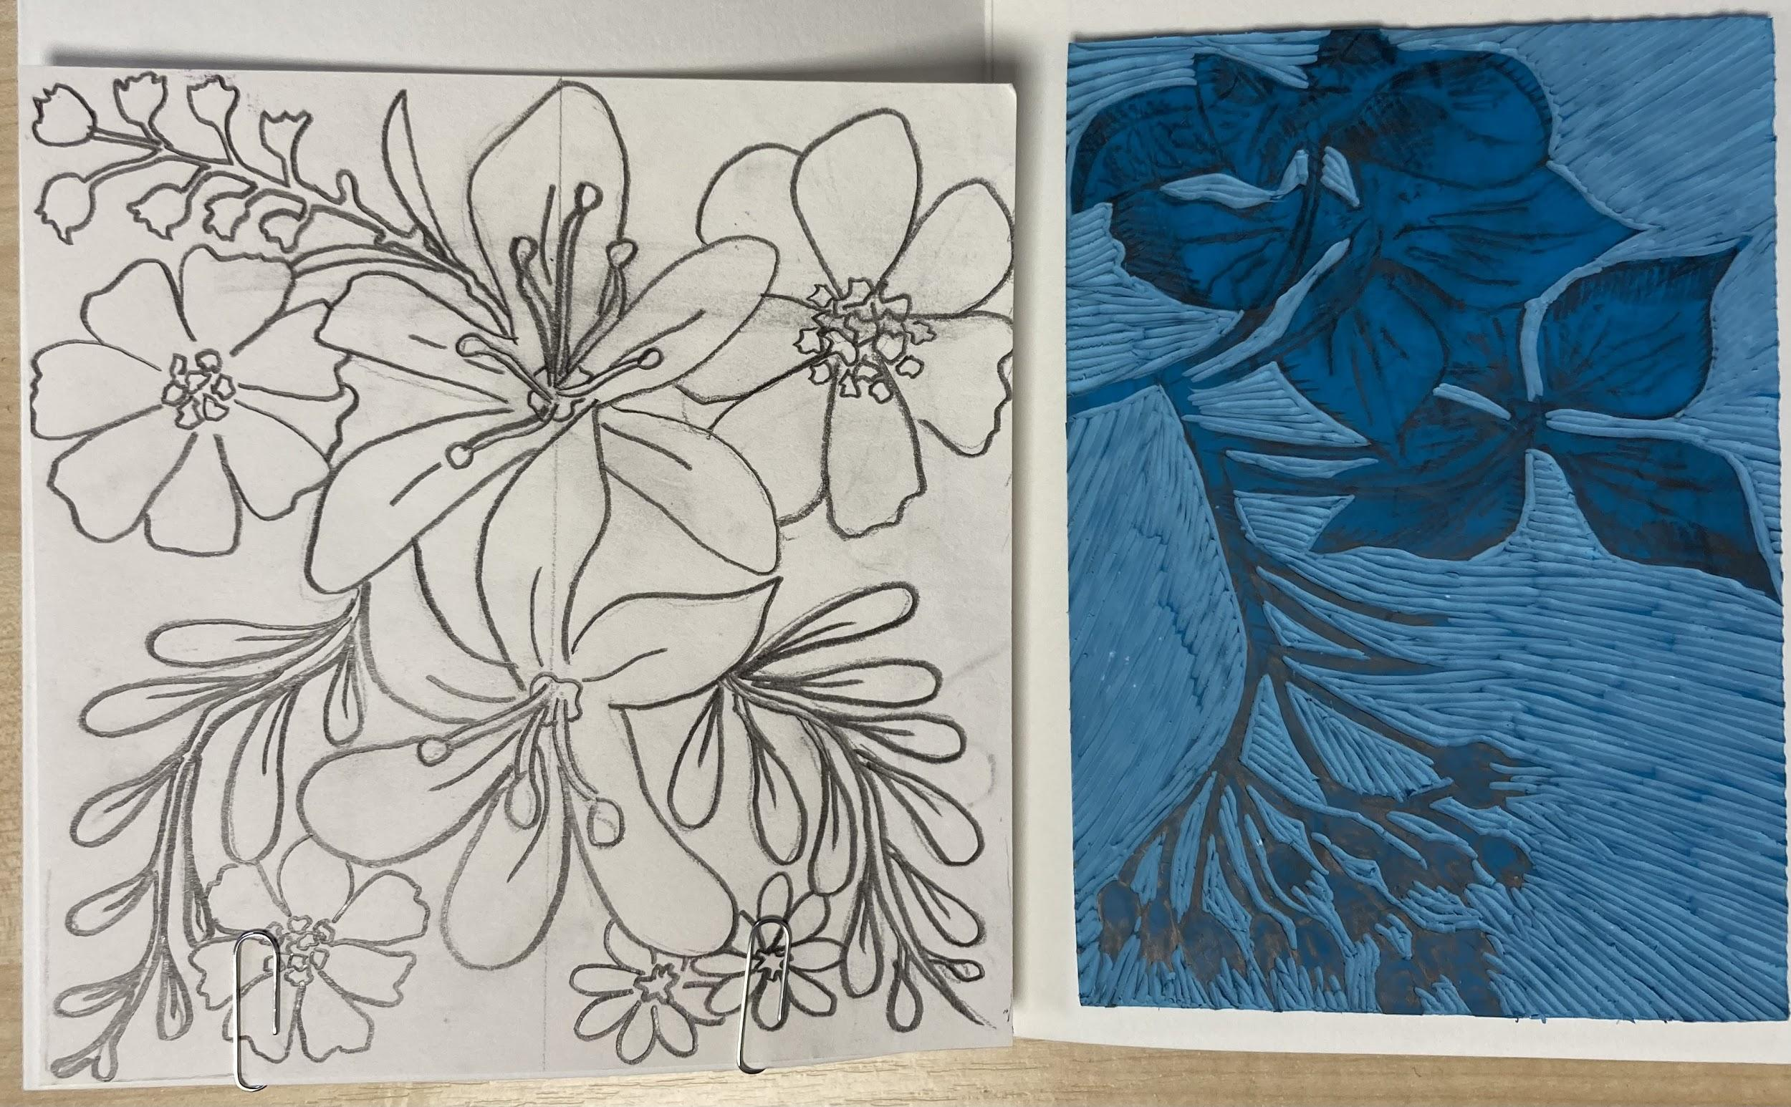
Developing ideas informed by artists (Morris)

