Slide 1
Photoshop Techniques
Editing Portraits

Slide 2
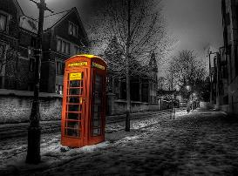
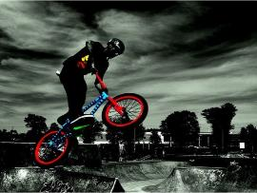
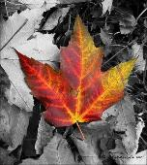
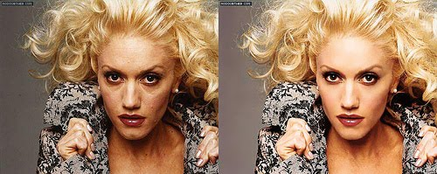
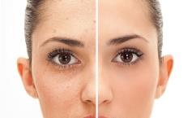
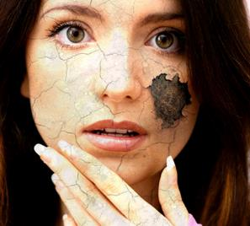
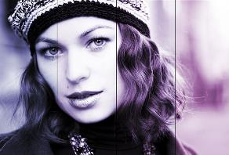
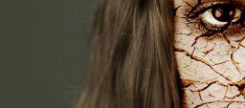
Colour Dash
Air-Brushing/ removing shine
Photoshop Techniques
Adding a gradient/ texture overlay

Slide 3
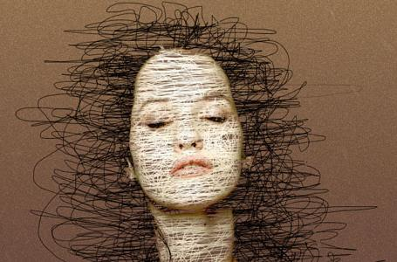
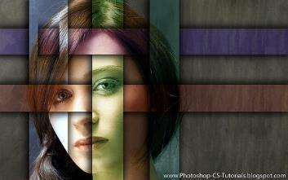
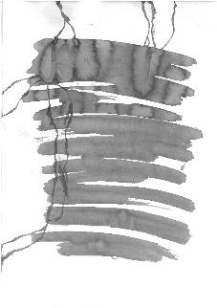
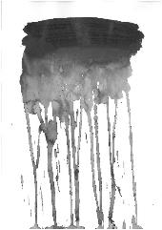
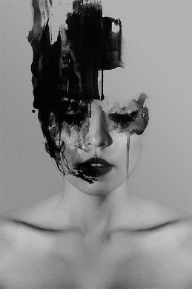
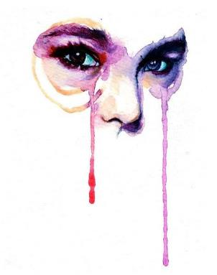
https://youtu.be/XnBTorzXnNE
Januz Miralles

Slide 4
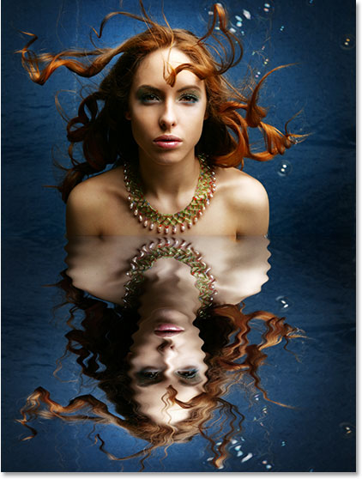
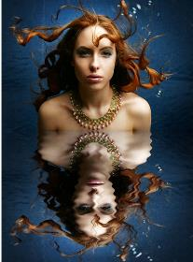
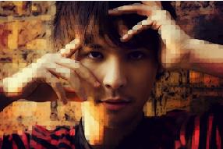
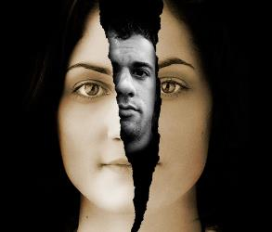
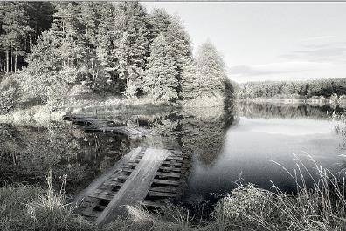
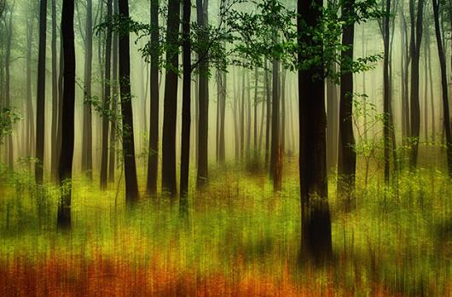
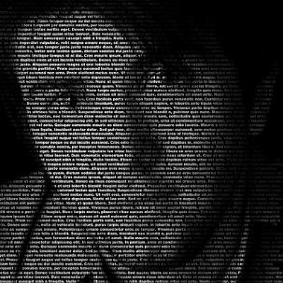
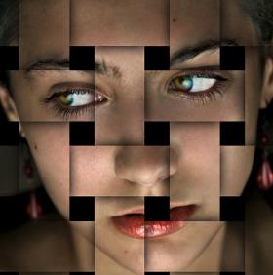
Photoshop Essentials
AO1 & AO2
Reflection
AO1: Development of ideas
AO2: Experimentation with materials
Infra-red
Surreal motionscape
Typographical portrait

Slide 5
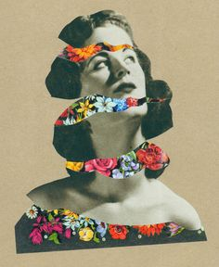
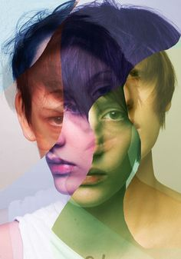
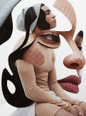
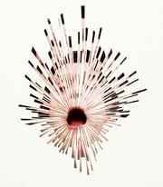
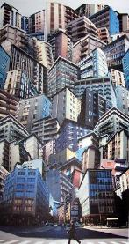
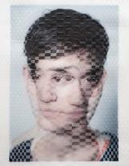
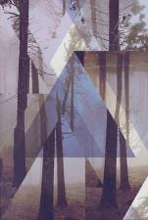
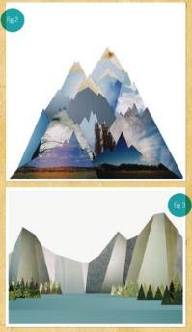
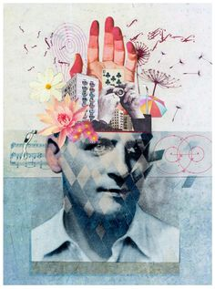
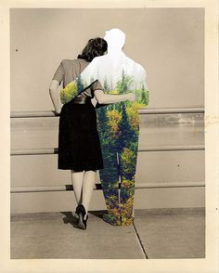
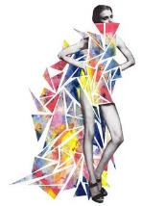
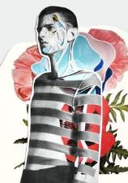
Collage/ Cutting Techniques
AO2: Experimentation with materials
CHRISTMAS HOMEWORK:
To produce 3 A5 outcomes- annotated and presented in your sketchbook as an A3 page

Slide 6
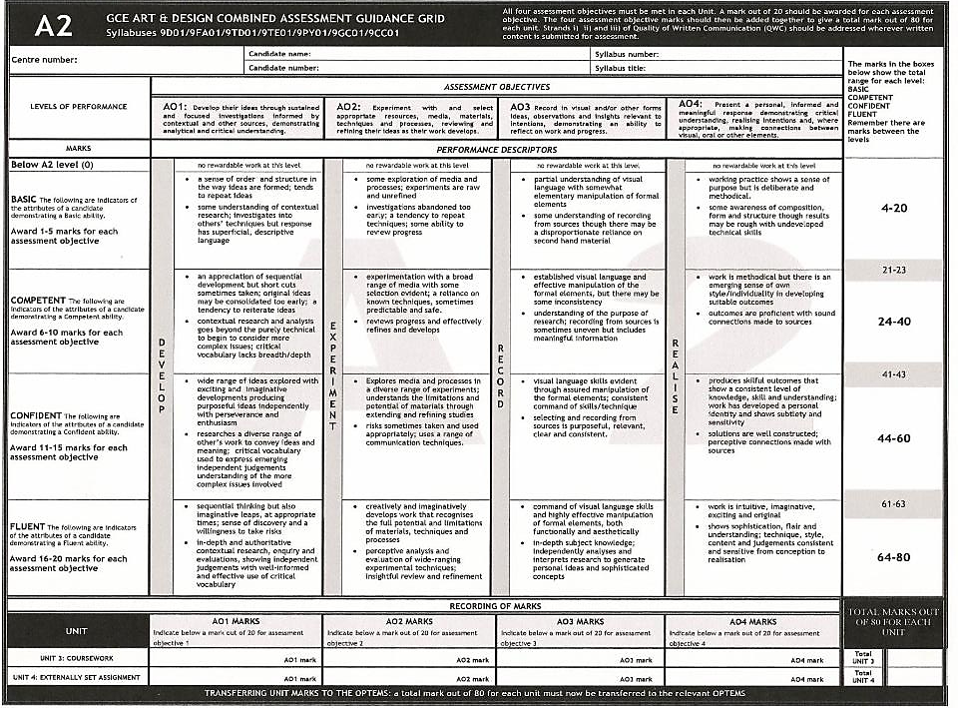
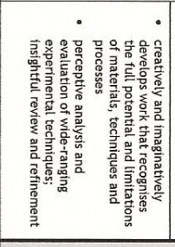
Evidence:
Range of media/ techniques- across multiple disciplines (Textiles, 3D, Illustration, Graphics etc.)
Broad range of Experimentations within each media selected

Slide 7
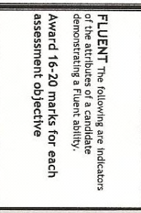
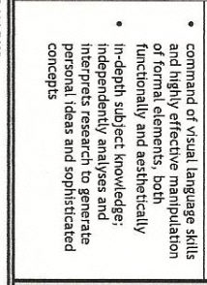
Evidence:
Contact Sheets
Straight Edits- 6-8 min
Annotation- consistent use of technical language including camera settings, links to theme/ photographers responding to. Links made to contextual info and wider world experiences. Explain how the editing techniques used impact the way we interpret the image.

Slide 8
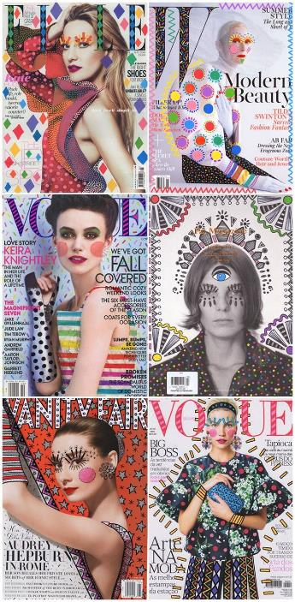
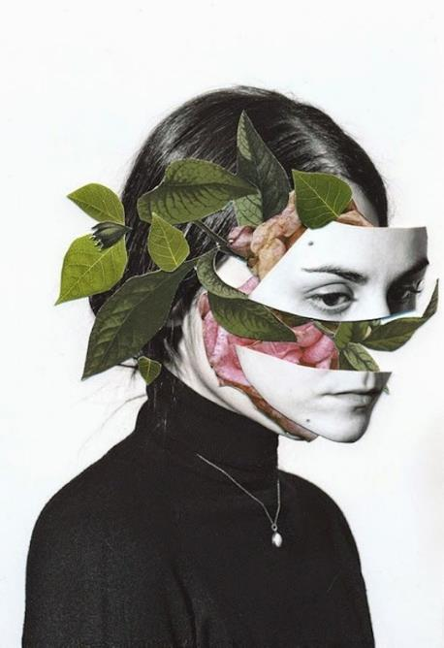
Rocio Montoya
Ana Strumpf

Slide 9
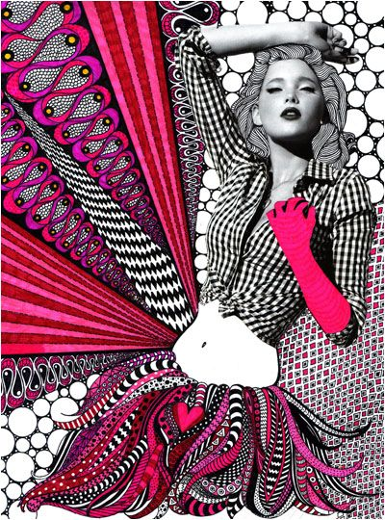
Ana Strumpf

Slide 10
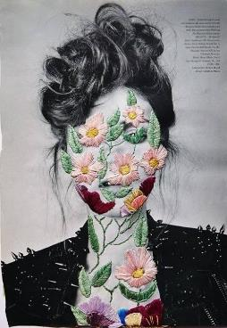
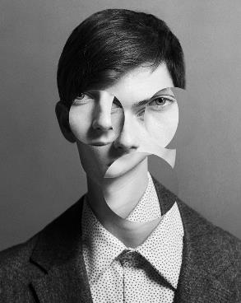
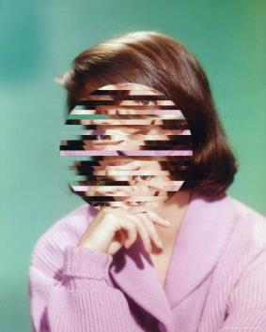
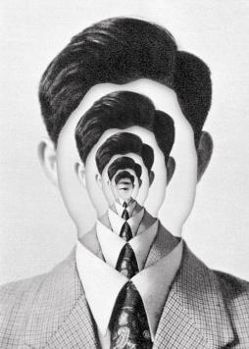
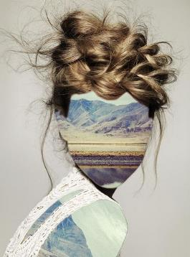
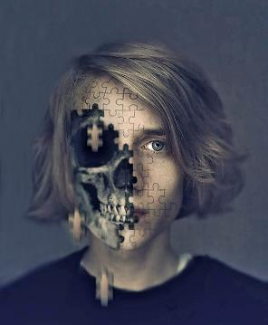
Erin Case
Sebastian Eriksson's

Slide 11
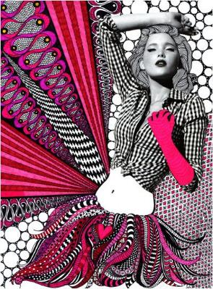
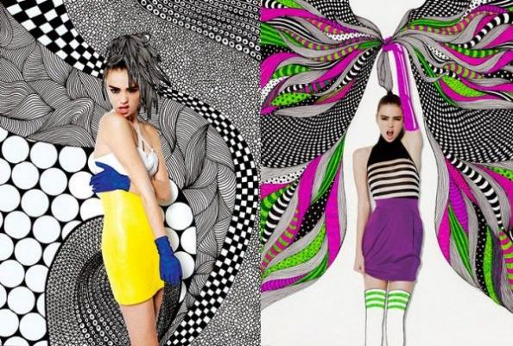
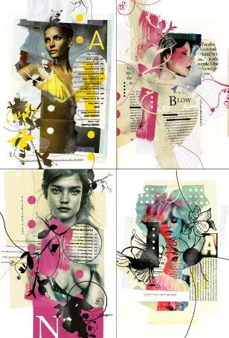
Nikki Farquharson
Dela Deso
Jenny Liz Rome
Douglas Alves

Slide 12
Jose Romussi
Manny Robertson

Slide 22
New York artist Michael Mapes creates elaborate specimen boxes by dissecting photographs and then compartmentalizing individual fragments within plastic bags, glass vials, magnifiers, in gelatin capsules and on insect pins. The boxes exist in an uncanny area between photography and sculpture, functioning both as portraits and as fascinating scientific canvases that make you question the logic behind the organization of each piece.

Slide 25
Digital Illustration

Slide 26
Digital Illustration
Success Criteria:

Slide 28
Digital Illustration
Evidence:
Range of media/ techniques- across multiple disciplines (Textiles, 3D, Illustration, Graphics etc.)
Broad range of Experimentations within each media selected

Slide 31
Nostalgia using paint techniques
Philippine Janus Miralles
Aliza Razell

Slide 32
Fabienne Rivory
French artist Fabienne Rivory creates these unusually beautiful images by working with mirrored photographs and watercolor paints. Rivory has been making artwork that blends paint and photography since 2007, a process she likens to the exploration of memory versus reality.

Slide 33
Success criteria:
Different techniques: burning, natural dying, scratching, digital outcomes (painting), etc.
Annotations – discuss techniques and how this affects our interpretation
Presentation - enhancing nostalgia vibes – labels, polaroid, prepared backgrounds,
Fill the page – no gaps
Clear title

Slide 34
Adventures In Watercolour & Photography
Daniel Castro, photography
Katie Rodgers, illustration

Slide 35
Rekha Garton Photography

Slide 36
Stitching/ Embroidery
Hinke Schreuders
Jose Romussi

Slide 37
Maurizio Anzeri
Manny Robertson

Slide 38
Stitch samples:
Running stitch (backwards)
Chain stitch
.

Slide 41
Jelle Martins
Nick Frank

Slide 42
Stephanie Jung

Slide 43
Lucas Davison
Walker Evans

Slide 44
Hand Painting
Ben Heine
Liz Brizzi

Slide 45
Abigail Reynolds
Mike Falcon

Slide 46
Nacho Ormaechea
Randy Grskovic

Slide 47
Stephen Gill
Hackney Flowers

Slide 50
How do these images link together?

Slide 51
Preparing your SCREEN PRINTING IMAGE
In order to prepare a screen print you need a BLACK AND WHITE image with NO GREY tones
IMAGE > ADJUSTMENTS > THRESHOLD
FILTER > FILTER GALLERY > STAMP TOOL
THRESHOLD
STAMP TOOL

Slide 54
What makes a successful screen print?

Slide 55
Dain

